Slide 1
A Deep Dive into a Deep Learning Library for the A64FX Fugaku CPU – Meet the Developer
oneAPI Developer Summit at IWOCL 2021
Apr. 26, 2021
Kentaro KAWAKAMI(kawakami.k@fujitsu.com)
Senior Researcher
Scalable Heterogenous Computing Project
Fujitsu Research, Fujitsu Ltd.

Slide 2
Acknowledgements
We would like to thank Intel for releasing the wonderful software, oneDNN, as OSS.
Thanks to oneDNN, we have made great progress in developing AI processing software for Supercomputer Fugaku and Fujitsu’s products.

Slide 3
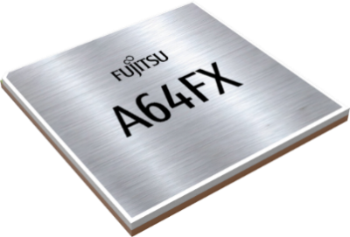
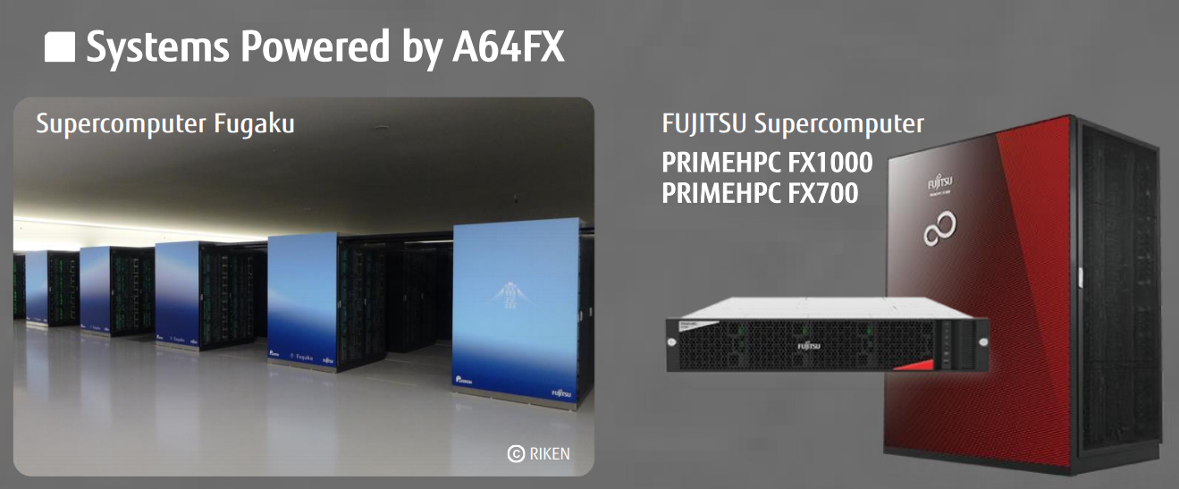
Motivation
We have been porting oneDNN for SVE512(Armv8-A + Scalable Vector Extension (SVE)) for Supercomputer Fugaku, two consecutive Top500 winner. oneDNN for SVE512 runs on Fugaku and other HPC server products (FX1000/700(*1)).
  SVE is an instruction set extension of Armv8-A CPU for HPC.
  A64FX(*2) is the world first CPU to support SVE.
*1 https://www.fujitsu.com/downloads/JP/jsuper/a64fx/a64fx_infographics_en.pdf
*2 https://www.fujitsu.com/downloads/JP/jsuper/a64fx/a64fx_datasheet_en.pdf

Slide 4
Deep Learning Software Stack for A64FX
Application
ResNet
Mask R-CNN
NMT
BERT
Framework
TensorFlow
PyTorch
oneDNN for SVE512 (Armv8-A + SVE512)
Interfaces for frameworks
Thread control
Primitive(operation kernel) selection
Input/output data reordering
for efficient processing,
and data format conversion
(fp32, int8, int32, etc)
Just-In-Time (JIT) code generation
  JIT assembler
  for x64 -> Xbyak
  for Armv8-A -> Xbyak_aarch64(*1)
We can reuse these this portion.
->From Framework’s point of view, oneDNN for SVE512 can be used in the same way as the original oneDNN is used.
Library
We have customized and optimized this portion for Armv8-A + SVE512 to obtain the best performance of A64FX.
Hardware
Fujitsu A64FX
Thanks to oneDNN, we were able to develop the DL software stack for A64FX in a short time.
*1 Mitsunari-san of Cybozu Labs, developer of Xbyak(kəi-bja-k) for x64, gave us technical advice and helped our development.

Slide 5
oneDNN for SVE512 Development Status
Thanks to Intel’s help, our source code has been merged into the original
oneDNN. Eventually, we want to put everything of our port into the original.

Slide 6
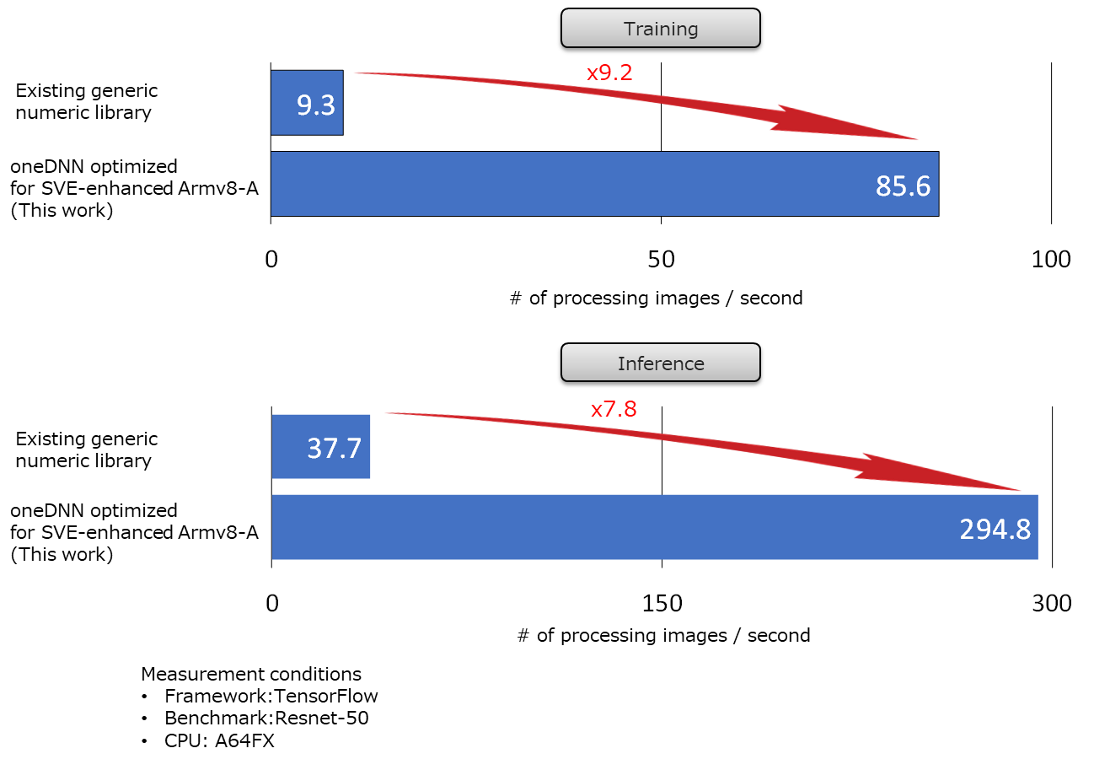
Performance Improvement of oneDNN for SVE512
Appropriate use of SVE instructions to fully exploit the performance of A64FX
TechBlog
https://blog.fltech.dev/entry/2020/11/19/fugaku-onednn-deep-dive-en

Slide 7
Deep Learning Software Stack for A64FX
Application
ResNet
Mask R-CNN
NMT
BERT
Framework
TensorFlow
PyTorch
oneDNN for SVE512 (Armv8-A + SVE512)
Interfaces for frameworks
Thread control
Primitive(operation kernel) selection
Input/output data reordering
for efficient processing,
and data format conversion
(fp32, int8, int32, etc)
Just-In-Time (JIT) code generation
  JIT assembler
  for x64 -> Xbyak
  for Armv8-A -> Xbyak_aarch64(*1)
We can reuse these this portion.
->From Framework’s point of view, oneDNN for SVE512 can be used in the same way as the original oneDNN is used.
We are also customizing Frameworks to get the best performance of oneDNN for SVE512.
  It is not limited to Fugaku but other AArch64 environment including Fujitsu’s products.
Some pull requests have been submitted to PyTorch community.
We are also planning to submit pull requests to TensorFlow.
Library
We have customized and optimized this portion for Armv8-A + SVE512 to obtain the best performance of A64FX.
Hardware
Fujitsu A64FX
*1 Mitsunari-san of Cybozu Labs, developer of Xbyak(kəi-bja-k) for x64,
gave us technical advice and helped our development.

Slide 8
Performance Improvement of Various NN models
oneDNN has contributed greatly to speeding up
the DL processing on A64FX.
Measurement condition:
FX700 including A64FX @ 2.0GHz
24 cores out of 48 cores were used.

Slide 9
MLPerf HPC v0.7 results
Both Closed and Open division, our results outperformed other sites.
  Closed division
  Open division
https://mlperf.org/training-results-0-7
Submitter | System | Processor | # | Accelerator | # | Software | Time [min]
Fujitsu | ABCI | Xeon Gold 6148 | 256 | NVIDIA V100 | 512 | TensorFlow | 34.42
Fujitsu/ RIKEN | Fugaku | A64FX | 8192 | - | - | TensorFlow + Mesh TensorFlow | 101.49
NCSA | HAL | POWER 9 model 2.2 | 32 | NVIDIA V100 | 64 | TensorFlow | 265.59
Fujitsu/ RIKEN | Fugaku | A64FX | 512 | - | - | TensorFlow + Mesh TensorFlow | 268.77
CSCS | Piz Daint | Xeon E5-2690 v3 | 256 | NVIDIA P100 | 256 | TensorFlow | 327.01
LBNL | Cori GPU | Xeon Gold 6148 | 16 | NVIDIA V100 | 64 | TensorFlow | 364.73
oneDNN for SVE512 inside!
Submitter | System | Processor | # | Accelerator | # | Software | Time [min]
Fujitsu | ABCI | Xeon Gold 6148 | 1024 | NVIDIA V100 | 2048 | TensorFlow | 13.21
Fujitsu/ RIKEN | Fugaku | A64FX | 16384 | - | - | TensorFlow + Mesh TensorFlow | 30.07
LBNL | Cori KNL | Xeon Phi 7250 | 1024 | - | - | Tensorflow | 419.69

Slide 10
Improvements for MLPerf HPC other than oneDNN for SVE512
Improve data staging time
  Shared SSD storage
  Compress data
  Data loader
Use data pre-read for verification process
Use Keras auto mixed-precision to reduce calculation workload
Optimize batch size and other hyper parameters
Use Mesh-TensorFlow to calculate in model parallel fashion
For Fugaku, this technique was essential to obtain the best performance of very large-scale system.

Slide 11
Scaling of Throughput for Global Batch Sizes
The total throughput scales out almost ideally with data parallelism.
8K nodes achieve 92.9% of “(throughput of 128 nodes) x 64)”.
But if we simply increase # of node only with data parallelism,
# of epochs, # of iteration to achieve required training accuracy, also increases as shown in the next page.
×64×92.9%
=128x64

Slide 12
The Number of Epochs to Converge for Different Batch Sizes
Global batch sizes | # Epochs | Increase ratio of # epochs | Speed-up ratio
512 | Around 45 | 1 | 1
2048 | 90 - 100 | 2.1 | 1.90 (≓ 4 / 2.1)
4096 | 150 - 160 | 1.63 | 1.23 (≓ 2 / 1.63)
8192 | 290 - 310 | 1.94 | 1.03 (≓ 2 / 1.94)
×4
×2.1
×2
×1.63
×2
×1.94
Throughput scales out as shown in the previous page.
But # of epochs increases so as to global batch size.
Therefore, the total speed-up of deep learning training is limited despite the increased # of nodes (batch size).
The total speed-up ratio by data parallelism is limited to batch size = 4096 even if throughput scales ideally.
  For DeepCAM, speedup ratio is limited to batch size 2048
In the current benchmarks, model parallelism is necessary in order to reduce runtime by scaling more than 4096 nodes (CPUs or accelerators).

Slide 13
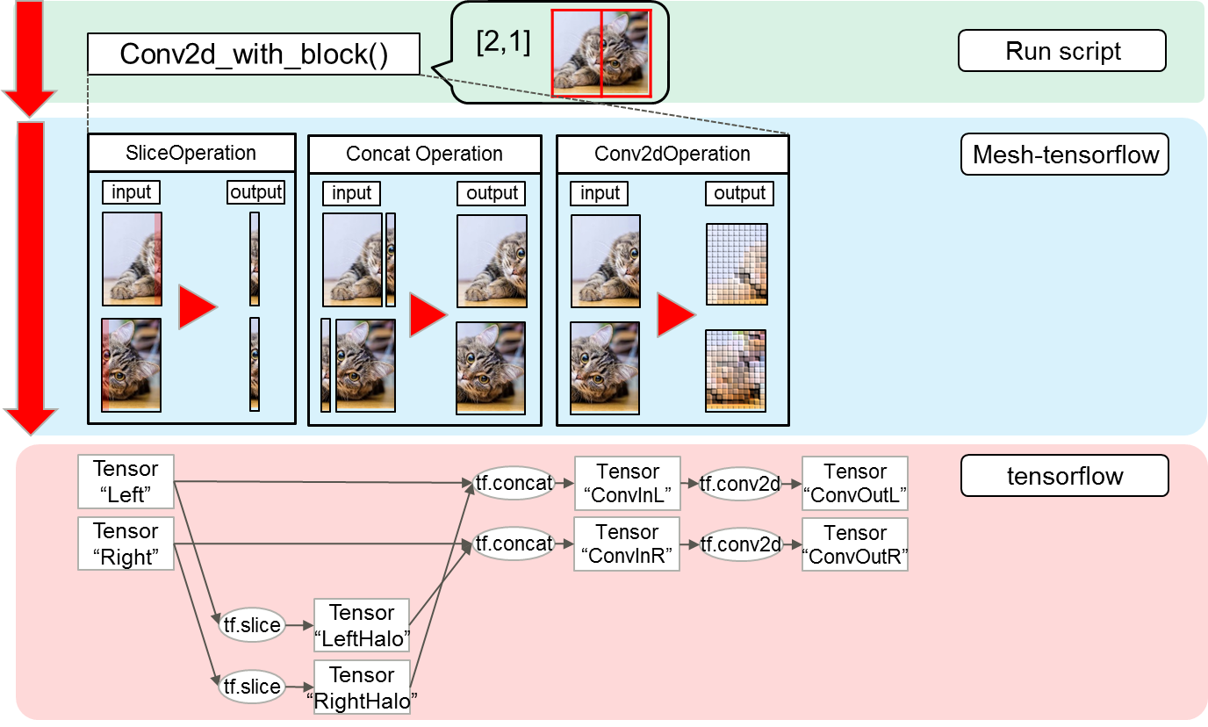
Mesh-TensorFlow for
(multi-process)×(model and data parallelisms)
Mesh-TensorFlow(MTF) converts NN into several operations in order to work in model parallel.
We modified MTF in order to work in multi-process model and data parallelisms.
  This MTF may work with not only A64FX, but also x64 and other Arm-based CPUs. We are submitting a pull request of our code to TensorFlow community.
  TensorFlow framework was used with little modification.
  TensorFlow is easily connected to oneDNN for SVE512, since they can communicate with each other by the same APIs of the original oneDNN.
Our changes
from the original
Support | Original MTF | Our MTF
2x2x2 conv3d | No | Yes
Model parallel | Yes | Yes
Data parallel | No | Yes
Multi process | No | Yes

Slide 14
Scaling for Global Batch Sizes
Our modification for Mesh-TensorFlow, model and data parallelism, keeps the scaling out of total throughput.
  In fact, our Mesh-TensorFlow achieves better throughput.
Batch size
data parallel
data+model parallel(2x1)
data+model parallel(4x1)
128
64
32
256
128
64
512
256
128
1024
512
256
2048
1024
512
4096
2048
1024
8192
4096
2048

Slide 15
Speedup Ratio of Data + Model Parallelisms
Barrier to speed-up in case of (baseline) data parallel
Our model and data parallel Mesh-TensorFlow make full use of many nodes without speed-up saturation.
# of nodes
128
256
512
1024
2048
4096
8192

Slide 16
Estimated Runtime Reduction,
If Batch Size Limitation is Relaxed
Performance improvements can be achieved using more nodes.
Total # of nodes in Fugaku = 158,976
For Fugaku-ideal, assume the number of epochs does not increase up to batch size 16384 and model parallelism scales by 2x using 4 processes per data
If the rule was relaxed, lowering training accuracy, runtime of Fugaku (and other large-scale supercomputers) would be greatly reduced.

Slide 17
Future plans
We continue submitting pull requests of our porting work, oneDNN, PyTorch and TensorFlow.
Our next target applications are shifting to Mask R-CNN, NMT, BERT. We will tune oneDNN for SVE512 to make these applications faster.
  So far, we have been developing targeting to ResNET50 and MLPerfHPC.
To accelerate development with Arm/Linaro/OSS community, we are also releasing the source codes and publishing TechBlogs.
Github repositories
TechBlog
https://github.com/fujitsu/oneDNN/tree/fj_main
https://github.com/fujitsu/xbyak_aarch64
https://github.com/fujitsu/xbyak_translator_aarch64
https://github.com/fujitsu/pytorch
https://github.com/fujitsu/tensorflow
https://github.com/fujitsu/A64FX
https://blog.fltech.dev/entry/2020/11/19/fugaku-onednn-deep-dive-en

Slide 18
Summary
The API and source code for oneDNN are publicly available. This helped us a lot in developing the software stack of the deep learning processing on A64FX in a short time.
Since oneDNN has become the default library available from various frameworks, it is easy and convenient to use for various deep learning applications.

Slide 20
Appendix
If you are interested in our customize of Mesh-TensorFlow, please refer this appendix and our source code submitted to MLPerf Training v0.7 Results (https://mlperf.org/training-results-0-7).

Slide 21
An Alternative Mesh Model
We do not use a mesh model of original MTF for multi-process support.
  The mesh model of original MTF assumes a common address spaces.
We defined an alternative mesh model using MPI communicator.
e.g.) Halo exchange between multi processes
  Our MTF has “SendRecv Operation” using mpi4py and exchanges the buffers between processes.
proc0
Tensor
“Left”
tf.concat
Tensor
“ConvInL”
tf.conv2d
Tensor
“ConvOutL”
proc1
Tensor
“Right”
tf.concat
Tensor
“ConvInR”
tf.conv2d
Tensor
“ConvOutR”
tf.slice
Tensor
“LeftHalo”
sendrecv
Tensor
“ExHaloL”
tf.slice
Tensor
“RightHalo”
sendrecv
Tensor
“ExHaloR”
Insert “SendRecv Operation”

Slide 22
Model Parallelism in CosmoFlow
Data loader
  Each process in model parallelism has same input data and clips the input data according to the own process number in model parallelism.
proc0
proc1
Conv3d layers
  Model parallelism is applied.
  Communicates halo using send/recv function of mpi4py.
  Each process has same weights.
    Using same initializer as reference model.
    Each process initialized with same seed number.
Conv3d_to_dense layer
  Calls allgather communication and concatenates each received buffer.
Allgather
Dense layers
  Model parallelism is Not applied
  Each process in model parallelism is given the same input by allgather operation
  Each process has same weights.

Slide 23
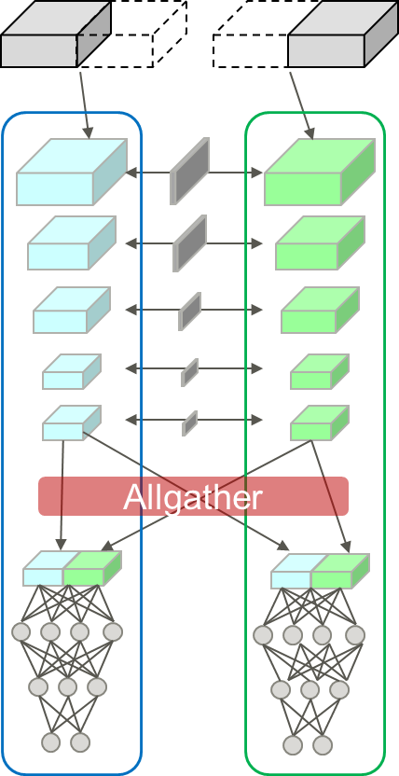
Computing Gradients in Data + Model parallelisms
Since each conv3d layer calculates gradients for the divided inputs, the gradients are divided by the number of model parallel processes.
  For dense layers, the gradients are divided by the number of data + model parallel processes
Allreduce(gradientｓ) / Data_parallel
e.g.)
Data_parallel : 4
Model_parallel : 2
= Total 8 procs
Allreduce(gradientｓ) / ( Data_parallel *Model_parallel )
Proc0
Proc1
Proc2
Proc3
Proc4
Proc5
Proc6
Proc7

