Slide 1
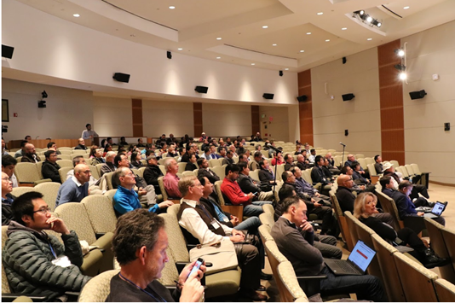
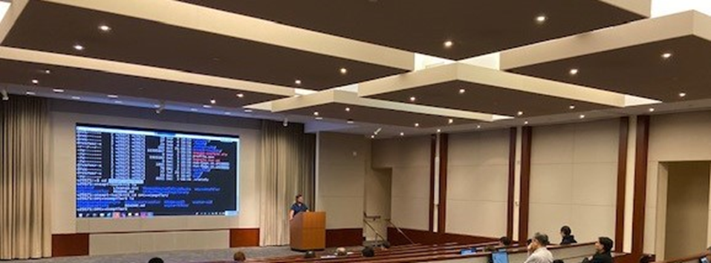
Developer Summit at IWOCL 2021
Intel oneAPI
April 26th

Slide 2
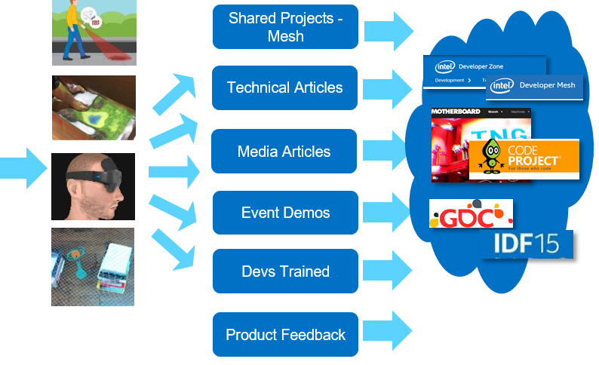
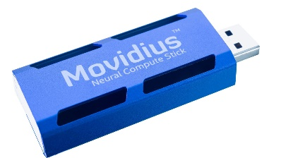
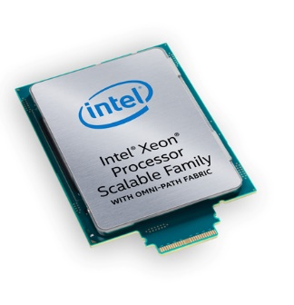
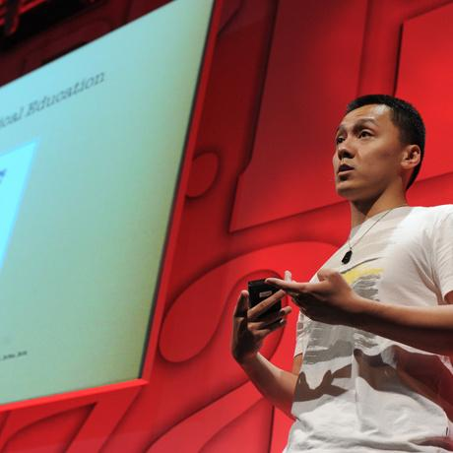
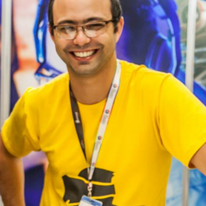
Introduction to Innovator Program (https://devmesh.intel.com-> member Programs)
Top Tier Experts Who
Innovate & Like To Share Work Go under NDA
Access to Intel Hardware & Intel Expertise
Early Experiments, Prototypes, Testing & Research
Spotlight
Speakerships & Demos at Major conferences and Public Events

Slide 3
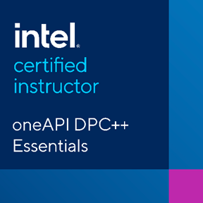
Intel® Certified Instructors for oneAPI
Intel® Certified Instructors are endorsed by Intel to teach oneAPI topics creating a global network of oneAPI experts.
Instructors come from consulting companies & solution providers in the Intel® oneAPI Technology Partner Program, academia and the Software Innovator program.
Connecting with an Intel® Certified Instructor:
64 instructors certified to teach Data Parallel C++ across 10 countries
Find your local expert here:
software.intel.com/oneAPI/training/certified-instructors
Instructor Qualifications:
Technical expertise and mastery of DPC++ language
Demonstrated teaching ability
Ability to use Intel® DevCloud as a teaching tool
Successful completion of our hands-on workshops and assessments

Slide 4
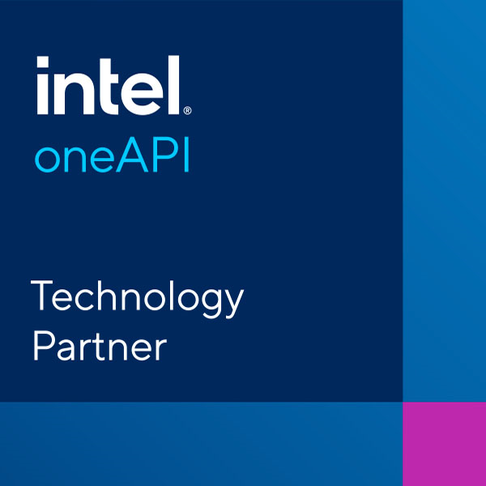
Intel® oneAPI Technology Partners
Companies endorsed by Intel who provide services based on their Intel® oneAPI technical expertise to meet the business and technical needs of customers and the local developer community.
Connecting with an Intel® oneAPI Technology Partner:
19 companies in 10 countries
Certified on various programming models for HPC and AI using Intel oneAPI
Find your local expert here:
software.intel.com/content/dam/develop/external/us/en/documents/pdf/intel-oneapi-tech-partners-v-1-0.pdf
PARTNER Qualifications:
Expertise in parallel programming for CPU & GPU
Provide consulting & services such as porting applications, coding, tuning, code-modernization, etc.
Successful completion of training portal and technical assessments

Slide 5
Priority Support & Benefits
April 15, 2021
Pranati Tewari, Mike Lee

Slide 7
Get the Support You Need- We’re In This Together!
Software Development is Challenging
Tools Usage
Best Known Methods for Optimization
Time to Results
Frequent product updates
Community Forums
Public / Open
Community Driven Solutions
Priority Support
Private/Confidential
Timely
Intel Engineer Staffed

Slide 8
Priority Support Benefits
Download Access to & Support for new product updates and older versions
Direct and private interaction with Intel’s Support Engineers
Accelerated Response time
Priority Solutions for escalated defects and feature requests
Access to a vast library of self-help documentation
Access to Intel public community forums
On-site or online training and consultation by Intel technical consulting engineers may be added at an additional cost
https://software.intel.com/content/www/us/en/develop/tools/oneapi/support.html

Slide 9
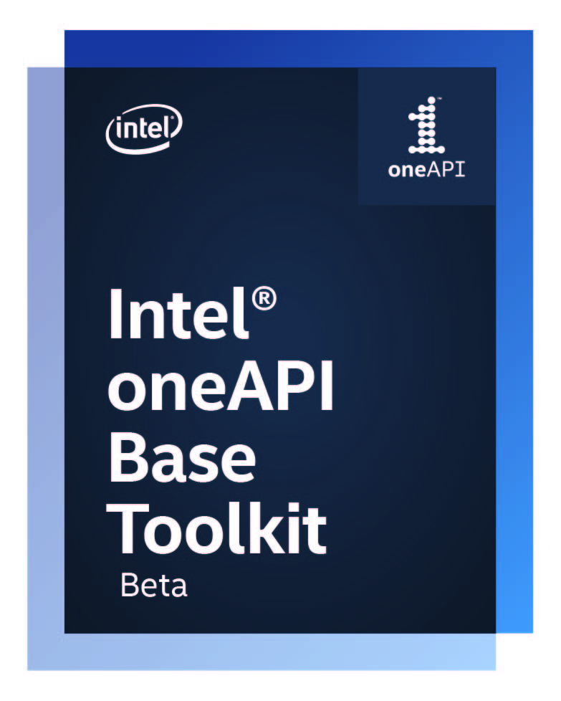
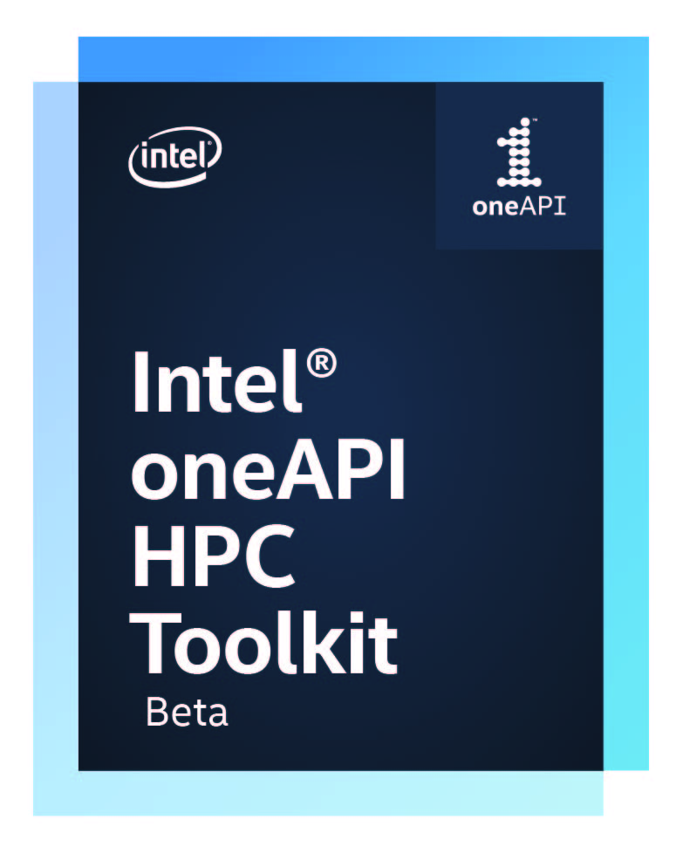
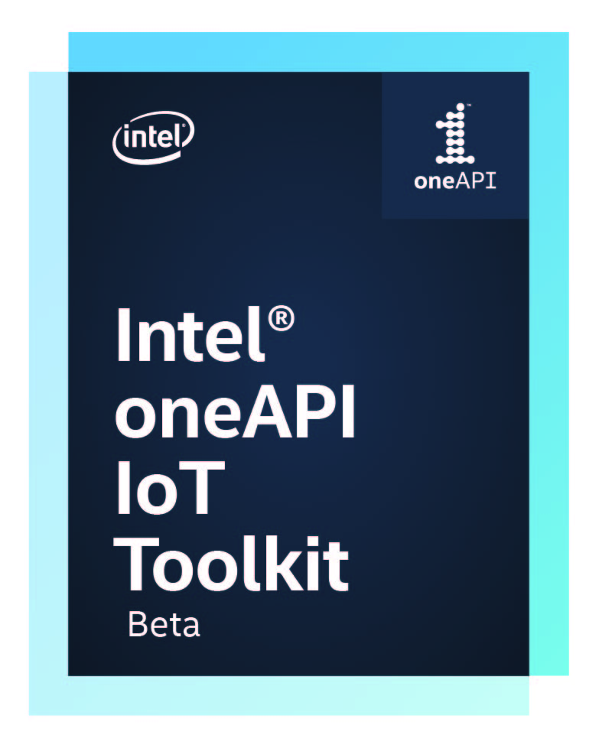
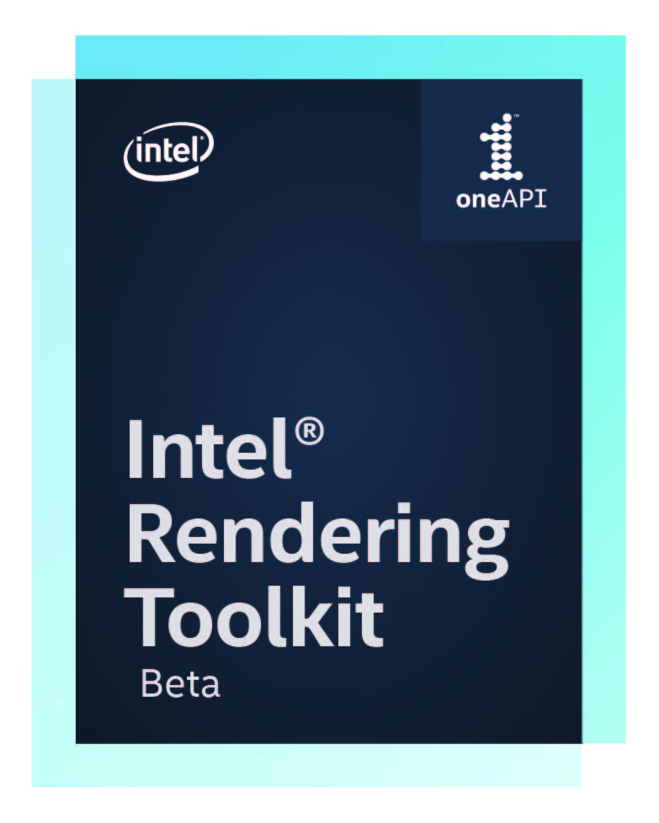
Intel® oneAPI Commercially Supported Products
oneAPI ”Products” with Priority Support
Intel® oneAPI Base Toolkit
Intel® oneAPI Base & HPC Toolkit
Intel® oneAPI Base & HPC Toolkit Single-Node
Intel® oneAPI Base & HPC Toolkit Multi-Node
Intel® oneAPI Base & IoT Toolkit
Intel® oneAPI Base & Rendering Toolkit
Intel® oneAPI Base & Rendering Toolkit Single-Node
Intel® oneAPI Base & Rendering Toolkit Multi-Node
https://software.intel.com/content/www/us/en/develop/tools/oneapi/support.html

Slide 10
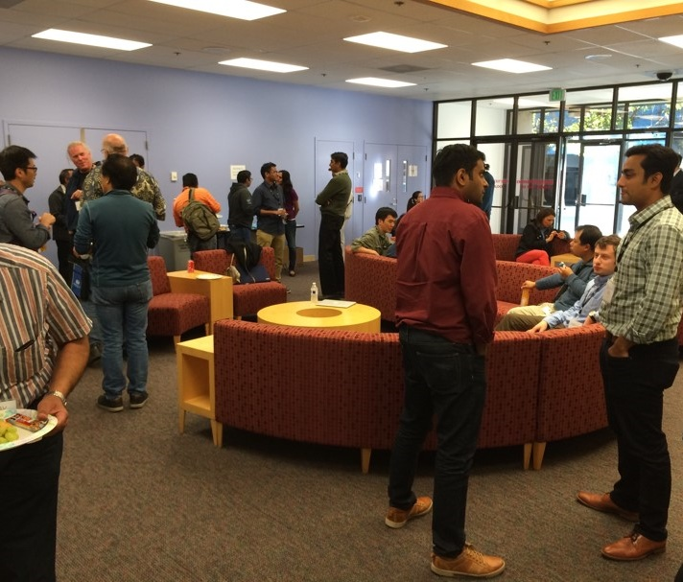
Happy Hour
Let’s get to know each other!
6:00 – 7:00 PM CET

Slide 11
$15 Food Voucher
Fill out this form to get your $15 food voucher!
Please note:
First come, first serve basis as we have a limited supply.
You will need to have a PayPal account in order to receive the voucher. If you do not have a PayPal account you can sign up at www.paypal.com/signup
If you can not create a PayPal account, please contact us directly

Slide 12
Data Parallel C++ Book
Message Gabrielle Amoranto privately to receive a free physical copy of the book.
** We have a limited supply. The book will be given out on a first come, first serve basis**
For a free digital copy: https://link.springer.com/content/pdf/10.1007%2F978-1-4842-5574-2.pdf

Slide 13
Data Parallel C++ Book Winners
ambica prmaod
Piotr Ratuszniak
Joachim Meyer
Stig Rune Jensen
M. Augusto Maidana Silanes
Gene Stoltz
Carlos G
Juan Fumero
Michel Migdal
Ajay Soni
Puya Amiri
Fariz Huseynli
Ram Meenakshisundram
Andrey Alekseenko
Marlon Cabilin
Neuber Sousa
If your name is listed, Gabrielle Amoranto will privately message you for your contact information.

Slide 14
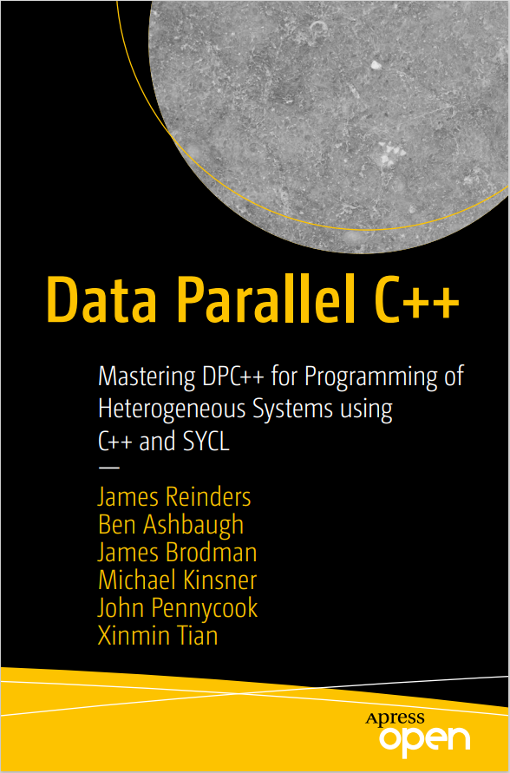
Prizes! Prizes! Prizes!
*Contest Rules
1. Win a $50 gift card during the Jeopardy game
2. Participate in the Happy Hour to get your hands on a physical DPC++ book (limited quantity)
4. MUST BE PRESENT WHEN WE ANNOUNCE THE WINNERS

Slide 16
Squiggle
Birds

Slide 17
Notes:
NASA did a study where they looked at creativity by age. Where 98% of 5 year olds scored as creative geniuses on the Torrance Scale, at age 10, that number has already dropped to 30%. By 15, it’s down to 12%. And as for us adults… this is really bleak… after age 25 only 2% of us maintain the high level of creativity nearly all of us once had as preschoolers.
This is not only unfortunate for the companies that we work for, but also just makes me sad as a parent and as a human…

Slide 18
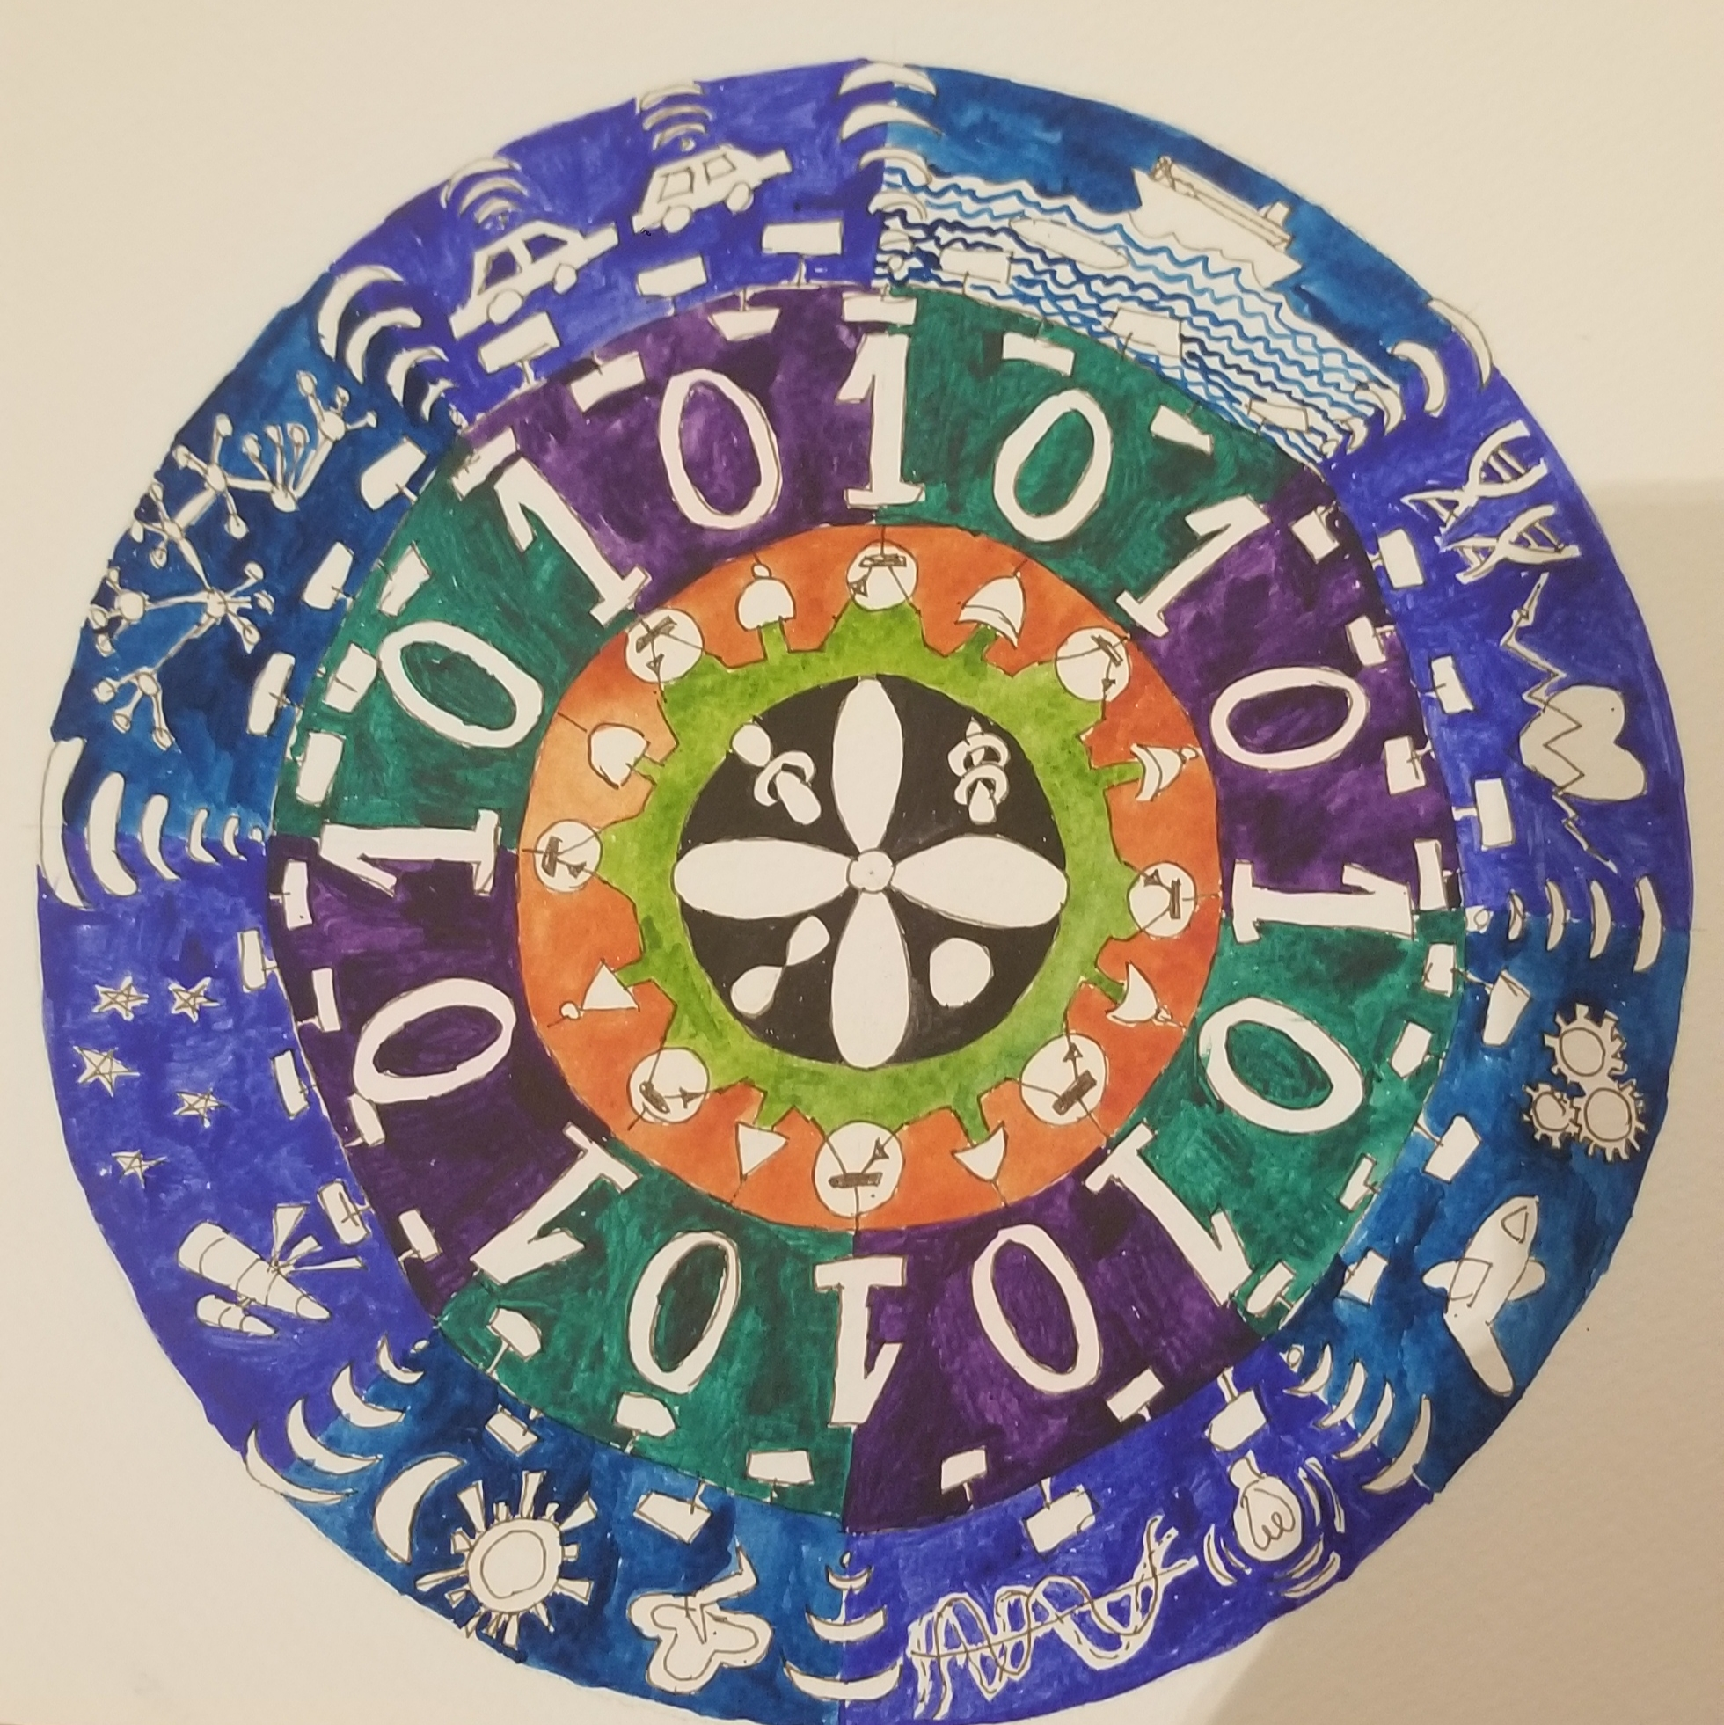
Mandala Activity

Slide 19
TAKE OUR SURVEY
We would like to hear your feedback via a short questionnaire on your oneAPI Developer Summit 2021 experience.
We Want to Hear From You

Slide 20
Thank you for attending!

