Slide 1
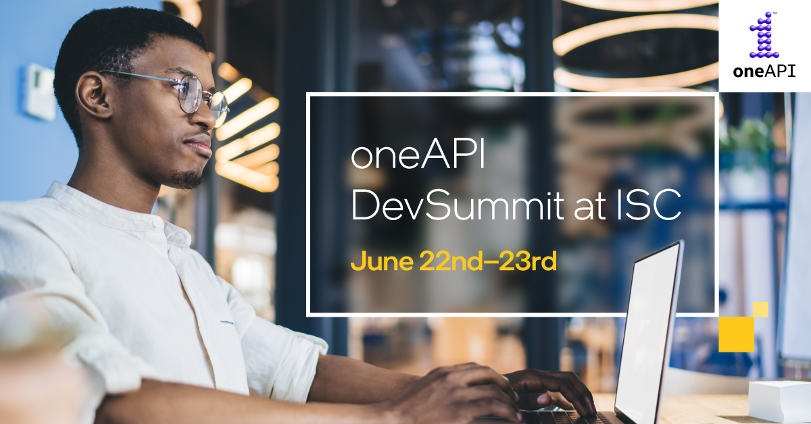

Slide 2
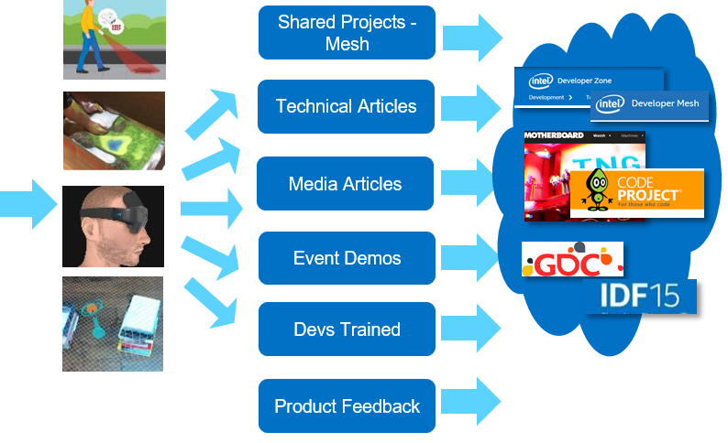
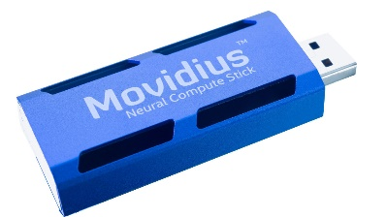
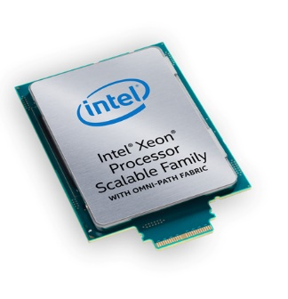
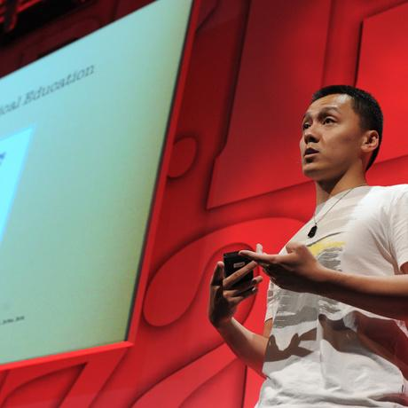
Introduction to Innovator Program (https://devmesh.intel.com-> member Programs)
Top Tier Experts Who
Innovate & Like To Share Work Go under NDA
Access to Intel Hardware & Intel Expertise
Early Experiments, Prototypes, Testing & Research
Spotlight
Speakerships & Demos at Major conferences and Public Events

Slide 3
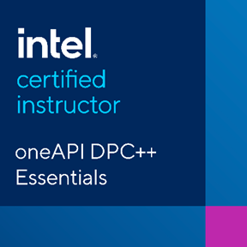
Intel® Certified Instructors for oneAPI
Intel® Certified Instructors are endorsed by Intel to teach oneAPI topics creating a global network of oneAPI experts.
Instructors come from consulting companies & solution providers in the Intel® oneAPI Technology Partner Program, academia and the Software Innovator program.
Connecting with an Intel® Certified Instructor:
64 instructors certified to teach Data Parallel C++ across 10 countries
Find your local expert here:
software.intel.com/oneAPI/training/certified-instructors
Instructor Qualifications:
Technical expertise and mastery of DPC++ language
Demonstrated teaching ability
Ability to use Intel® DevCloud as a teaching tool
Successful completion of our hands-on workshops and assessments

Slide 4
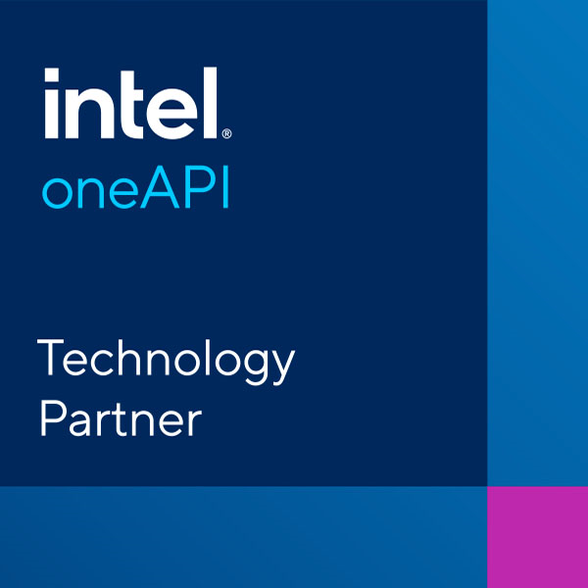
Intel® oneAPI Technology Partners
Companies endorsed by Intel who provide services based on their Intel® oneAPI technical expertise to meet the business and technical needs of customers and the local developer community.
Connecting with an Intel® oneAPI Technology Partner:
19 companies in 10 countries
Certified on various programming models for HPC and AI using Intel oneAPI
Find your local expert here:
software.intel.com/content/dam/develop/external/us/en/documents/pdf/intel-oneapi-tech-partners-v-1-0.pdf
PARTNER Qualifications:
Expertise in parallel programming for CPU & GPU
Provide consulting & services such as porting applications, coding, tuning, code-modernization, etc.
Successful completion of training portal and technical assessments

Slide 5
oneAPI Toolkits & Support
June 22, 2021
Pranati Tewari, Mike Lee

Slide 6
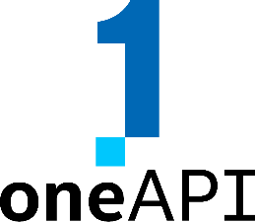
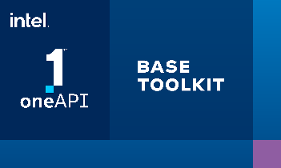
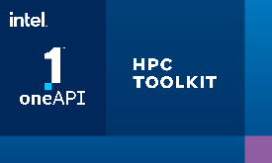
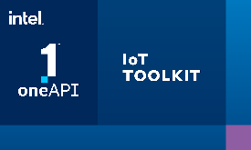
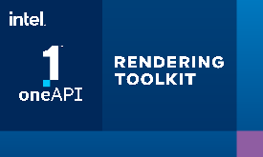
Intel® oneAPI Toolkits
A complete set of proven developer tools expanded from CPU to XPU
Intel® oneAPI Base Toolkit
Native Code Developers
A core set of high-performance tools for building C++, Data Parallel C++ applications & oneAPI library-based applications
Add-on Domain-specific Toolkits
Intel® oneAPI Tools for HPC
Intel® oneAPI Tools for IoT
Deliver fast Fortran, OpenMP & MPI applications that scale
Build efficient, reliable solutions that run at network’s edge
Intel® oneAPI AI Analytics Toolkit
Intel® oneAPI Rendering Toolkit
Specialized Workloads
Accelerate machine learning & data science pipelines with optimized DL frameworks & high-performing Python libraries
Create performant, high-fidelity visualization applications
Toolkit
powered by oneAPI
Intel® Distribution of OpenVINO™ Toolkit
Deploy high performance inference & applications from edge to cloud
Data Scientists & AI Developers
Intel® oneAPI Toolkits 2021.2 in early March - Intel Confidential

Slide 7
Intel® oneAPI Toolkits Free Availability
Run the tools locally
Run the tools in the Cloud
Downloads
Get Started Quickly Code Samples, Quick-start Guides, Webinars, Training
software.intel.com/oneapi
DevCloud
Repositories
Containers

Slide 8
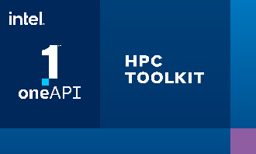
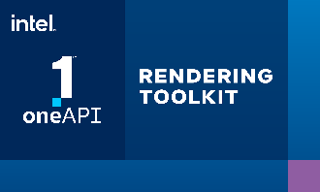
Commercial Toolkits Deliver Priority Support
Next Generation of Commercial Intel® Software Development Products
Worldwide support from Intel technical consulting engineers
Prior commercial tool suites, Intel® Parallel Studio XE and Intel® System Studio, transition to oneAPI products
+
+
+
Intel® Parallel Studio XE
Intel® System Studio

Slide 9
Priority Support Benefits
Download Access to & Support for new product updates and older versions
Direct and private interaction with Intel’s Support Engineers
Accelerated Response time
Priority Solutions for escalated defects and feature requests
Access to a vast library of self-help documentation
Access to Intel public community forums
On-site or online training and consultation by Intel technical consulting engineers may be added at an additional cost
https://software.intel.com/content/www/us/en/develop/tools/oneapi/support.html

Slide 10
What’s next…..
Try your code on Intel® DevCloud
Develop, run, and optimize your oneAPI project on the Intel® DevCloud, a free development sandbox with access to the latest hardware and software from Intel. No software downloads. No configuration steps. No installations. Get started in minutes.
Get started in minutes
Continue your self-paced learning
Work step-by-step through code examples to that will help you optimize your Intel® oneAPI solution in the Intel® DevCloud and enhance your understanding of DPC++.
Start Trainings
Innovate, Collaborate & Share on DevMesh:
Submit your project to showcase your work and get feedback and support from experts and Intel. See how others are leveraging Intel® oneAPI Products.
Share on DevMesh
Notes:
Data behind why we’re segmenting products the way we are
IPC for each subset of Xe
SG1: capabilities of card, not individual GPUs
Primer on ray tracing vs rasterization & differences between two
Adding versioning for SW support. Timing of support

Slide 11
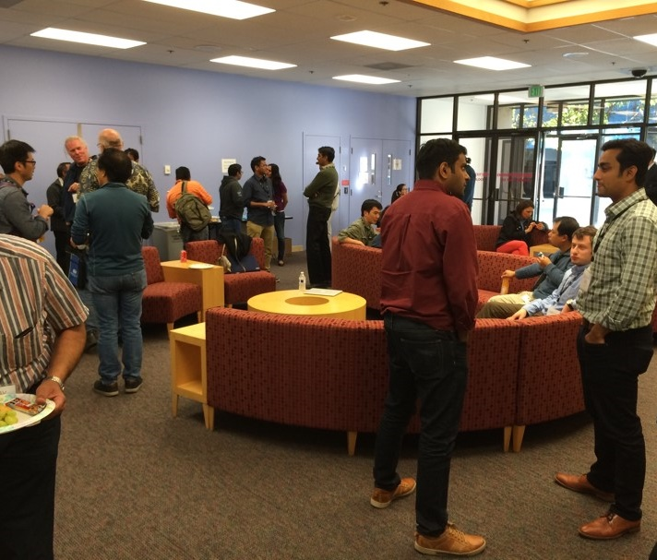
Happy Hour
Let’s get to know each other!
6:00 – 7:00 PM CET

Slide 12
Data Parallel C++ Book
First come, First serve:
Email gabrielle.amoranto@intel.com for a chance to win a book.
For a free digital copy: https://link.springer.com/content/pdf/10.1007%2F978-1-4842-5574-2.pdf

Slide 14
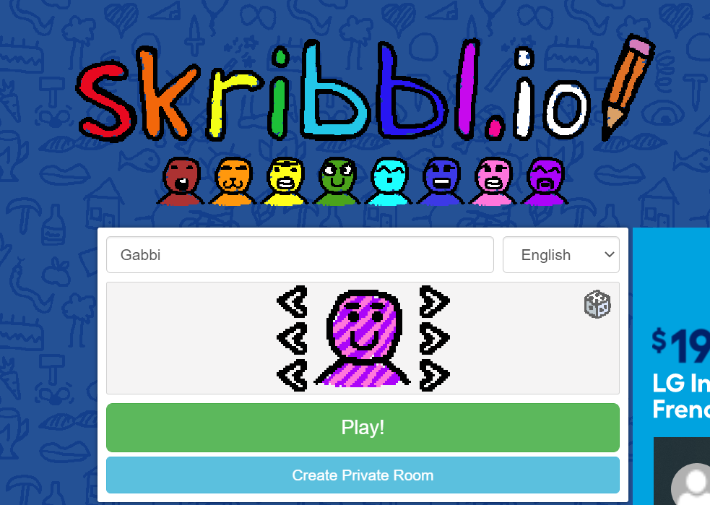
How to Play:
Last names A-E: Game 1
Last names F-J: Game 2
Last names K-O: Game 3
Last names R-V: Game 4
Last names W-Z: Game 5
2. Join your group’s game by clicking the link provided
3. Enter your first name
4. Click “Play!”
5. Wait for your game to start

Slide 15
Enter your guesses in the bottom right chat box

Slide 16
Create a DevMesh Project
Go
Go to https://devmesh.intel.com
Create
Create a DevMesh project
Share
Share your project during Happy Hour

Slide 17
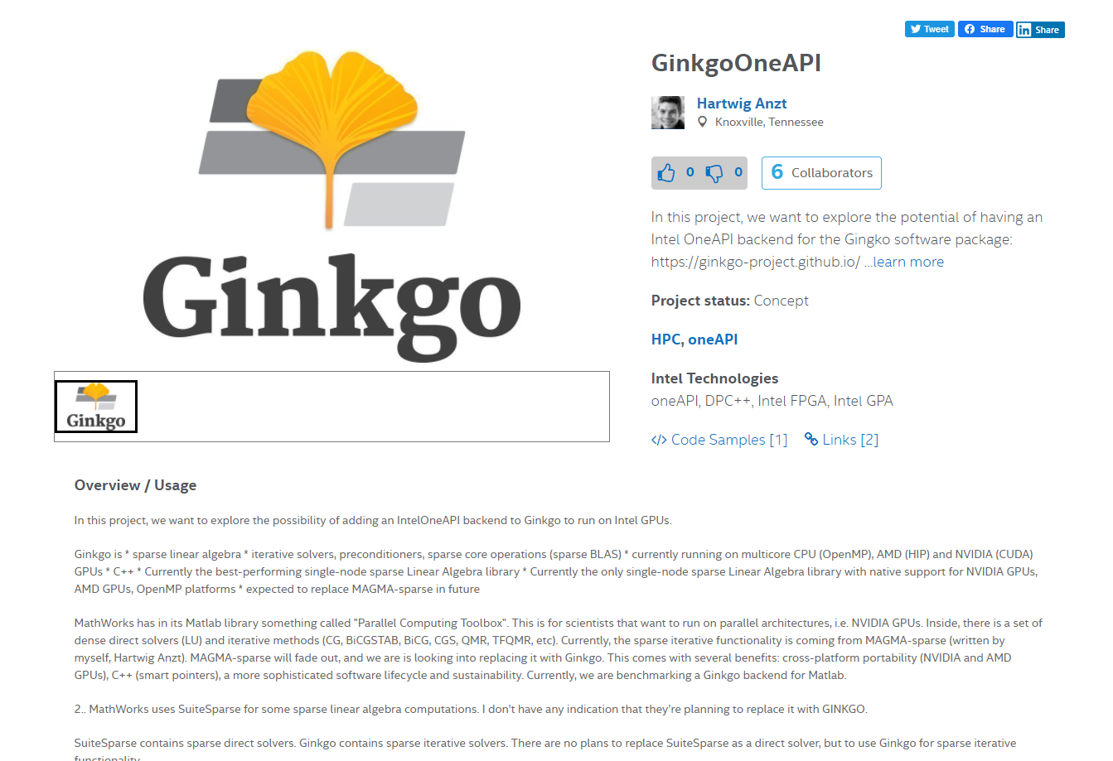
Share your DevMesh Project!

Slide 18
TAKE OUR SURVEY
We would like to hear your feedback via a short questionnaire on your oneAPI Developer Summit 2021 experience.
We Want to Hear From You

Slide 19
Thank you for attending!

