Slide 1
TAU Performance System®
oneAPI Developer Summit at IWOCL 2021
April 26, 2021, 5:15 – 5:45pm CET/8:15am – 8:45am PT
https://www.oneapi.com/events/devcon2021iwocl/
Sameer Shende
Research Associate Professor and Director,
Performance Research Laboratory, OACISS, University of Oregon
http://tau.uoregon.edu/TAU_IWOCL21.pdf

Slide 2
Challenges
With growing hardware complexity, it is getting harder to accurately measure and optimize the performance of our HPC and AI/ML workloads.
TAU Performance System®:
Deliver a scalable, portable, performance evaluation toolkit for HPC and AI/ML workloads
http://tau.uoregon.edu

Slide 3
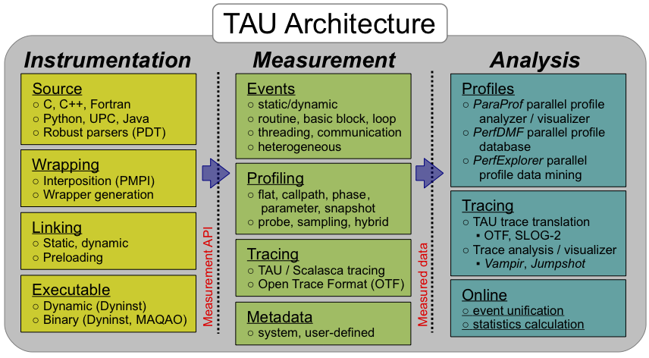
TAU Performance System®
Parallel performance framework and toolkit
Supports all HPC platforms, compilers, runtime system
Provides portable instrumentation, measurement, analysis

Slide 4
TAU Performance System
Instrumentation
Fortran, C++, C, UPC, Java, Python, Chapel, Spark
Automatic instrumentation
Measurement and analysis support
MPI, OpenSHMEM, ARMCI, PGAS, DMAPP
pthreads, OpenMP, OMPT interface, hybrid, other thread models
GPU: OpenCL, oneAPI DPC++/SYCL (Level Zero), OpenACC, Kokkos, RAJA
Parallel profiling and tracing
Analysis
Parallel profile analysis (ParaProf), data mining (PerfExplorer)
Performance database technology (TAUdb)
3D profile browser

Slide 5
Application Performance Engineering using TAU
How much time is spent in each application routine and outer loops? Within loops, what is the contribution of each statement? What is the time spent in OpenMP loops? In kernels on GPUs.
How many instructions are executed in these code regions? Floating point, Level 1 and 2 data cache misses, hits, branches taken? What is the extent of vectorization for loops?
What is the memory usage of the code? When and where is memory allocated/de-allocated? Are there any memory leaks? What is the memory footprint of the application? What is the memory high water mark?
How much energy does the application use in Joules? What is the peak power usage?
What are the I/O characteristics of the code? What is the peak read and write bandwidth of individual calls, total volume?
How does the application scale? What is the efficiency, runtime breakdown of performance across different core counts?

Slide 6
Instrumentation
Add hooks in the code to perform measurements
Source instrumentation using a preprocessor
Add timer start/stop calls in a copy of the source code.
Use Program Database Toolkit (PDT) for parsing source code.
Requires recompiling the code using TAU shell scripts (tau_cc.sh, tau_f90.sh)
Selective instrumentation (filter file) can reduce runtime overhead and narrow instrumentation focus.
Compiler-based instrumentation
Use system compiler to add a special flag to insert hooks at routine entry/exit.
Requires recompiling using TAU compiler scripts (tau_cc.sh, tau_f90.sh…)
Runtime preloading of TAU’s Dynamic Shared Object (DSO)
No need to recompile code! Use mpirun tau_exec ./app with options.

Slide 7
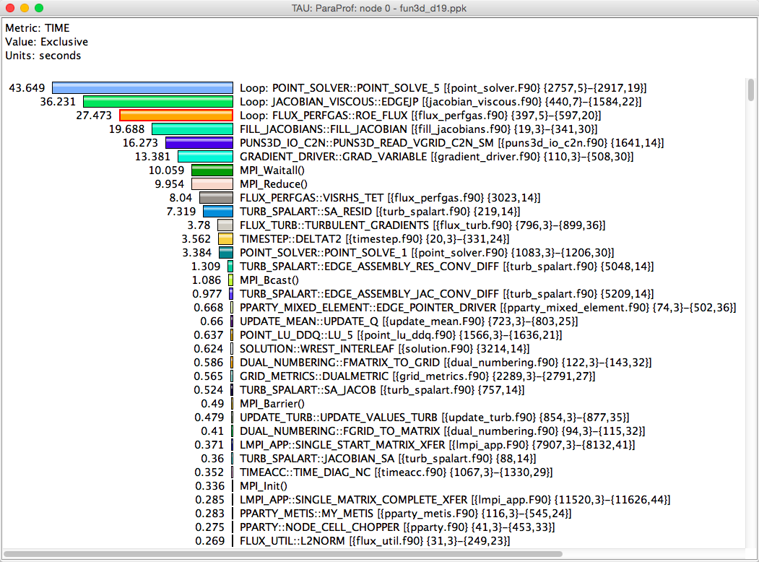
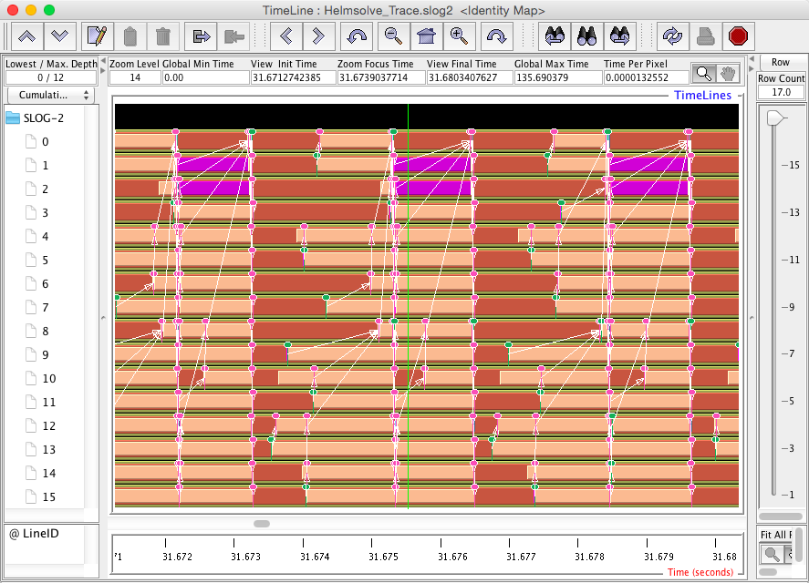
Profiling and Tracing
Profiling
Tracing
Profiling shows you how much (total) time was spent in each routine
Tracing shows you when the events take place on a timeline
Profiling and tracing
Profiling shows you how much (total) time was spent in each routine
Tracing shows you when the events take place on a timeline

Slide 8
Instrumentation
Direct and indirect performance observation
Instrumentation invokes performance measurement
Direct measurement with probes
Indirect measurement with periodic sampling or hardware performance counter overflow interrupts
Events measure performance data, metadata, context, etc.
User-defined events
Interval (start/stop) events to measure exclusive & inclusive duration
Atomic events take measurements at a single point
Measures total, samples, min/max/mean/std. deviation statistics
Context events are atomic events with executing context
Measures above statistics for a given calling path

Slide 9
Inclusive vs. Exclusive Measurements
Performance with respect to code regions
Exclusive measurements for region only
Inclusive measurements includes child regions
int foo()
{
int a;
a =a + 1;
bar();
a =a + 1;
return a;
}
inclusive
duration
exclusive
duration

Slide 10
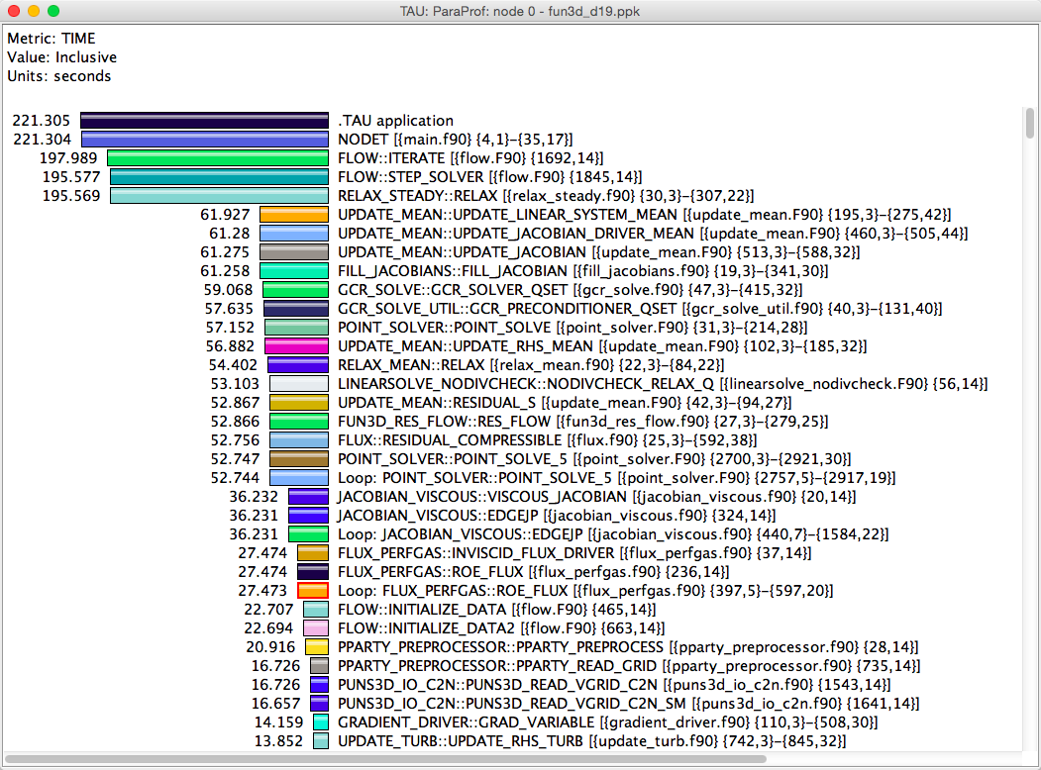
Inclusive Measurements

Slide 11
Exclusive Time

Slide 12
How much data do you want?
Limited Profile
Loop Profile
Callpath Profile
O(KB)
O(TB)
Flat Profile
Callsite
Profile
Trace

Slide 13
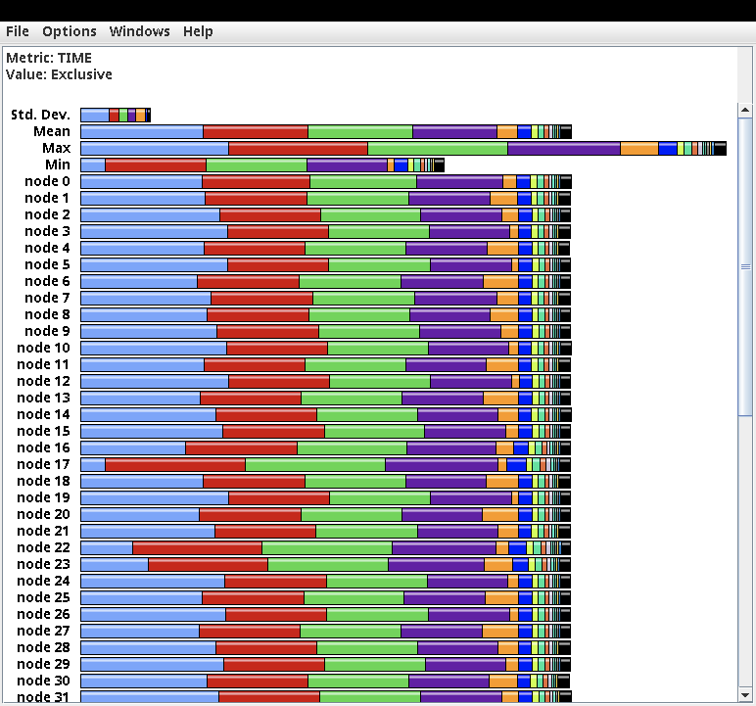
ParaProf Profile Browser
% paraprof

Slide 14
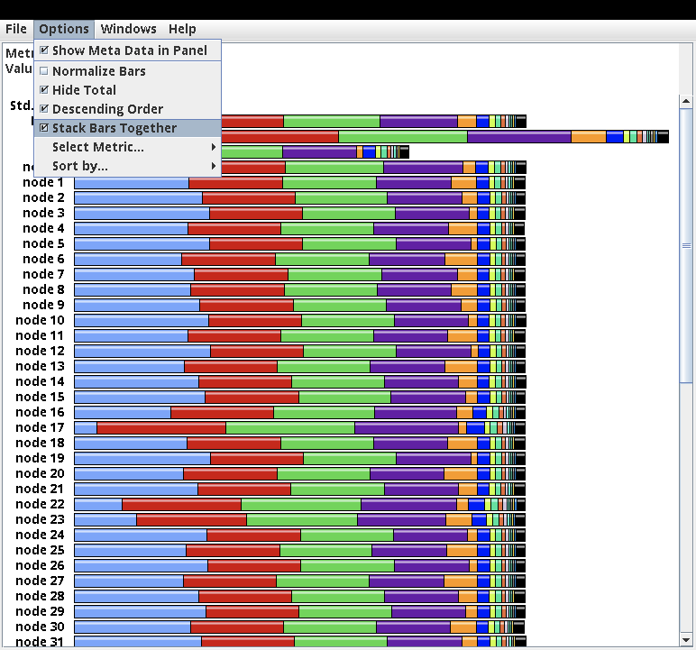
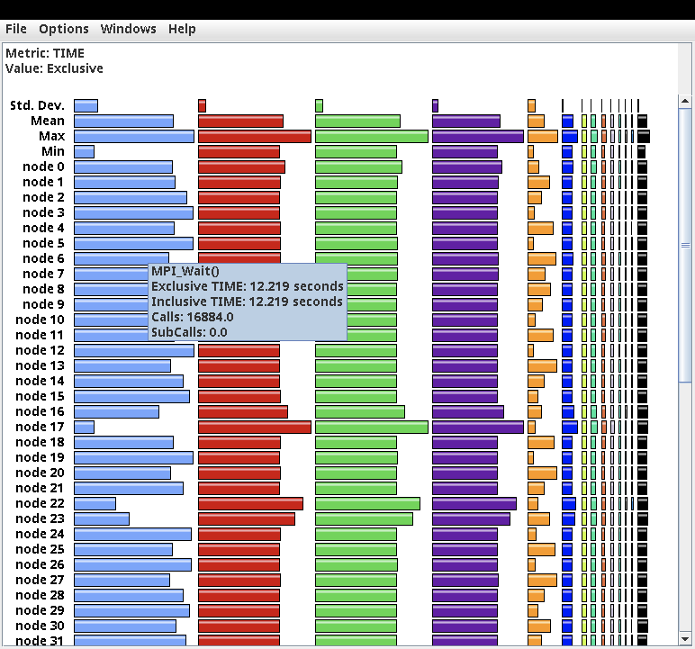
ParaProf Profile Browser

Slide 15
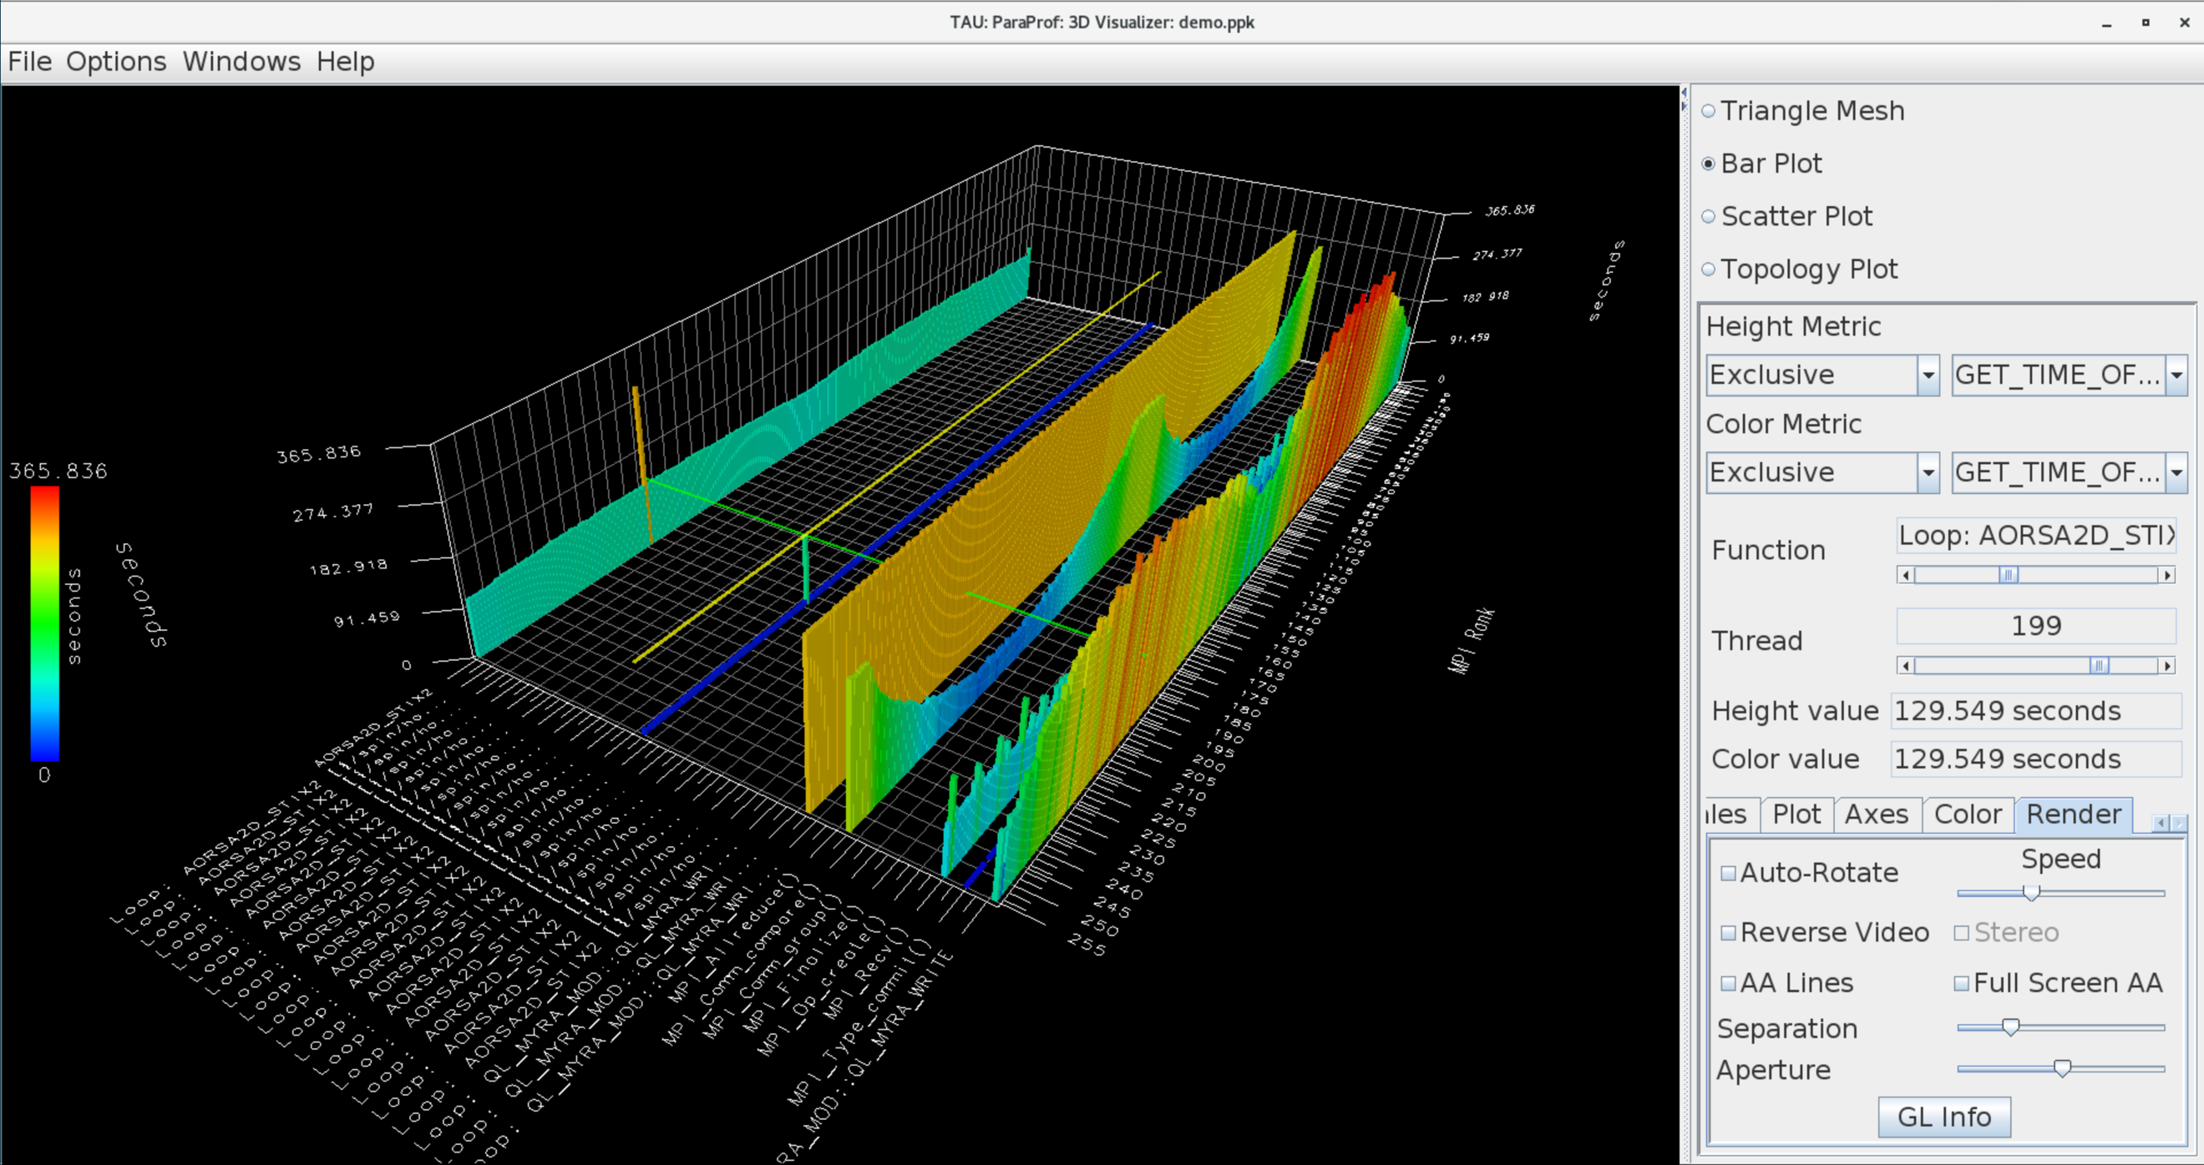
ParaProf 3D Profile Browser

Slide 16
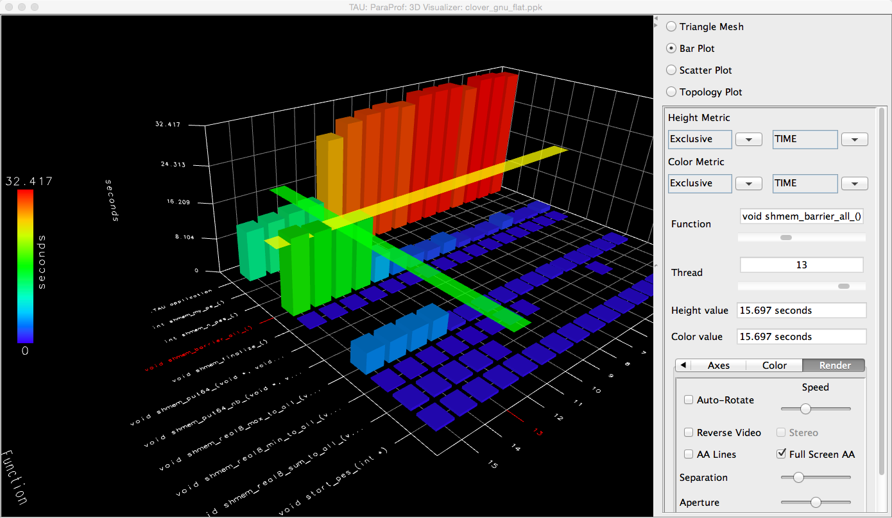
TAU – ParaProf 3D Visualization
% paraprof app.ppk
Windows -> 3D Visualization -> Bar Plot (right pane)

Slide 17
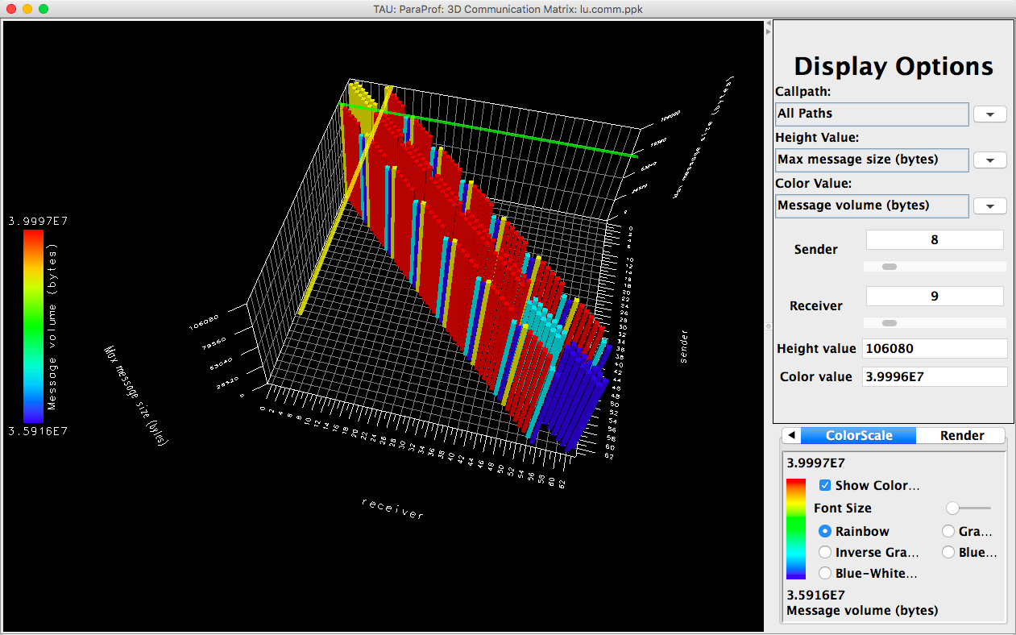
TAU – 3D Communication Window
% export TAU_COMM_MATRIX=1; mpirun … tau_exec ./a.out
% paraprof ; Windows -> 3D Communication Matrix

Slide 18
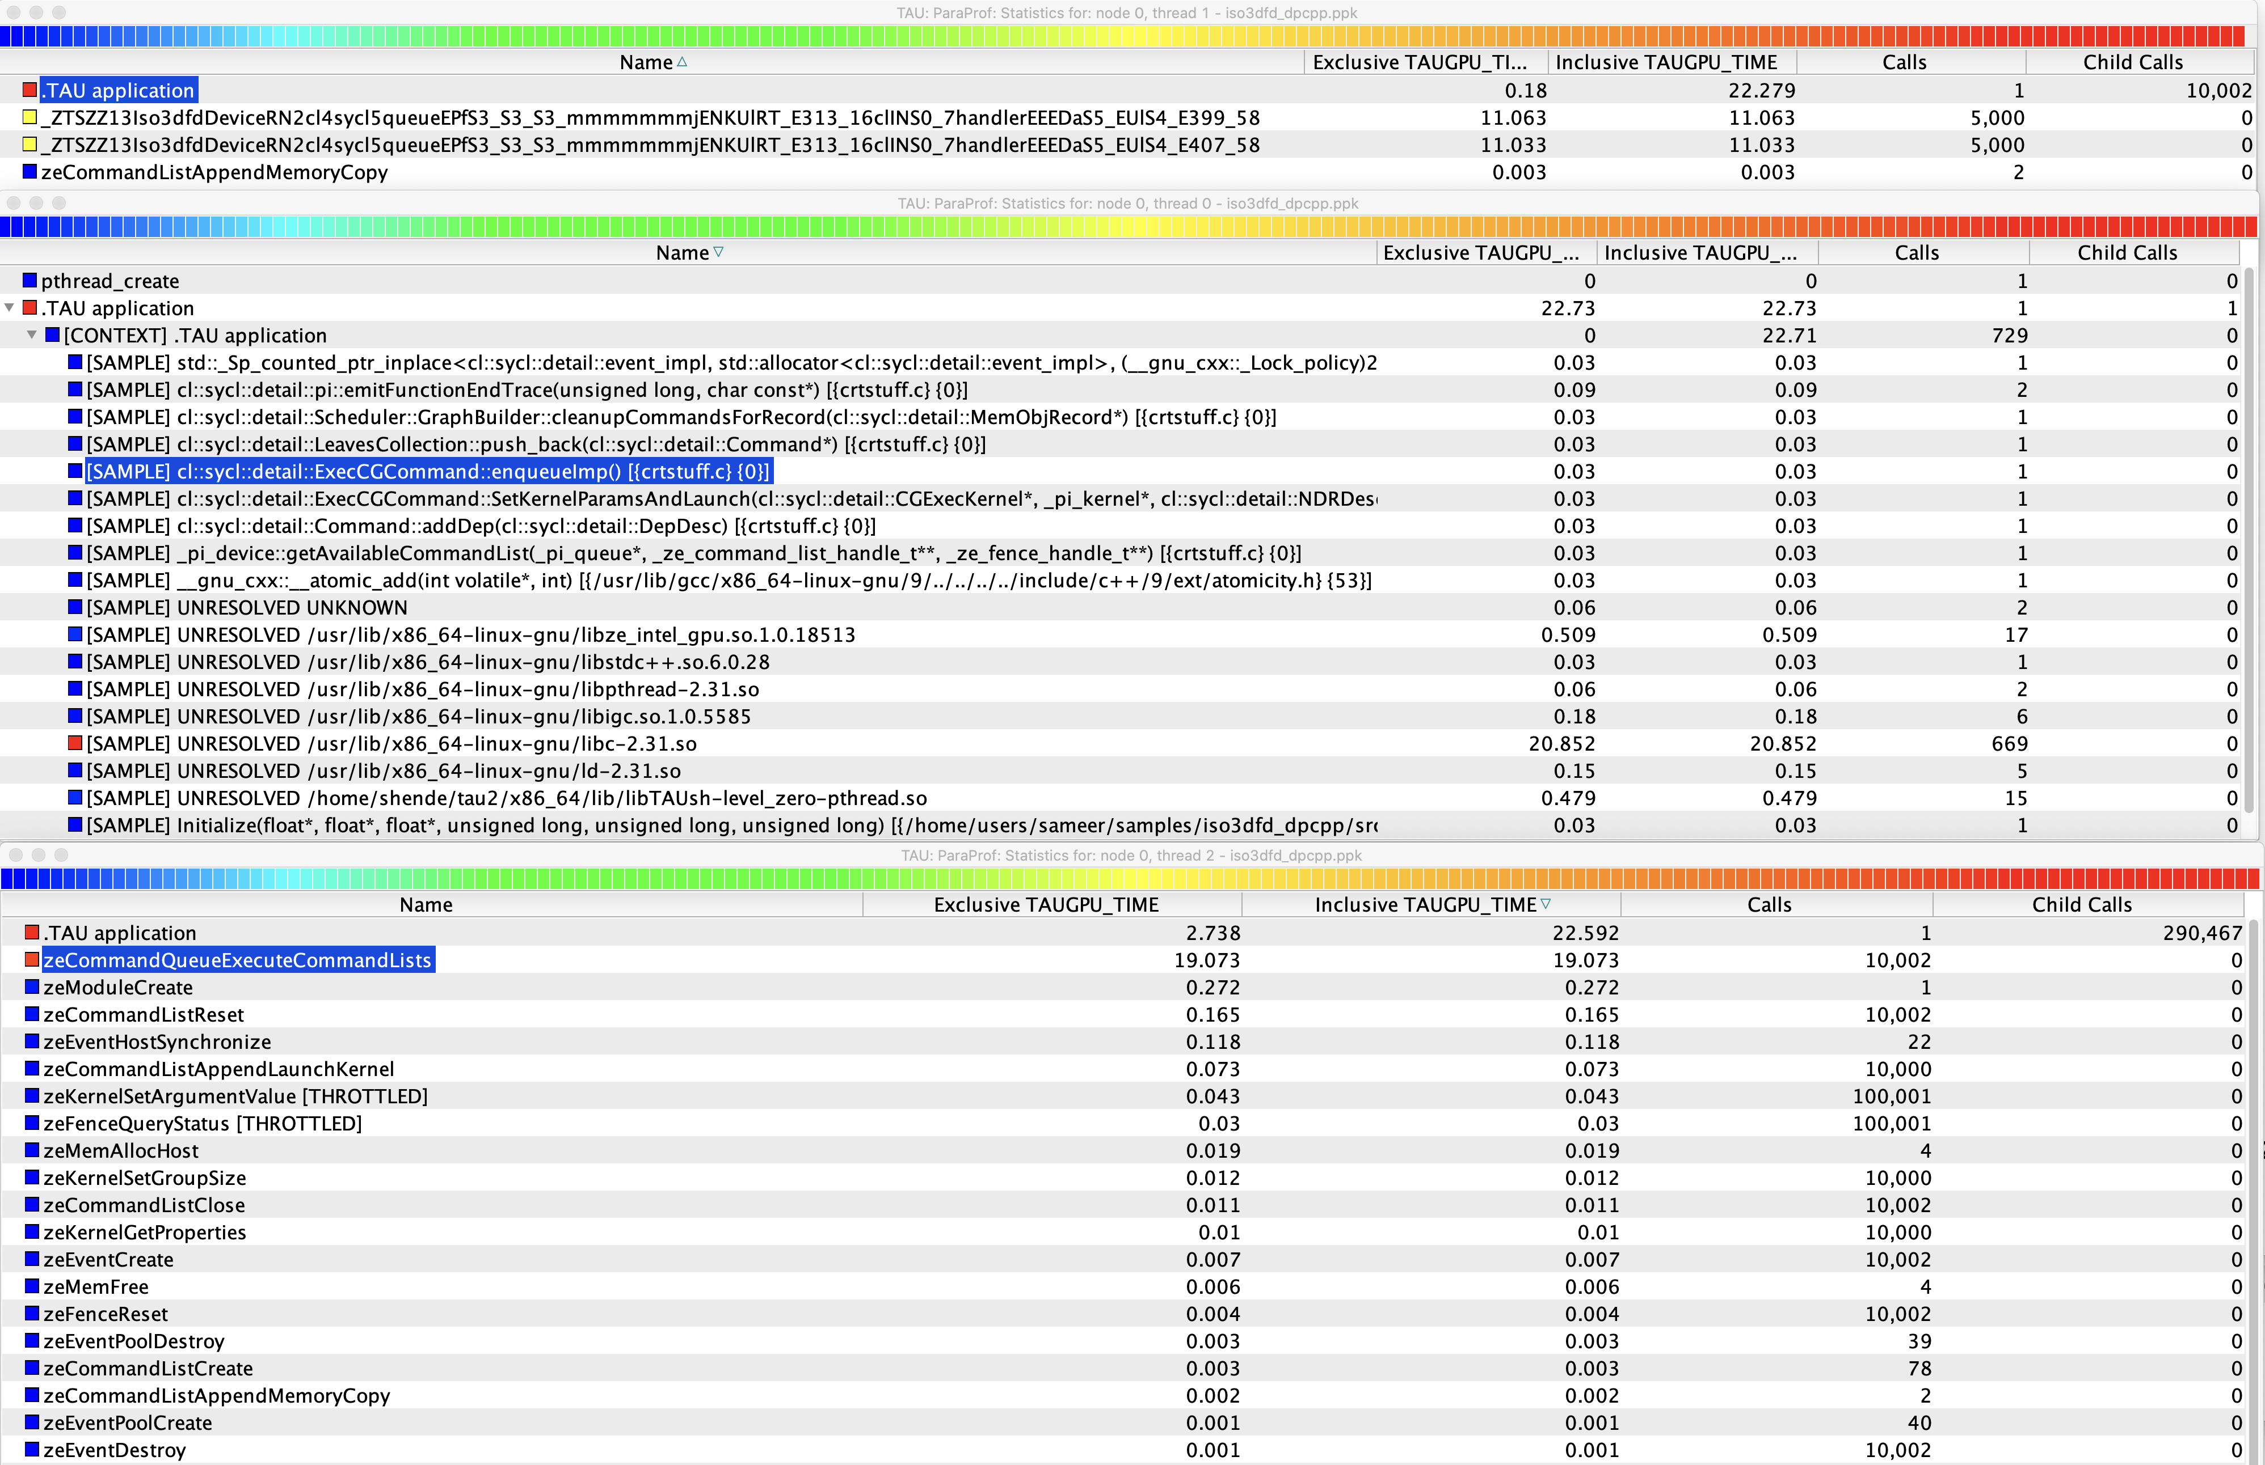
TAU: Intel oneAPI DPC++ on an Intel Gen12LP or DG1 GPU
% tau_exec –T level_zero,serial –l0 ./a.out

Slide 19
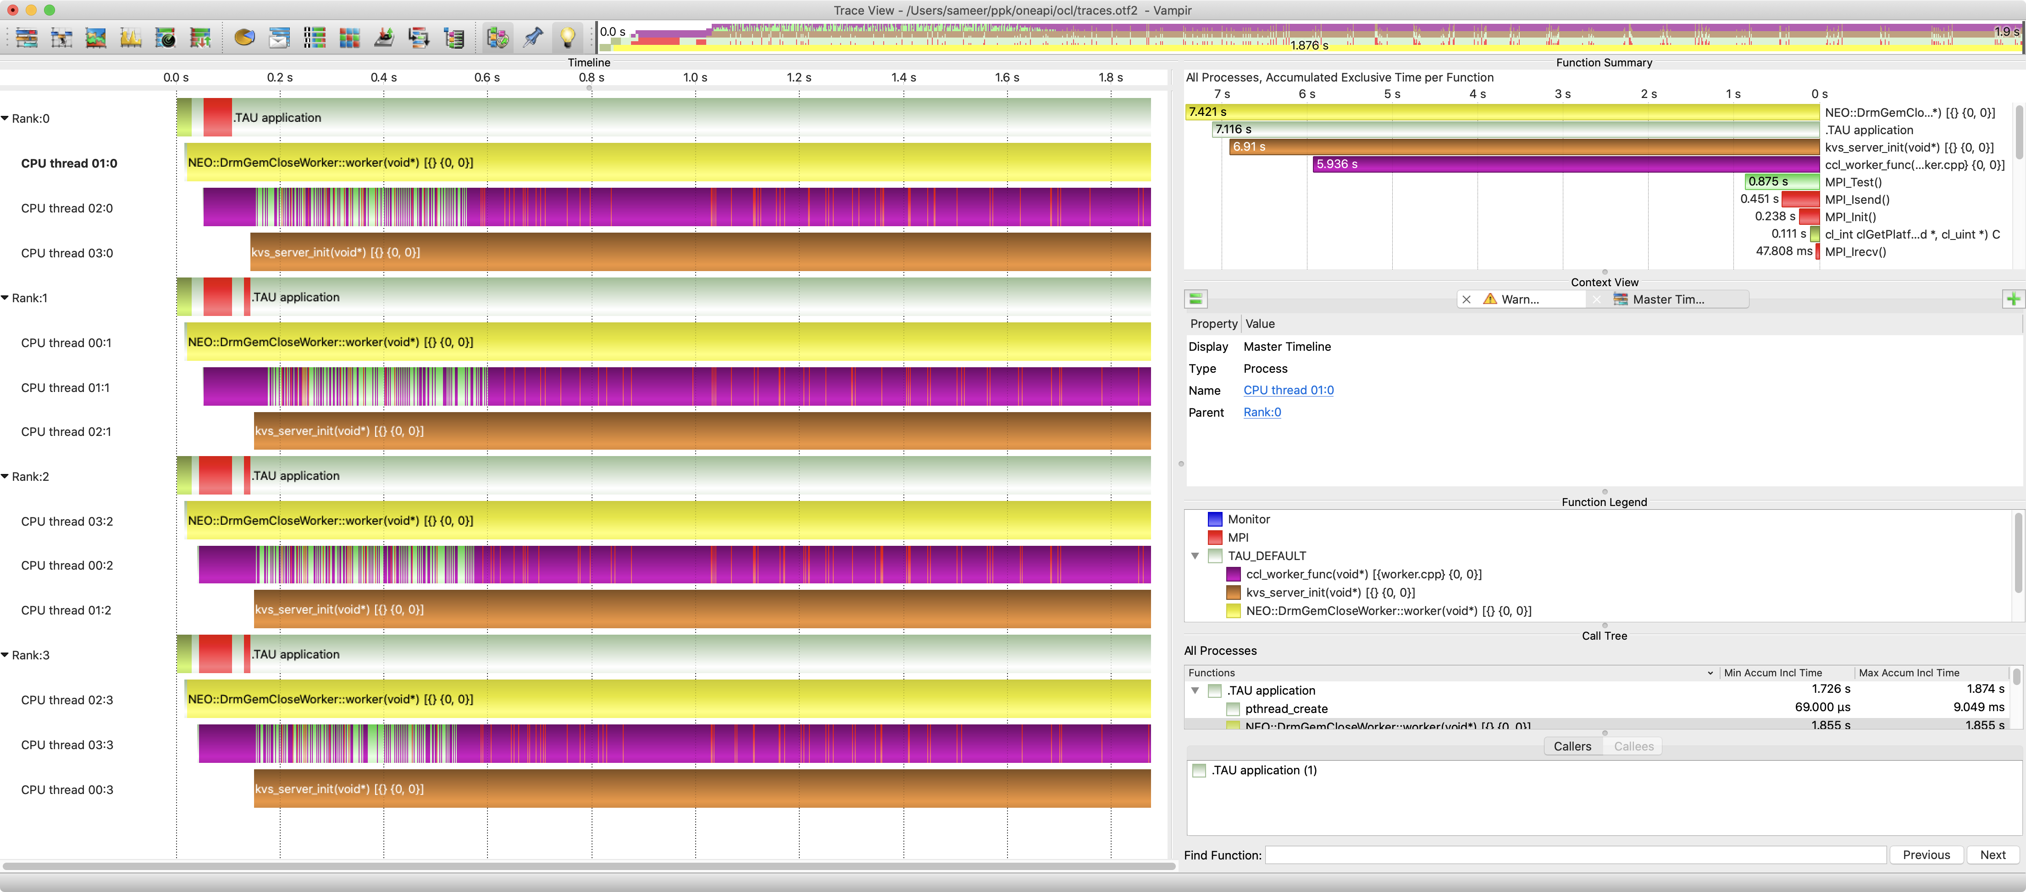
TAU and Vampir [TU Dresden]: Intel oneAPI OpenCL (oneCCL)
% export TAU_TRACE=1; export TAU_TRACE_FORMAT=otf2
% mpirun –np 4 tau_exec –T level_zero,serial –opencl ./a.out

Slide 20
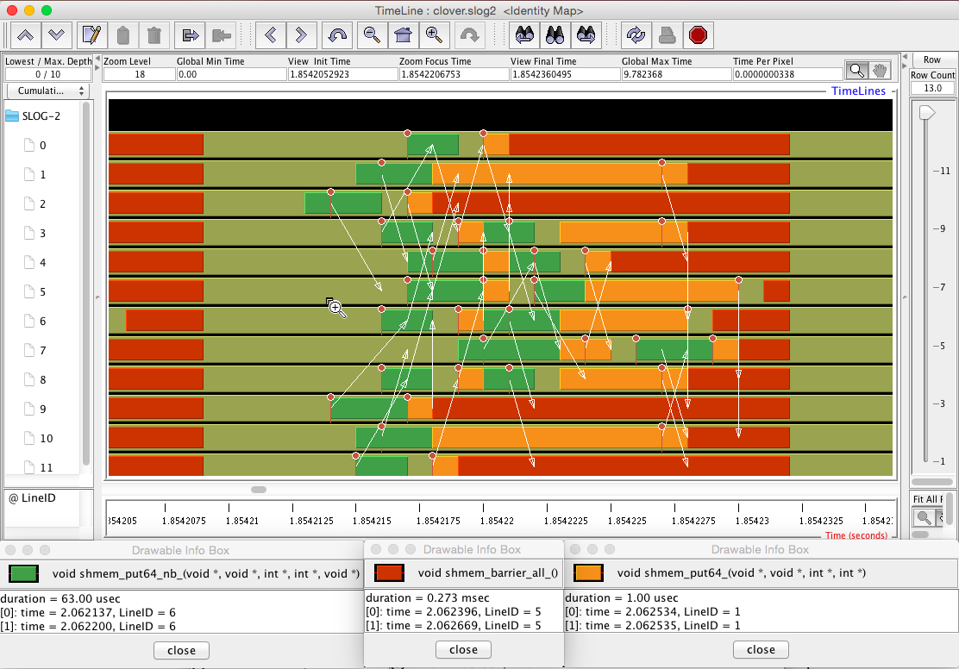
Tracing: Jumpshot (ships with TAU)

Slide 21
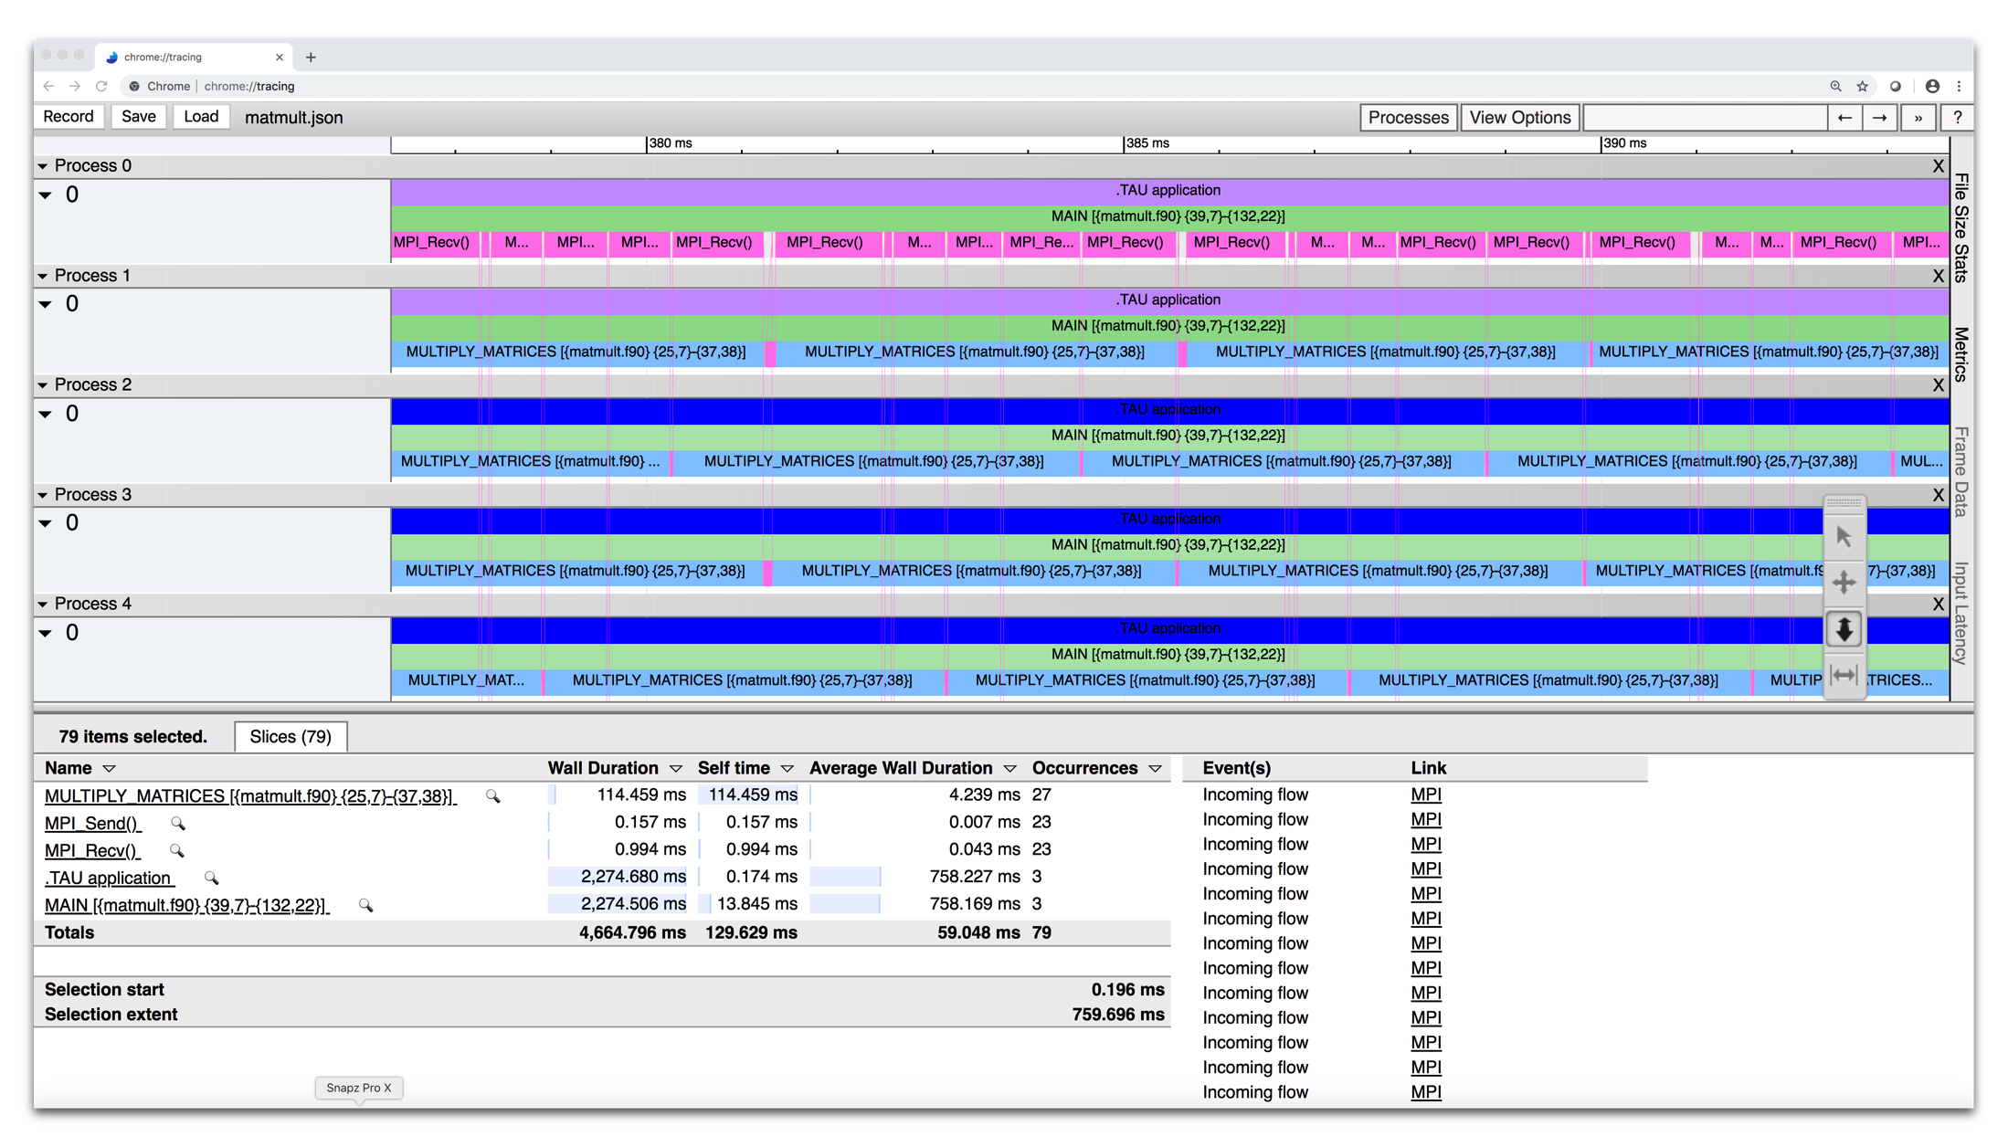
Tracing: Chrome Browser
% export TAU_TRACE=1
% mpirun –np 256 tau_exec ./a.out
% tau_treemerge.pl; tau_trace2json tau.trc tau.edf –chrome –ignoreatomic –o app.json
Chrome browser: chrome://tracing (Load -> app.json)
Notes:
21

Slide 22
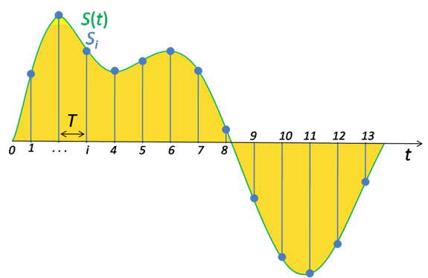
Performance Data Measurement
Direct via Probes
Indirect via Sampling
Call START(‘potential’)
// code
Call STOP(‘potential’)
Exact measurement
Fine-grain control
Calls inserted into code
No code modification
Minimal effort
Relies on debug symbols (-g)

Slide 23
Sampling
t₁
t₂
t₃
t₄
t₅
t₆
t₇
t₈
t₉
Time
main
foo(0)
foo(1)
foo(2)
Measurement
int main() { int i; for (i=0; i < 3; i++) foo(i); return 0; } void foo(int i) {
if (i > 0) foo(i – 1); }
Running program is periodically interrupted to take measurement
Timer interrupt, OS signal, or HWC overflow
Service routine examines return-address stack
Addresses are mapped to routines using symbol table information
Statistical inference of program behavior
Not very detailed information on highly volatile metrics
Requires long-running applications
Works with unmodified executables

Slide 24
Instrumentation
t₁
t₂
t₃
t₄
t₅
t₆
t₇
t₈
t₉
t₁₀
t₁₁
t₁₂
t₁₃
t₁₄
Time
Time
main
foo(0)
foo(1)
foo(2)
Measurement
int main() { int i; for (i=0; i < 3; i++) foo(i); return 0; } void foo(int i) { if (i > 0) foo(i – 1);
}
Measurement code is inserted such that every event of interest is captured directly
Can be done in various ways
Advantage:
Much more detailed information
Disadvantage:
Processing of source-code / executable necessary
Large relative overheads for small functions
Start(“main”);
Stop(“main”);
Start(“foo”);
Stop(“foo”);

Slide 25
Using TAU’s Runtime Preloading Tool: tau_exec
Preload a wrapper that intercepts the runtime system call and substitutes with another
MPI
OpenMP
POSIX I/O
Memory allocation/deallocation routines
Wrapper library for an external package
No modification to the binary executable!
Enable other TAU options (communication matrix, OTF2, event-based sampling)

Slide 26
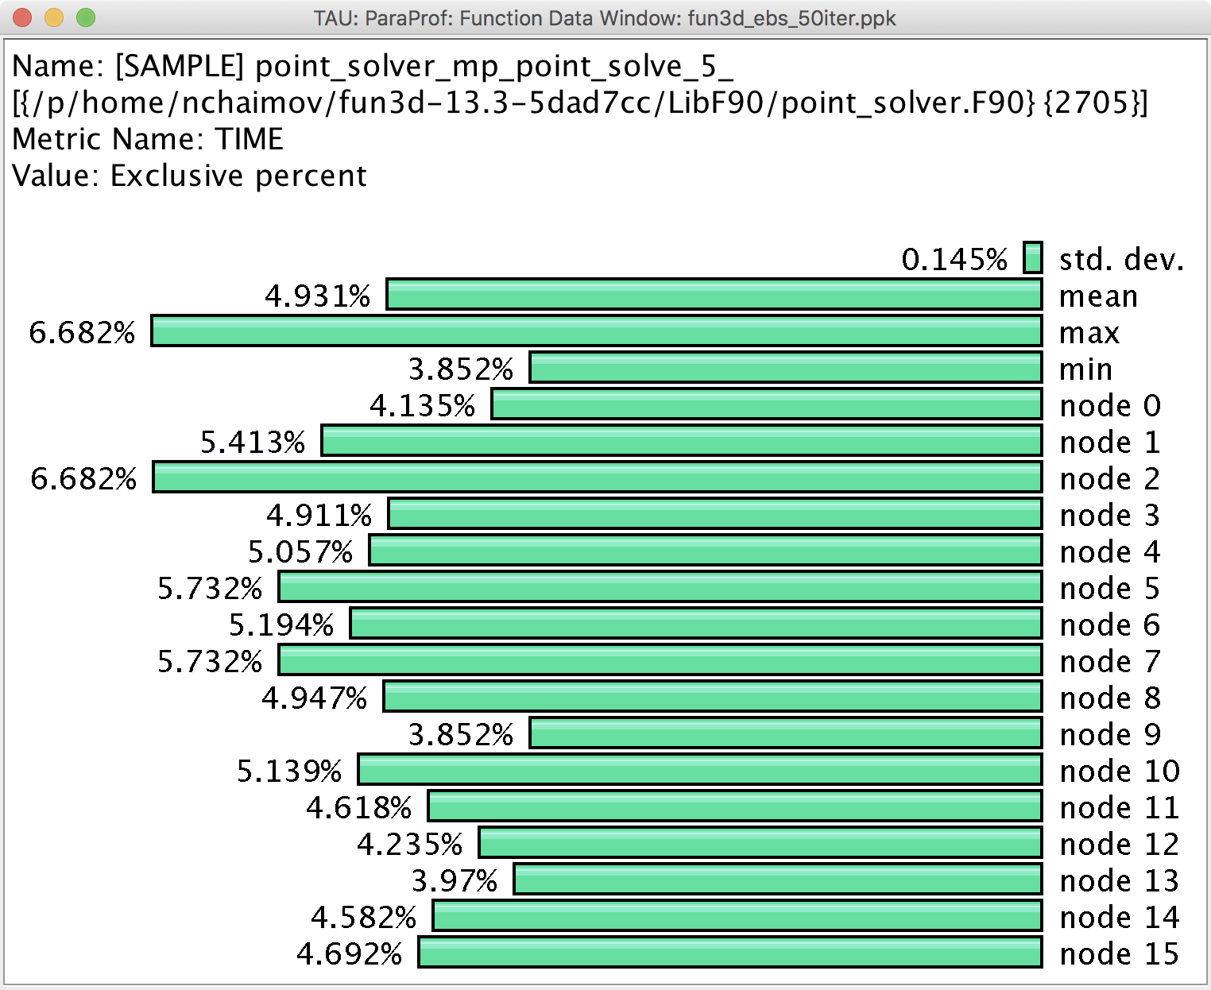
Event Based Sampling (EBS)
File: point_solver.F90
Line: 2705
Uninstrumented!
% mpirun -n 16 tau_exec –ebs a.out

Slide 27
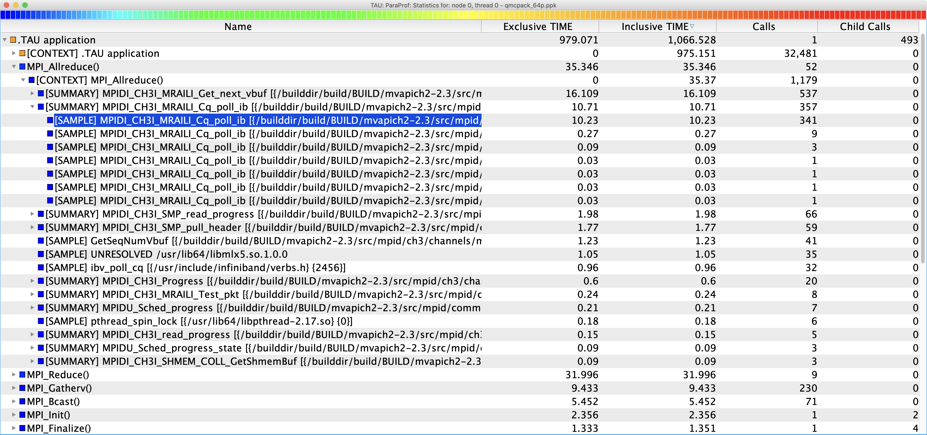
Event Based Sampling (EBS): QMCPack
Ran for 1066.528 seconds. Outside of MPI calls, TAU can explain 975.151 seconds out of 979.071 seconds of exclusive time using EBS!

Slide 28
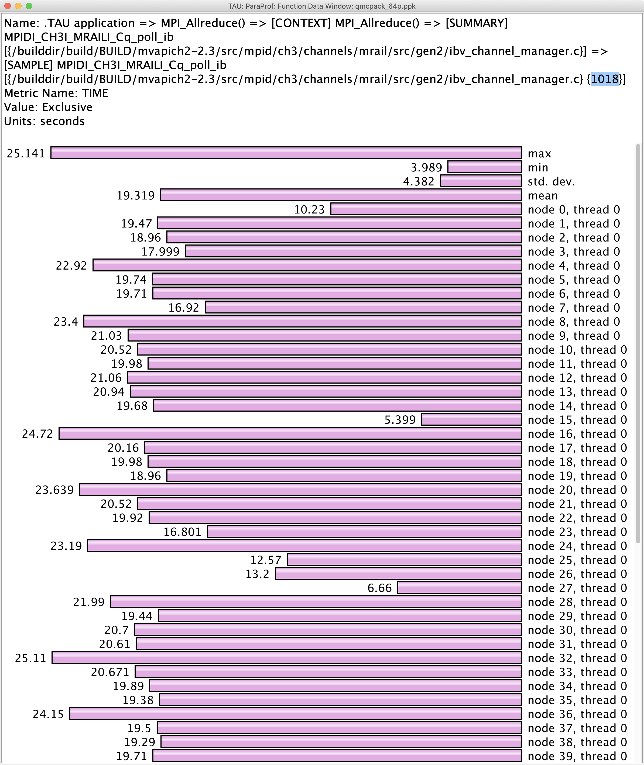
Event Based Sampling (EBS) shows statement level information
File: ibv_channel_manager.c
Line: 1018

Slide 29
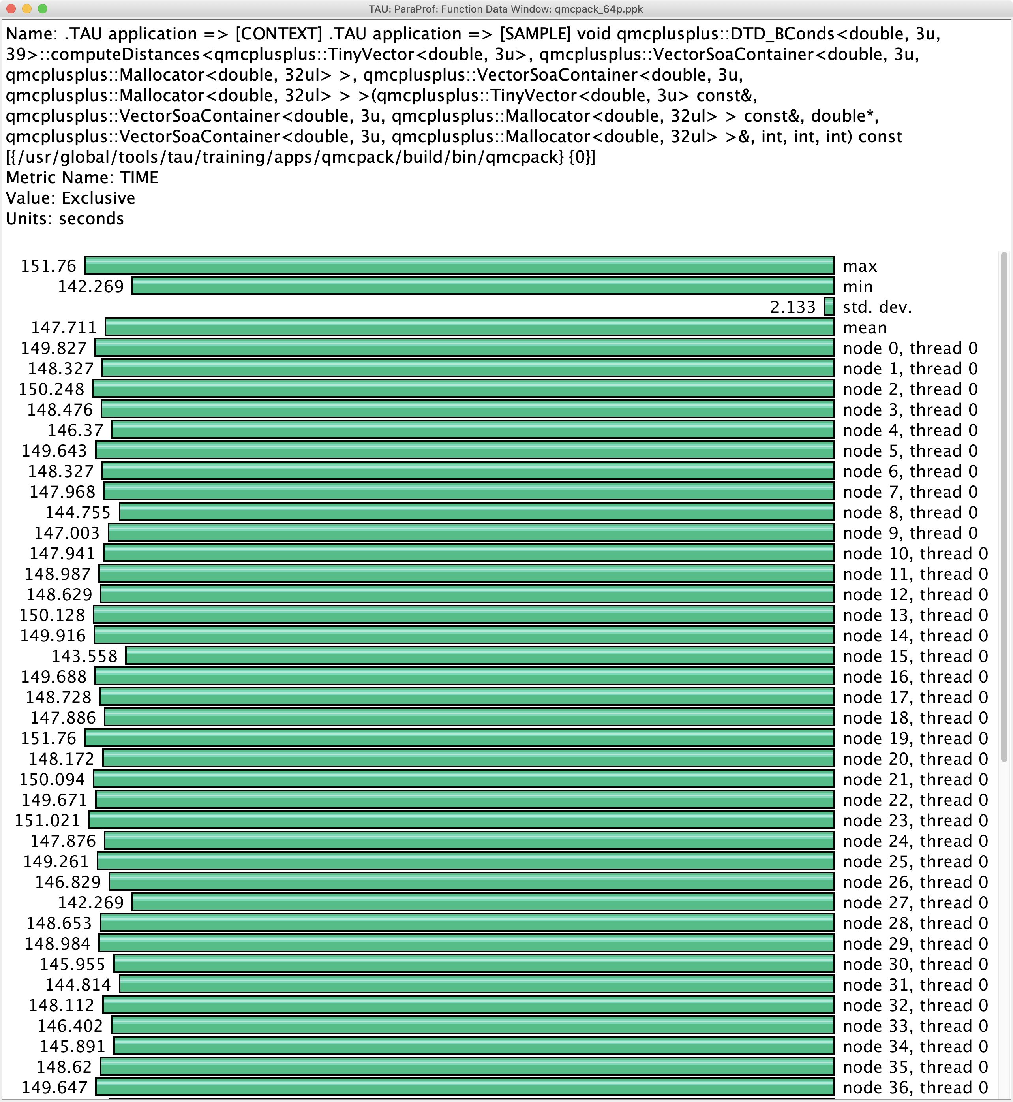
Event Based Sampling without symbol information (-g): QMCPack
Line number is 0!
~147.71 seconds are spent in
Qmcplusplus:DTD_Bconds::
computeDistances method

Slide 30
TAU’s Support for Runtime Systems
MPI
PMPI profiling interface
MPI_T tools interface using performance and control variables
Pthread
Captures time spent in routines per thread of execution
OpenMP
OMPT tools interface to track salient OpenMP runtime events
Opari source rewriter
Preloading wrapper OpenMP runtime library when OMPT is not supported
OpenACC
OpenACC instrumentation API
Track data transfers between host and device (per-variable)
Track time spent in kernels

Slide 31
TAU’s Support for Runtime Systems (contd.)
OpenCL
OpenCL profiling interface
Track timings of kernels
Intel® OneAPI
Level Zero
Track time spent in kernels executing on GPU
Track time spent in OneAPI runtime calls
Kokkos
Kokkos profiling API
Push/pop interface for region, kernel execution interface
Python
Python interpreter instrumentation API
Tracks Python routine transitions as well as Python to C transitions
Notes:
Collect basic routine-level timing profile to determine where most time is being spent
Collect routine-level hardware counter data to determine types of performance problems
Collect callpath profiles to determine sequence of events causing performance problems
Conduct finer-grained profiling and/or tracing to pinpoint performance bottlenecks
Loop-level profiling with hardware counters
Tracing of communication operations

Slide 32
Examples of Multi-Level Instrumentation
MPI + OpenMP
MPI_T + PMPI + OMPT may be used to track MPI and OpenMP
MPI + pthread
PMPI + pthread interfaces
MPI + Intel ® oneAPI DPC++/SYCL
PMPI + Level Zero interfaces
OpenCL + Python
OpenCL + Python instrumentation interfaces
Kokkos + OpenMP
Kokkos profiling API + OMPT to transparently track events
Kokkos + pthread + MPI
Kokkos + pthread wrapper interposition library + PMPI layer
MPI + OpenCL
PMPI + OpenCL profiling interfaces

Slide 33
Kokkos
Provides abstractions for node level parallelism (X in MPI+X)
Productive, portable, and performant shared-memory programming model
Helps you create single source performance portable codes
Provides data abstractions
C++ API for expressing parallelism in your program
Aggressive compiler transformations using C++ templates
Low level code targets backends such as OpenMP, Pthread, DPC++/SYCL
Creates a problem for performance evaluation tools
Gap: performance data and higher-level abstractions
Solution: Kokkos profiling API for mapping performance data
https://kokkos.org Sandia National Laboratories, NM

Slide 34
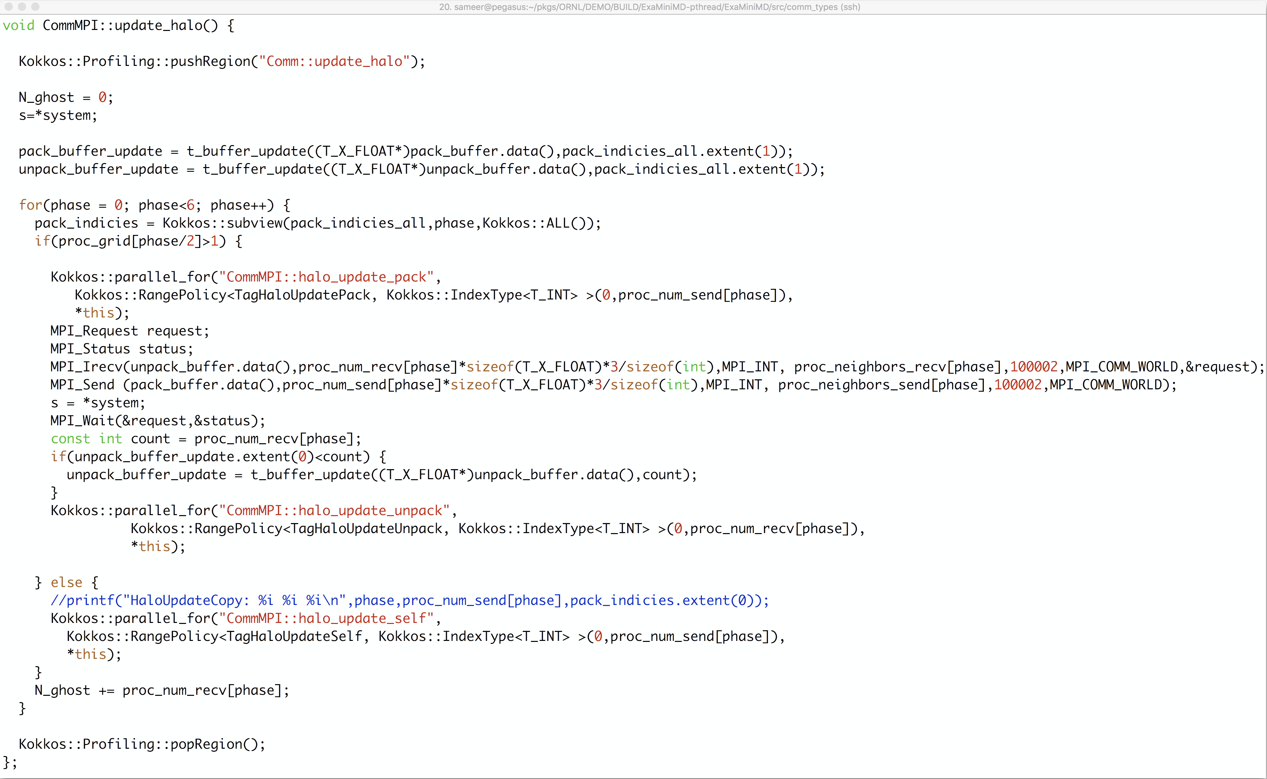
Kokkos API use in ExaMiniMD
pushRegion(“Comm::update_halo”)
Kokkos::parallel_for
popRegion

Slide 35
ExaMiniMD: TAU Phase
Comm::update_halo phase in TAU ParaProf’s Thread Statistics Table

Slide 36
TAU Execution Command (tau_exec)
Uninstrumented execution
% mpirun -np 256 ./a.out
Track GPU operations
% mpirun –np 256 tau_exec –l0 ./a.out
% mpirun –np 256 tau_exec –opencl ./a.out
% mpirun –np 256 tau_exec –openacc ./a.out
Track MPI performance
% mpirun -np 256 tau_exec ./a.out
Track I/O, and MPI performance (MPI enabled by default)
% mpirun -np 256 tau_exec -io ./a.out
Track OpenMP and MPI execution (using OMPT for Intel v19+ or Clang 8+)
% export TAU_OMPT_SUPPORT_LEVEL=full;
% mpirun –np 256 tau_exec –T ompt,v5,mpi -ompt ./a.out
Track memory operations
% export TAU_TRACK_MEMORY_LEAKS=1
% mpirun –np 256 tau_exec –memory_debug ./a.out (bounds check)
Use event based sampling (compile with –g)
% mpirun –np 256 tau_exec –ebs ./a.out
Also export TAU_METRICS=TIME,PAPI_L1_DCM… -ebs_resolution=<file | function | line>

Slide 37
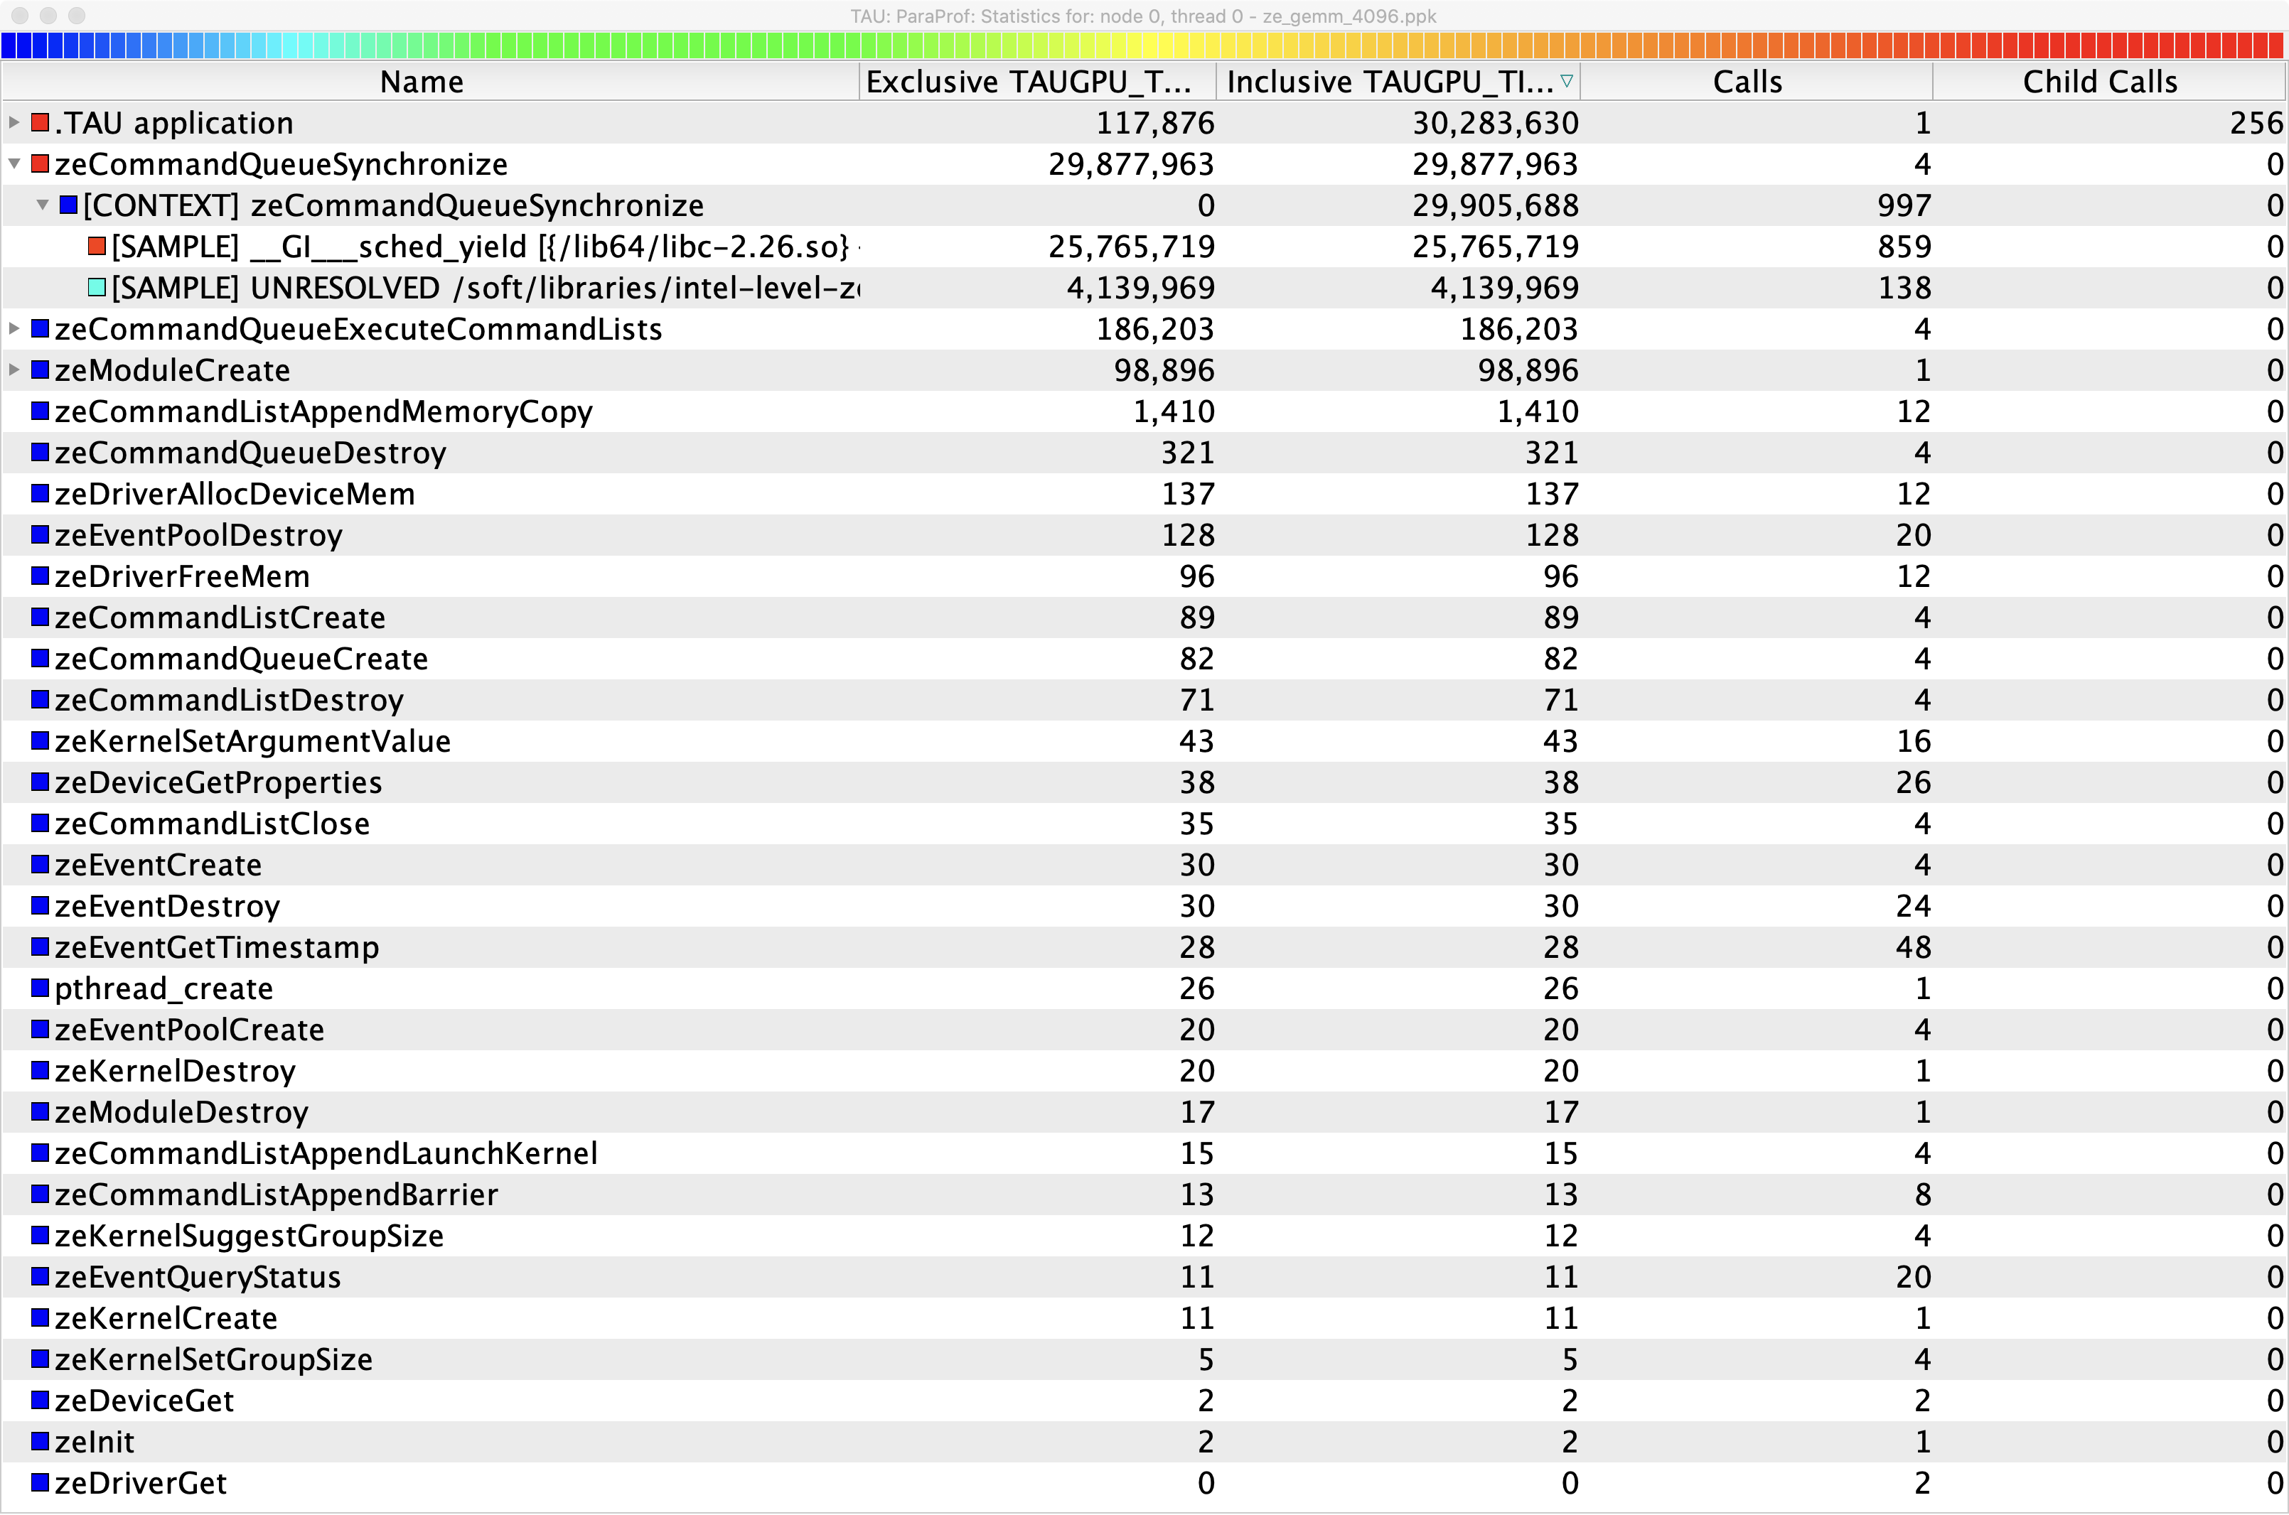
Intel Level Zero (TigerLake Gen12LP integrated CPUs or DG1)
Units: seconds
Time spent in GEMM kernel
Units: microseconds
% mpirun –np 64 tau_exec –l0 ./a.out

Slide 38
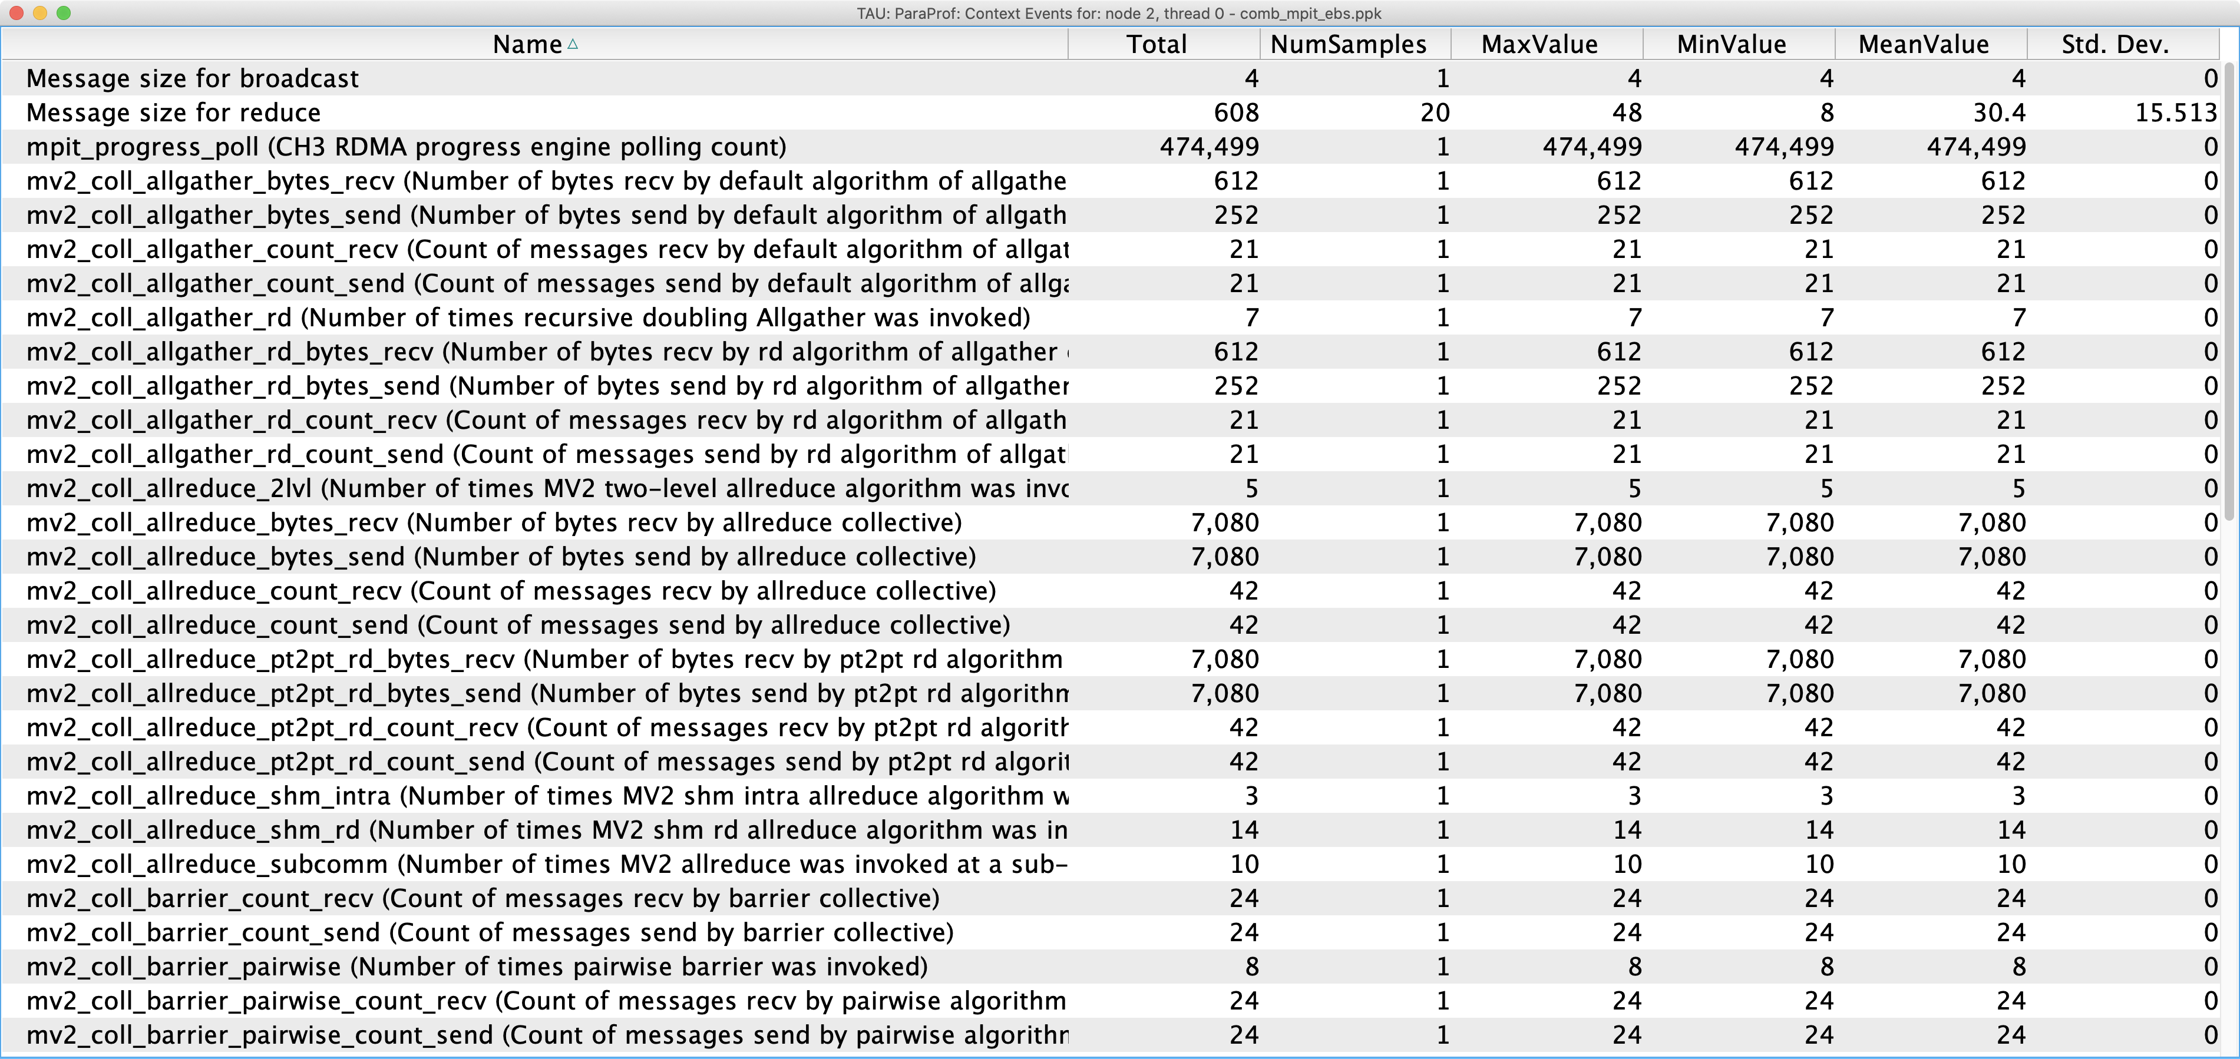
MPI Tools Interface: PVARs and CVARs
% export TAU_TRACK_MPI_T_PVARS=1
% mpirun –np 64 tau_exec –T mpit ./a.out

Slide 39
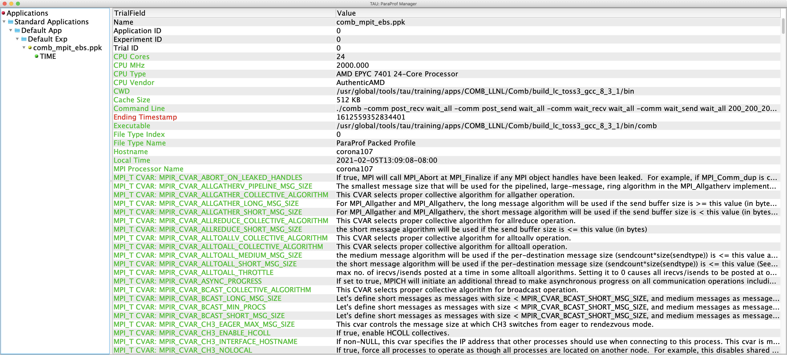
MPI Tools Interface: Control Variables (CVARs)

Slide 40
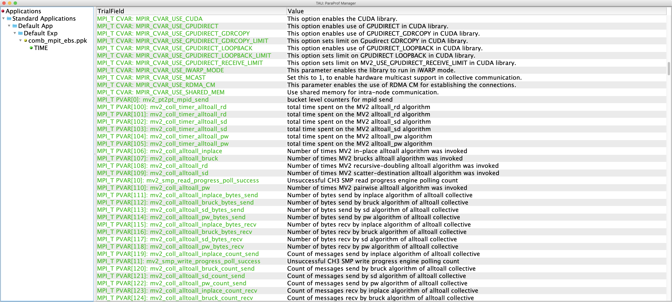
MPI Tools Interface: Performance Variables (PVARs)

Slide 41
TAU’s Runtime Environment Variables
Environment Variable | Default | Description
TAU_TRACE | 0 | Setting to 1 turns on tracing
TAU_CALLPATH | 0 | Setting to 1 turns on callpath profiling
TAU_TRACK_MEMORY_FOOTPRINT | 0 | Setting to 1 turns on tracking memory usage by sampling periodically the resident set size and high water mark of memory usage
TAU_TRACK_POWER | 0 | Tracks power usage by sampling periodically.
TAU_CALLPATH_DEPTH | 2 | Specifies depth of callpath. Setting to 0 generates no callpath or routine information, setting to 1 generates flat profile and context events have just parent information (e.g., Heap Entry: foo)
TAU_SAMPLING | 1 | Setting to 1 enables event-based sampling.
TAU_TRACK_SIGNALS | 0 | Setting to 1 generate debugging callstack info when a program crashes
TAU_COMM_MATRIX | 0 | Setting to 1 generates communication matrix display using context events
TAU_THROTTLE | 1 | Setting to 0 turns off throttling. Throttles instrumentation in lightweight routines that are called frequently
TAU_THROTTLE_NUMCALLS | 100000 | Specifies the number of calls before testing for throttling
TAU_THROTTLE_PERCALL | 10 | Specifies value in microseconds. Throttle a routine if it is called over 100000 times and takes less than 10 usec of inclusive time per call
TAU_CALLSITE | 0 | Setting to 1 enables callsite profiling that shows where an instrumented function was called. Also compatible with tracing.
TAU_PROFILE_FORMAT | Profile | Setting to “merged” generates a single file. “snapshot” generates xml format
TAU_METRICS | TIME | Setting to a comma separated list generates other metrics. (e.g., ENERGY,TIME,P_VIRTUAL_TIME,PAPI_FP_INS,PAPI_NATIVE_<event>:<subevent>)

Slide 42
Runtime Environment Variables
Environment Variable | Default | Description
TAU_TRACE | 0 | Setting to 1 turns on tracing
TAU_TRACE_FORMAT | Default | Setting to “otf2” turns on TAU’s native OTF2 trace generation (configure with –otf=download)
TAU_EBS_UNWIND | 0 | Setting to 1 turns on unwinding the callstack during sampling (use with tau_exec –ebs or TAU_SAMPLING=1)
TAU_EBS_RESOLUTION | line | Setting to “function” or “file” changes the sampling resolution to function or file level respectively.
TAU_TRACK_LOAD | 0 | Setting to 1 tracks system load on the node
TAU_SELECT_FILE | Default | Setting to a file name, enables selective instrumentation based on exclude/include lists specified in the file.
TAU_OMPT_SUPPORT_LEVEL | basic | Setting to “full” improves resolution of OMPT TR6 regions on threads 1.. N-1. Also, “lowoverhead” option is available.
TAU_OMPT_RESOLVE_ADDRESS_EAGERLY | 1 | Setting to 1 is necessary for event based sampling to resolve addresses with OMPT. Setting to 0 allows the user to do offline address translation.

Slide 43
Runtime Environment Variables
Environment Variable | Default | Description
TAU_TRACK_MEMORY_LEAKS | 0 | Tracks allocates that were not de-allocated (needs –optMemDbg or tau_exec –memory)
TAU_EBS_SOURCE | TIME | Allows using PAPI hardware counters for periodic interrupts for EBS (e.g., TAU_EBS_SOURCE=PAPI_TOT_INS when TAU_SAMPLING=1)
TAU_EBS_PERIOD | 100000 | Specifies the overflow count for interrupts
TAU_MEMDBG_ALLOC_MIN/MAX | 0 | Byte size minimum and maximum subject to bounds checking (used with TAU_MEMDBG_PROTECT_*)
TAU_MEMDBG_OVERHEAD | 0 | Specifies the number of bytes for TAU’s memory overhead for memory debugging.
TAU_MEMDBG_PROTECT_BELOW/ABOVE | 0 | Setting to 1 enables tracking runtime bounds checking below or above the array bounds (requires –optMemDbg while building or tau_exec –memory)
TAU_MEMDBG_ZERO_MALLOC | 0 | Setting to 1 enables tracking zero byte allocations as invalid memory allocations.
TAU_MEMDBG_PROTECT_FREE | 0 | Setting to 1 detects invalid accesses to deallocated memory that should not be referenced until it is reallocated (requires –optMemDbg or tau_exec –memory)
TAU_MEMDBG_ATTEMPT_CONTINUE | 0 | Setting to 1 allows TAU to record and continue execution when a memory error occurs at runtime.
TAU_MEMDBG_FILL_GAP | Undefined | Initial value for gap bytes
TAU_MEMDBG_ALINGMENT | Sizeof(int) | Byte alignment for memory allocations
TAU_EVENT_THRESHOLD | 0.5 | Define a threshold value (e.g., .25 is 25%) to trigger marker events for min/max

Slide 44
TAU: Quickstart Guide
Setup:
% module load tau
Profiling with an un-instrumented application:
MPI: % mpirun -np 64 tau_exec -ebs ./a.out
MPI+OpenMP with Clang 9+: % export TAU_OMPT_SUPPORT_LEVEL=full; % mpirun -np 64 tau_exec –T ompt,v5 –ompt ./a.out
Pthread: % mpirun -np 64 tau_exec –T mpi,pthread –ebs ./a.out
Python+MPI+Sampling: % mpirun -np 64 tau_python –ebs ./a.py
Python+MPI+OpenCL: % mpirun –np 64 tau_python –opencl ./a.py
DPC++/SYCL (no MPI): % tau_exec –T level_zero,serial –l0 ./foo
Analysis: % pprof –a –m | more; % paraprof (GUI)
Tracing:
Vampir: MPI: % export TAU_TRACE=1; export TAU_TRACE_FORMAT=otf2 % mpirun -np 64 tau_exec ./a.out; vampir traces.otf2 &
Chrome: % export TAU_TRACE=1; mpirun –np 64 tau_exec ./a.out; tau_treemerge.pl;
% tau_trace2json tau.trc tau.edf –chrome –ignoreatomic –o app.json
Chrome browser: chrome://tracing (Load -> app.json)
Jumpshot: % export TAU_TRACE=1; mpirun –np 64 tau_exec ./a.out; tau_treemerge.pl;
% tau2slog2 tau.trc tau.edf –o app.slog2; jumpshot app.slog2 &

Slide 45
TAU contacts and links
GPU profiling and tracing: Sameer Shende sameer@cs.uoregon.edu
E4S: Sameer Shende sameer@cs.uoregon.edu
TAU Performance System®: http://tau.uoregon.edu
E4S: https://e4s.io

Slide 46
Download TAU from U. Oregon
http://tau.uoregon.edu
https://e4s.io [TAU in Docker/Singularity containers]
for more information
Free download, open source, BSD license

Slide 47
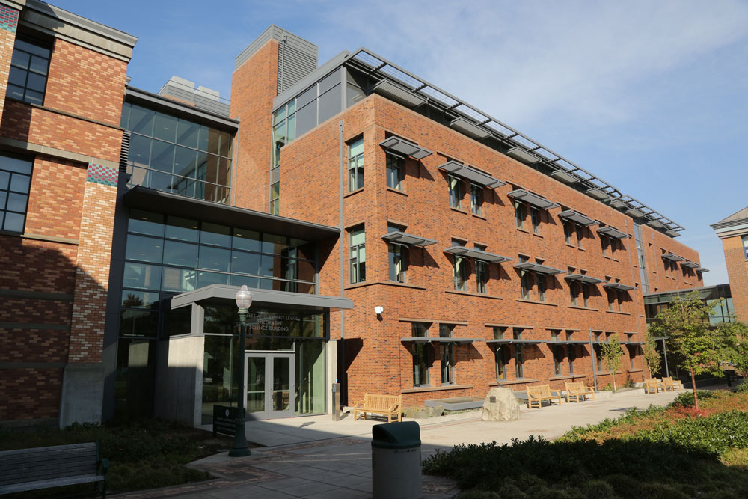
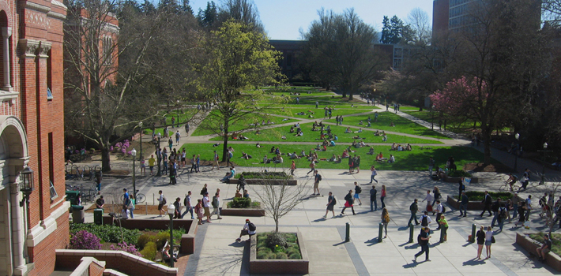
Performance Research Laboratory, University of Oregon, Eugene
www.uoregon.edu

Slide 48
Support Acknowledgements
US Department of Energy (DOE)
ANL
Office of Science contracts, ECP
SciDAC, LBL contracts
LLNL-LANL-SNL ASC/NNSA contract
Battelle, PNNL and ORNL contract
Department of Defense (DoD)
PETTT, HPCMP
National Science Foundation (NSF)
SI2-SSI, Glassbox
NASA
Intel
CEA, France
Partners:
University of Oregon
The Ohio State University
ParaTools, Inc.
University of Tennessee, Knoxville
T.U. Dresden, GWT
Jülich Supercomputing Center

Slide 49
Acknowledgment
“This research was supported by the Exascale Computing Project (17-SC-20-SC), a collaborative effort of two U.S. Department of Energy organizations (Office of Science and the National Nuclear Security Administration) responsible for the planning and preparation of a capable exascale ecosystem, including software, applications, hardware, advanced system engineering, and early testbed platforms, in support of the nation’s exascale computing imperative.”

