Slide 1
Boosting Epistasis Detection on Intel CPU+iGPU Systems oneAPI Great Cross-Architecture Challenge Highlight
Rafael Campos
Diogo Marques, Sergio Santander-Jiménez, Leonel Sousa, Aleksandar Ilic

Slide 2
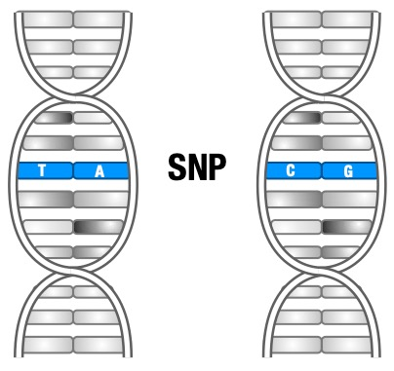
Epistasis Detection
Some SNP interactions may cause life-threating diseases (e.g., Alzheimer, breast cancer)
Discovering which and how many is important, but a challenging task!

Slide 3
Epistasis Detection
Allele - A1
Allele - A2
SNP X
P0
P1
P2
P3
…
Pn
Genotype
A1
A2
X0
0
0
0
1
…
0
0
Homozygous Major
X1
1
0
0
0
…
1
1
Heterozygous
X2
0
1
1
0
…
0
2
Homozygous Minor
phenotype
0
1
0
0
…
1
dominant allele
recessive allele

Slide 4
Epistasis Detection
Allele - A1
Allele - A2
SNP X
P0
P1
P2
P3
…
Pn
Genotype
A1
A2
X0
0
0
0
1
…
0
0
Homozygous Major
X1
1
0
0
0
…
1
1
Heterozygous
X2
0
1
1
0
…
0
2
Homozygous Minor
phenotype
0
1
0
0
…
1
dominant allele
recessive allele
N Samples (Patients)
SNP 0
Data set sizes can get
quite large, making epistasis detection complex and time consuming!
M SNPs
X0
SNP X
X1
X2
. . .
SNP M-1
phenotype

Slide 5
Epistasis Detection
Allele - A1
Allele - A2
SNP X
P0
P1
P2
P3
…
Pn
Genotype
A1
A2
X0
0
0
0
1
…
0
0
Homozygous Major
X1
1
0
0
0
…
1
1
Heterozygous
X2
0
1
1
0
…
0
2
Homozygous Minor
phenotype
0
1
0
0
…
1
dominant allele
recessive allele
N Samples (Patients)
Pair-wise interaction:
SNP 0
Search space: All SNP combinations
For each SNP combination (X,Y):
(0,1)
(0,2)
(0,3)
(0,4)
(…)
(0,M-1)
- Create a frequency table (FT)
(1,2)
(1,3)
(1,4)
(…)
(1,M-1)
M SNPs
X0
SNP X
(2,3)
(2,4)
(…)
(2,M-1)
- Go through all samples and fill FT
X1
X2
(3,4)
(…)
(3,M-1)
- Use the FT to obtain a score with an
objective function
M(M-1)/2
combinations
. . .
(…)
(…)
(M-2,M-1)
The combination with the best score will
be the solution
SNP M-1
phenotype

Slide 6
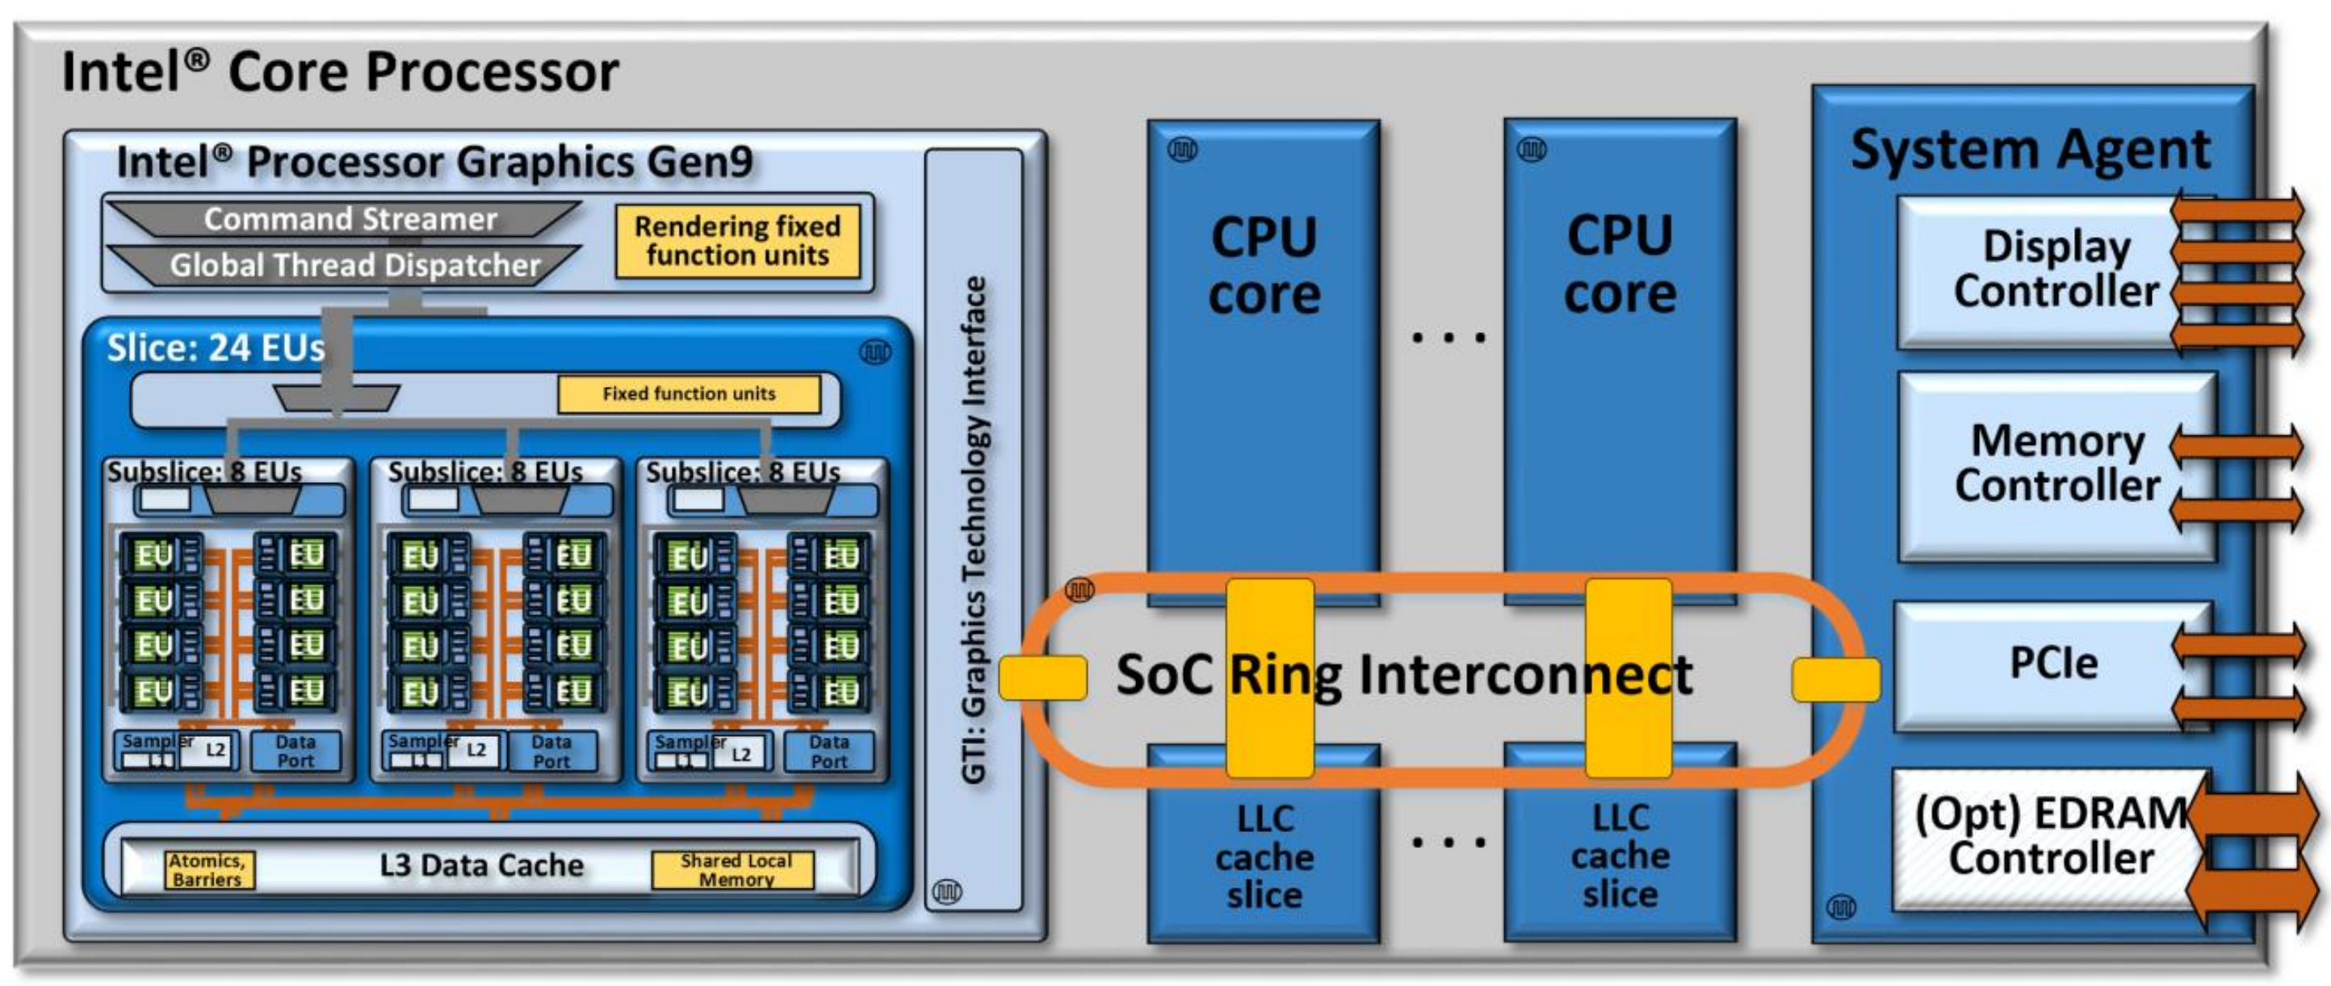
SoC architecture
GPU Optimization
Integrated GPU
CPU cores
“The Compute Architecture of Intel Processor Graphics Gen9”, Intel Corporation
Notes:
0

Slide 7
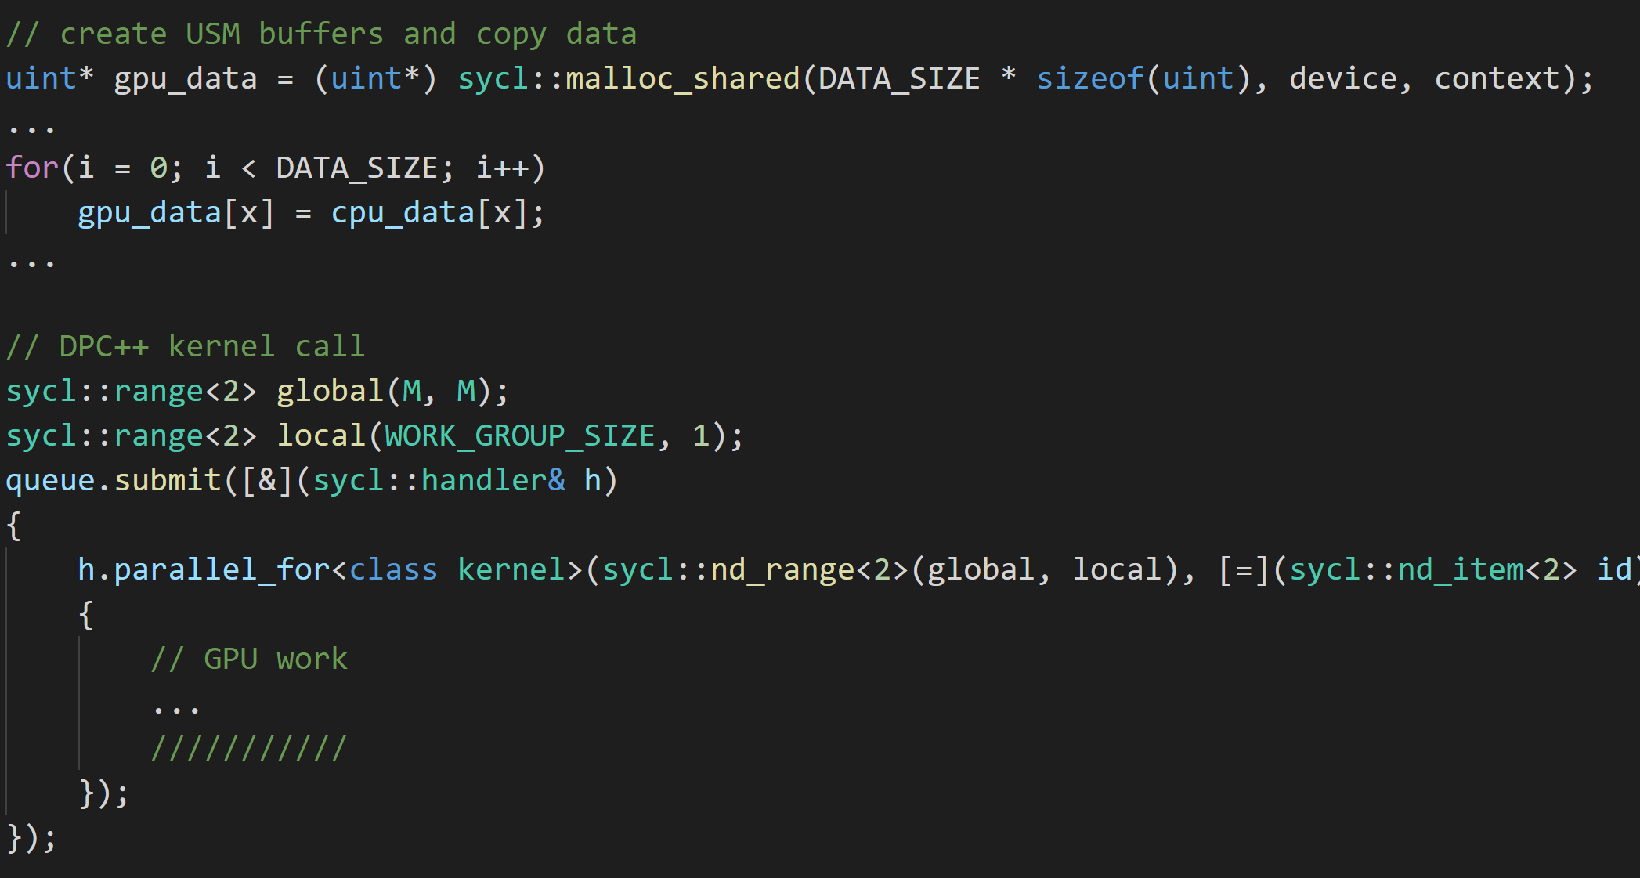
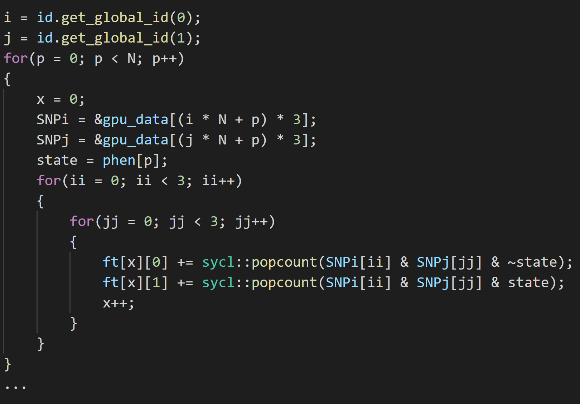
DPC++ Implementation
GPU Optimization
CPU code
GPU kernel
Direct adaptation of the original C++/OpenCL code
Single source file, simpler syntax
Notes:
0

Slide 8
Performance Comparison
GPU Optimization
7,8x
1.4x
Evaluating 2nd order epistasis on a data set with over 50M SNP combinations and 100k samples
Speedup of up to 7.8x VS optimized CPU version!
Results obtained using Intel Xeon E-2146G CPU 6c @ 3.5 GHz, Intel UHD Graphics P630 24 EUs @ 1.15 GHz, Intel Iris Xe MAX Graphics 96 EUs @ 1.55 GHz
Notes:
0

Slide 9
Performance Comparison
GPU Optimization
7,8x
1.4x
Conclusions: GPUs are a viable alternative to traditional architectures for epistasis detection
DPC++ allows for maintaining most C/C++ code unchanged
Results obtained using Intel Xeon E-2146G CPU 6c @ 3.5 GHz, Intel UHD Graphics P630 24 EUs @ 1.15 GHz, Intel Iris Xe MAX Graphics 96 EUs @ 1.55 GHz
Notes:
0

Slide 10
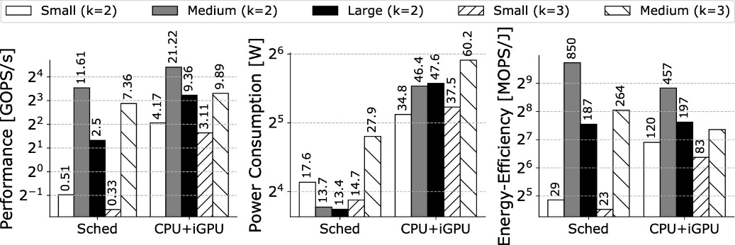
Previous Work: Epistasis Detection on Intel CPU+iGPU
Developing a heterogeneous framework for epistasis detection on CPU+iGPU systems
Using CPU+iGPU offered the overall best performance (2.1x higher)
Using Sched+iGPU led to the overall best power and energy efficiency (1.4x higher)
Best Performance
Best Power and Energy-Efficiency
R. Campos, D. Marques, S. Santander-Jiménez, L. Sousa, A. Ilic, “Heterogeneous CPU+ iGPU Processing for Efficient Epistasis Detection”, EuroPar (2020)

Slide 11
Going Forward: Epistasis Detection on CPU+GPU systems
GALUOPS
Peak: 208.98 GALUOPS
GALUOPS
L3 Bandwidth: 192.82 GB/sec
100
SLM Bandwidth: 192.71 GB/sec
Peak: 74.22 GALUOPS
100
70
70
L1 Bandwidth: 383.45 GB/sec
GTI Bandwidth: 73.6 GB/sec
40
40
L2 Bandwidth: 225.24 GB/sec
DRAM Bandwidth: 35.65 GB/sec
L3 Bandwidth: 139.34 GB/sec
10
10
7
DRAM Bandwidth: 38.55 GB/sec
GPU Optimization
7
ALUOP/Byte (Arithmetic Intensity)
4
0.7
1
4
7
10
CPU Optimization
ALUOP/Byte (Arithmetic Intensity)
0.1
0.4
0.7
1
4
7
10
40
Joining single-device optimization and better multi-device execution
to attain the highest performance the heterogeneous system can offer
Results obtained with Intel® Advisor | Platform: Intel® i7-8700K (3.7GHz) with HT/Prefetching/TurboBoost disabled, 6core vs. Intel® UHD Graphics 630 GPU (@1.15 GHz)
Notes:
0

Slide 12
Acknowledgements
Special thanks to Sujata Tibrewala and the Intel oneAPI Developer Program
Tutorial on Application optimization with CARM and Intel oneAPI Tools:
Earlier today in the conference. Recordings will be available!
Intel DevMesh Project:
Boosting epistasis detection on Intel CPU+GPU systems | Intel DevMesh
Presentation in oneAPI DevCon 2020:
Rooflining Bioinformatics: Boosting Epistasis Detection with Cache-aware Roofline Model – oneAPI
GitHub repository:
GitHub - rafatcampos/bio-epistasis-detection
Further reading:
R. Campos, D. Marques, S. Santander-Jiménez, L. Sousa, A. Ilic, “Heterogeneous CPU+ iGPU Processing for Efficient Epistasis Detection”, EuroPar (2020)
A. Lopes, F. Pratas, L. Sousa, A. Ilic, “Exploring GPU performance, power and energy-efficiency bounds with Cache-aware Roofline Modeling”, ISPASS (2017)
A. Ilic, F. Pratas and L. Sousa, “Cache-aware Roofline Model: Upgrading the Loft”, IEEE Computer Architecture Letters (2014)

Slide 13

Thank you!
Supported by Intel Corporation and Portuguese national funds through FCT under projects UIDB/50021/2020 and PTDC/CCI-COM/31901/2017 (HiPErBio).

