Slide 1
OneOligo oneAPI for DNA data storage
Eugenio Marinelli
Supervisor: Raja Appuswamy
EURECOM

Slide 2
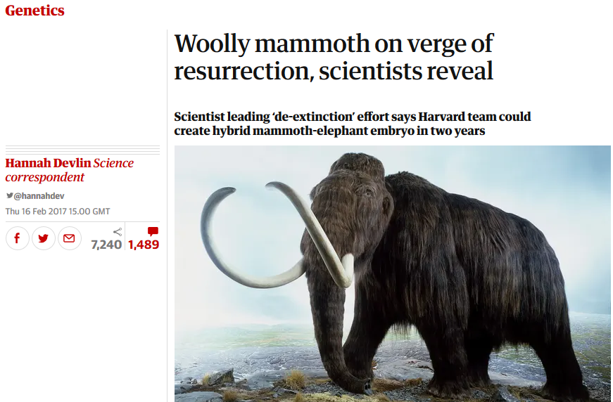
DNA: A biological media for archiving digital data
“80% enterprise data is cold, and increasing at 60% CAGR” [Horison]
“60% of archival data stored longer than 20 years” [SNIA]
Dense
Durable
[SemiSynBio Roadmap, 2018]
[The Guardian, 2017]

Slide 3
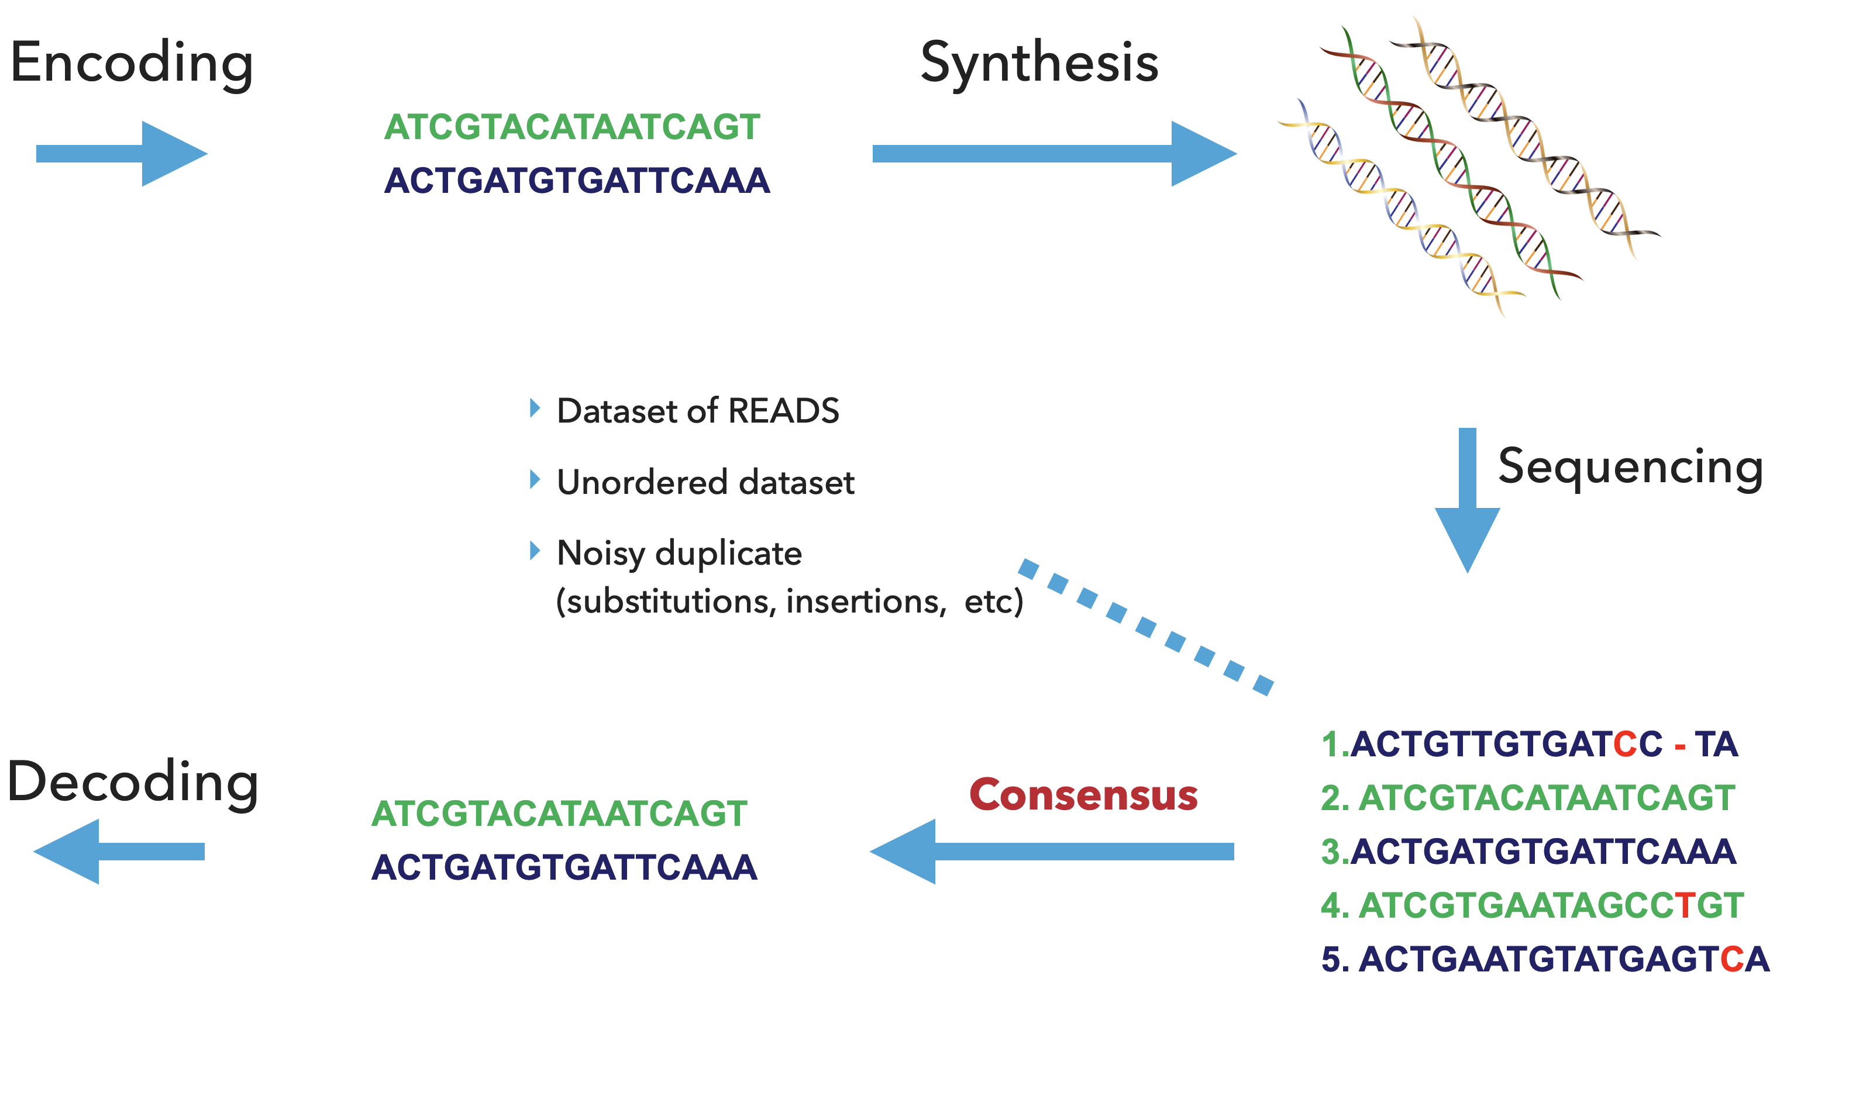

DNA Data Archival: Overview

Slide 4
Solving DNA Read Consensus
Edit
Similarity Join
Clustering
Consensus
Noisy Reads
ACTGATGTGATCC – TA
ACTGATGTGATGCGTA
ACTGATGTGATGCGCTA
ATCGTGCATAGTCAGT
ATCGTGCATAGTCTGT
ACTGATGTGATCC – TA
ACTGATGTGATGCGTA
ACTGATGTGATCC – TA
ACTGATGTGATGCGTA
ACTGATGTGATGCGTA
ACTGATGTGATGCGCTA
ATCGTGCATAGTCAGT
ATCGTGCATAGTCTGT
ACTGATGTGATCC - TA
ATCGTGCATAGTCAGT
ACTGATGTGATGCGTA
…
ATCGTGCATAGTCTGT
ACTGATGTGATGCGTCA
ACTGATGTGATGCGTA
ATCGTGCATAGTCAGT
N = O(100M to 1B) strings
O(N²) comparison operations
O(k²) per edit distance (k=length)
O(100k -1M) strings

Slide 5
OneJoin (Algorithm): Scalable, Cross-Architecture Edit Similarity Join with oneAPI
1. ACTGATGTGATCC - TA
2. ATCGTGCATAGTCAGT
3. ACTGATGTGATGCGTA
…
4. ATCGTGCATAGTCTGT
5. ACTGATGTGATGCGTCA
1. AACCCTGGGAAA…
2. AAAATTCCCGTG…
3.AAAAACTTTGGG…
…
4. ATTTTCCCGTTTG…
5. ACCTTTGAAATG…
Bucket 1
1. AACCCTGGGAAA…
3.AAAAACTTTGGG…
5. AACCTTTGAAATG…
…
2. AAAATTCCCGTG…
4. ATTTTCCCGTTTG…
5. AACCTTTGAAATG…
1. ACTGATGTGATCC – TA
3. ACTGATGTGATGCGTA
1. ACTGATGTGATCC – TA
5. ACTGATGTGATGCGTCA
3. ACTGATGTGATGCGTA
5. ACTGATGTGATGCGTCA
2. ATCGTGCATAGTCAGT
4. ATCGTGCATAGTCTGT
Low-distortion Embedding
Converts strings s_{1,} s₂ ∈ S into
s’_{1,} s’₂ ∈ S’ such that with Pr >= 0.999
Ham-dist(s’_{1,} s’₂) < O(Ed-dist(s_{1,} s₂)²)
Bucket N
Hamming LSH
Hash embedded strings into buckets using a family of hash functions s.t probability of two strings being similar within a bucket is very high.
Verification & Pair Generation
Compute ed-dist within each bucket to find all possible pairs.

Slide 6
OneJoin (Implementation): Scalable, Cross-Architecture Edit Similarity Join with oneAPI
Implemented in DPC++
Scalable
  Key steps implemented as data-parallel DPC++ kernels
    Embedding, Bucketization for Hamming LSH, Candidate generation
  Control logic on the host exploiting oneTBB
    Data structure reorganization at join stages (sort, dedup, …)
Cross-architecture
  Across CPU & GPU
    fork-join execution model
Cross-vendor
  using CodePlay LLVM backend

Slide 7
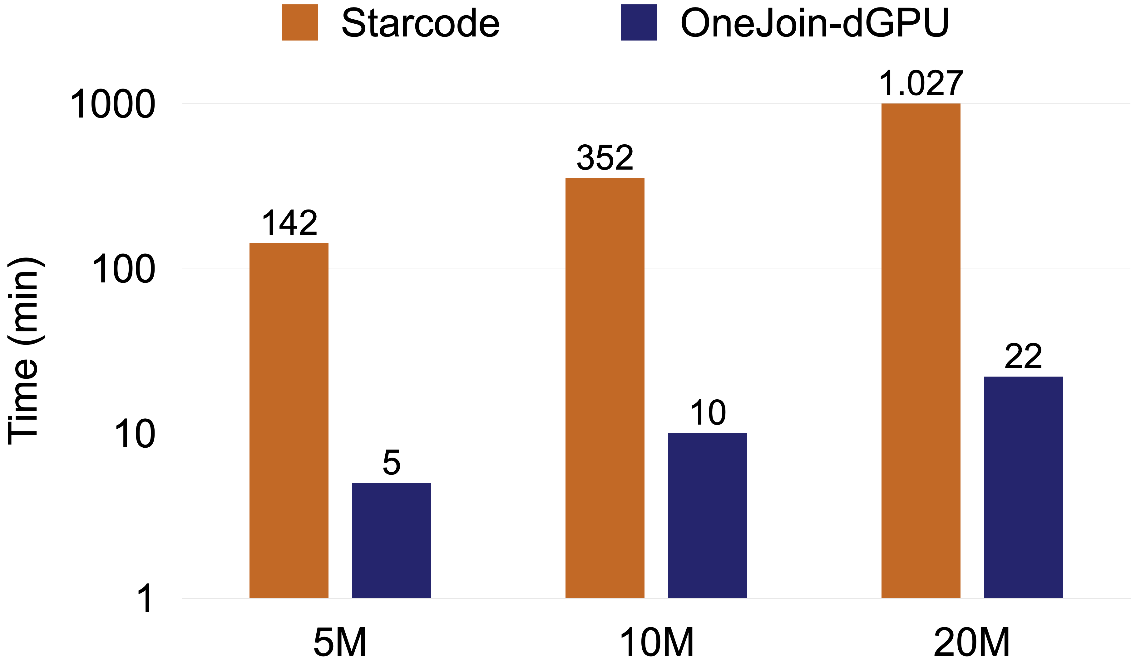
OneJoin & DNA Reads
Dataset
  5M, 10M, and 20M reads
Hardware
  12-core Intel core i9-10920X CPU
  NVIDIA-RTX-2080 (compiled with CodePlay LLVM Backend)

Slide 8
Conclusion
OneJoin scales well due to DPC++ & oneAPI
  DPC++ provides portable cross-architecture parallelism
DNA read consensus scales well due to OneJoin
  Fundamental solution applicable to other problems (sequence assembly/alignment, read clustering, …)
Code and more details
  https://devmesh.intel.com/projects/oneoligo-860c37
A shout-out to devcloud and oneAPI developer forum
  Thanks to devcloud for enabling rapid prototyping with diverse hardware
  Thanks to forum admins for their timely support

