Slide 1
It’s acceleration but faster! A business perspective on FPGA development

Slide 2
What we do Solving problems and creating opportunities
if(typeof(MiniHeader) != 'undefined') MiniHeader.registerInlineBlock("IntentPlus", 1223);
Grid Computing
Higher Performance/Cost reduction
The application of compute acceleration through analytics, securely, on premises and in the ‘cloud’
Edge Analytics
Higher Performance, low power, size and weight
Realising ‘every platform as a sensor’ practically with reduced bandwidth requirements through edge analytics
Smart
Gateways
Enterprise solutions for secure interoperability
Value Creation – solving problems and creating opportunities

Slide 3
CSS’ FPGA acceleration results
Solution | Performance improvement
1. Financial derivatives valuation | to x128
2. Molecular modelling | to x320
3. Electromagnetic modelling | to x5142
4. Financial Stats Libraries | Generally, II =1
Faster
Deterministic
Higher compute density
Green
Brings entirely new possibilities

Slide 4
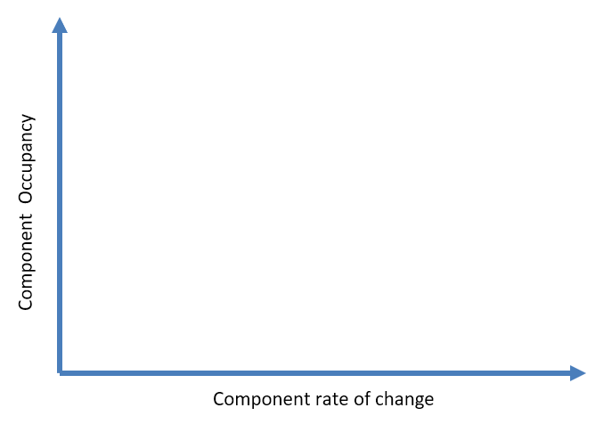
Acceleration cost/benefit

Slide 5
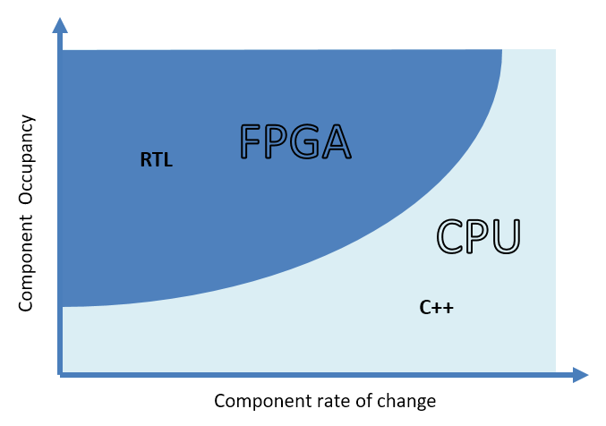
Original RTL approach

Slide 6
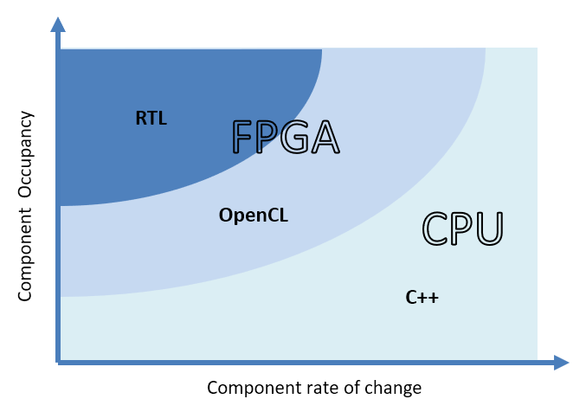
Move to include OpenCL

Slide 7
So, why aren’t more organisations deploying the benefits from FPGA?
Unfamiliar to software engineers
Relies on rare RTL skills
Complete code rewrite
Long design times/ high design costs
Costly to update
Potentially locked in to a niche supplier

Slide 8
A change in ethos
Faster delivery in a more widely acceptable development environment – Intel oneAPI
Iterative development with increasing performance where justified on cost/benefit grounds

Slide 9
Example: A Target Redemption Forward
A real world commonly traded FX derivative offered by sell side institutions issuing, valuing and risk managing structured derivatives -
Local volatility model
Monte Carlo simulation
64K paths, 512 points per path and 64 pricing events
Sobol low discrepancy number generator
Brownian bridge construction
Multiple pay-offs with time-dependent strike, target, barrier, leverage and notional factor

Slide 10
So, how do we do now?
oneAPI
Optional further enhancements
(36ms?)
oneAPI POC 1
8s
(A few days)
oneAPI POC 2
112ms
(+3 days)
oneAPI POC 3
70ms
(+3 days)
C++
1.4s
(Target)
RTL
18ms
(4 months)
t
Notes:
Some comments –
Software developer: “the tool makes hardware development more natural and approachable for someone like me”
Hardware developer: “OpenCL has the hardware and software components differentiated. The lines are much more blurred in DPC++. I can use VS to develop which makes me very happy and I find it a good environment to work with since its closer to C. The DevCloud has been a great asset, I no longer need to worry about random errors that I get from configurations and driver messages”
“It’s pivotal in a way that OpenCL wasn’t. oneAPI is key to making the development process more approachable allowing more heads to jump on the problem resulting in a faster Time to Market process”

Slide 11
oneAPI – what did we find?
Process
Agile
DevCloud
Notes:
Development is much faster
Can be developed by a software engineer
FPGA understanding required to optimise performance
Transformation rather than rewrite
It is slower in execution unless RTL embedded
oneAPI is more profligate with resources than RTL – number of // instances
loss of detailed control (cf the RTL level)
the Emulator only provides a functional check
Can apply modern agile methods to FPGA development
We can experiment far more extensively
Rapid prototyping – the ability to evolve and find better solutions
Flexibility to make fundamental structural change even at a late stage
Early deliverables
Iterations permit design creativity throughout
Can adjust readily to changing requirements
A framework of development tools with an established configuration allowing project set-up time to be minimised
A valuable resource allowing device decisions to be deferred
There’s more goodness to get

Slide 12
Process
Development faster
A software engineering task
Need FPGA understanding
Transformation not rewrite
Execution slower
More profligate with resources than RTL
Loss of detailed control
Amdahl is with us

Slide 13
Agile
Modern agile methods
Extensive experimentation
Rapid prototyping
Can make fundamental structural change even at a late stage
Early deliverables
Iterations permit design creativity throughout
Fast response to new requirements
Notes:
A framework of development tools with an established configuration allowing project set-up time to be minimised
A valuable resource allowing device decisions to be deferred
There’s more goodness to get

Slide 14
Intel DevCloud
A framework of development tools
Established configuration
Minimises project set up time
Allows device selection to be deferred
Emulator only provides a functional check
There’s more goodness to get

Slide 15
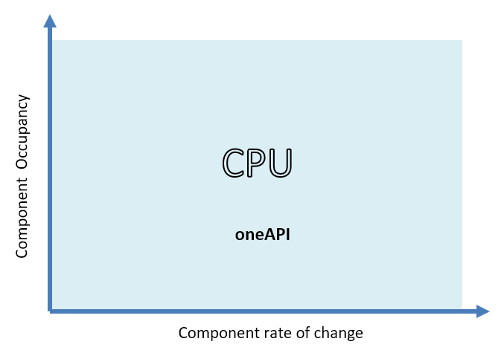
Phase 1: Functional solution

Slide 16
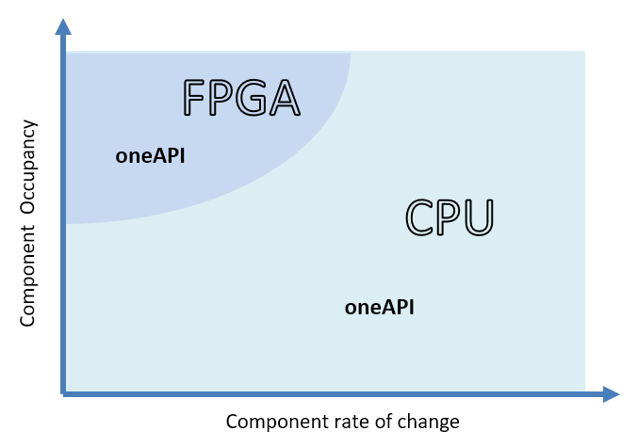
Phase 2: Experimental solutions

Slide 17
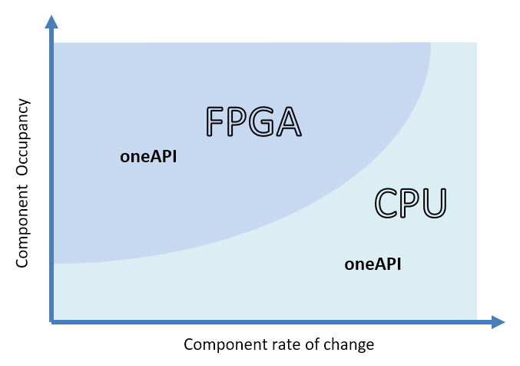
Phase 3: Deliverable solution

Slide 18
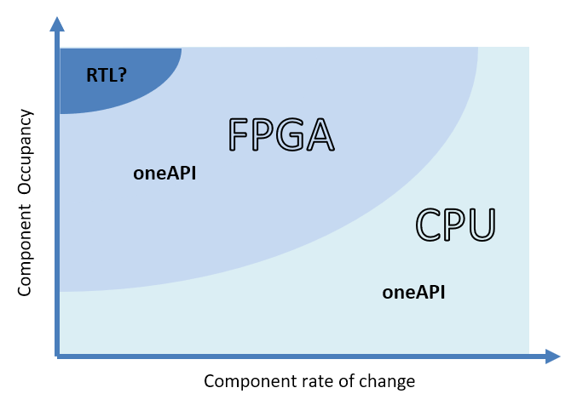
Optional further enhancement

Slide 19
oneAPI – Business perspective
Addresses the client risks we originally identified
Facilitates agile development - iterative development for escalating benefit
We’re on the right track!
Value Creation – solving problems and creating opportunities

Slide 20
Thank you!
Q&A
For further information contact:
David James
+44 7885 523 913
dave.james@css-com.com
www.css-com.com

