Slide 1


Migrating and Tuning a CUDA-based stencil computation to DPC++: An experience of Using OneAPI Toolkit to speed up RTM finite-difference.
oneAPI Developer Summit - IWOCL 2021
Clícia Pinto, Lucas Batista, Pedro de Santana and Georgina González
Supercomputing Center SENAI/CIMATEC, Salvador, Brazil

Slide 2
Agenda
oneAPI Developer Summit - IWOCL 2021
Introduction
  RTM Overview
  Objectives
  Computational Environment
Migrating Experience
  First Experiments
  Review and Memory Management Improvements​
Results
  Seismic modeling
  Roofline analysis
Conclusion
  Other research opportunities

Slide 3
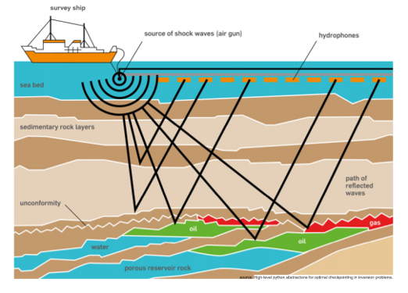
Introduction: RTM Overview
oneAPI Developer Summit - IWOCL 2021
Reverse Time Migration (RTM) as a popular seismic imaging method;
Widely used in the oil and gas industry to generate images of subsurface structures;

Slide 4
Introduction: RTM Overview
oneAPI Developer Summit - IWOCL 2021
Finite-difference method (stencil computation) applied for the acoustic wave equation;
Two major bottlenecks:
  The high number of floating-point operations;
  Wavefields storage;
The RTM algorithm:
  forward time propagation;
  Backward propagation and;
  Cross-correlation of image condition;

Slide 5
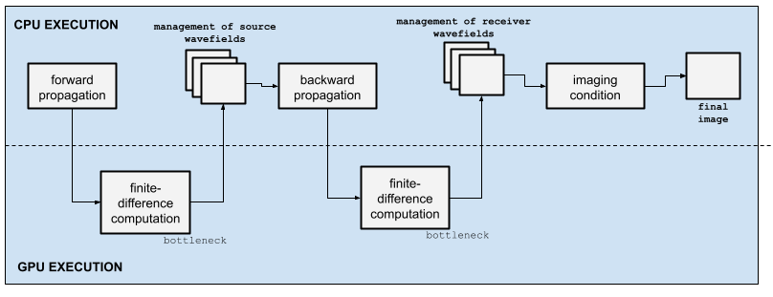
Introduction: RTM Overview
oneAPI Developer Summit - IWOCL 2021
Optimization of RTM as an economic advantage for the well-drilling process;
GPU can be used to speed up timely steps:

Slide 6
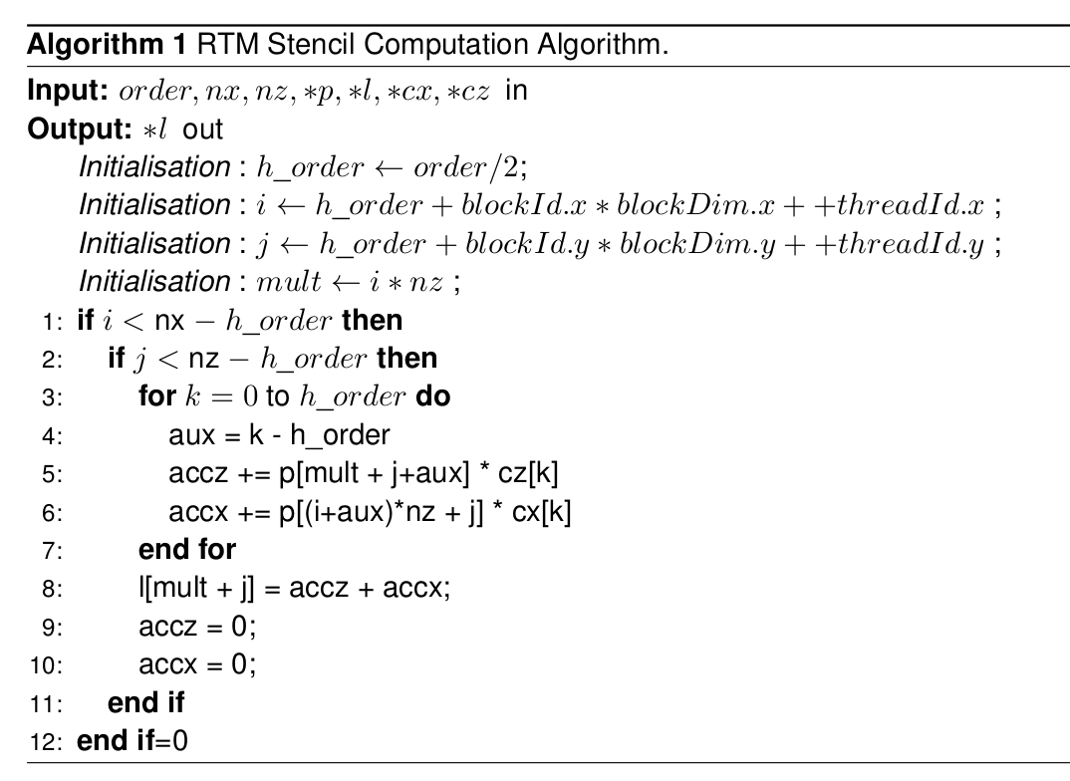
Introduction: RTM Overview
oneAPI Developer Summit - IWOCL 2021

Slide 7
Introduction: Objectives
oneAPI Developer Summit - IWOCL 2021
Proposal:
Using OneAPI functionalities to migrate 2D-RTM developed by SENAI CIMATEC from CUDA to DPC++ and evaluate its performance;
  Using DPC++ Compatibility Tool;
Evaluate migration process;
  Using Intel Advisor;
Review migrated source code and propose adjustments in memory management.

Slide 8
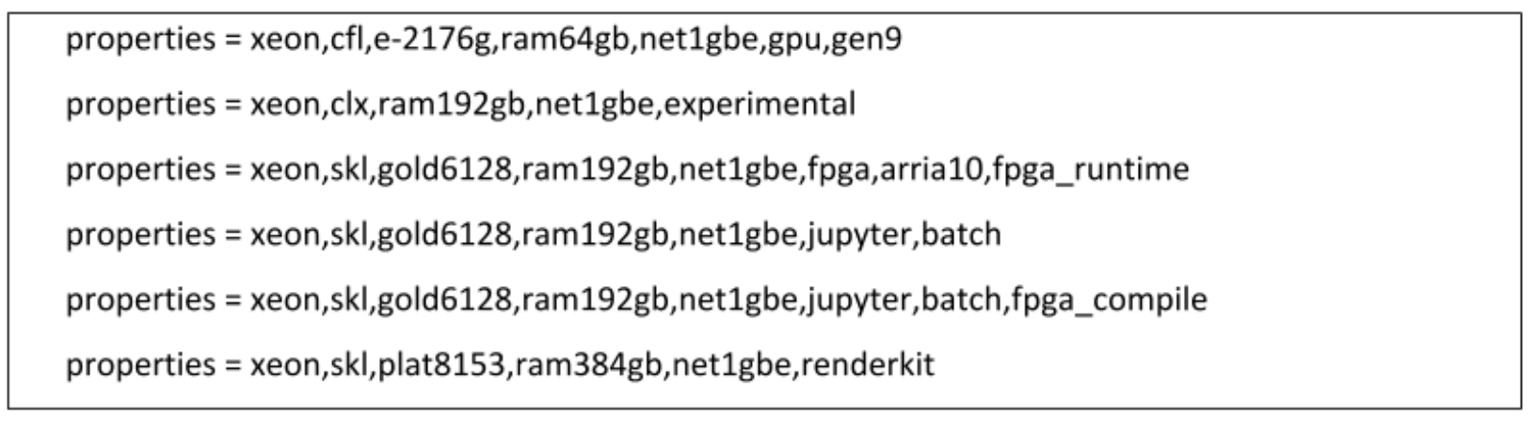
Introduction: Computational Environment
oneAPI Developer Summit - IWOCL 2021
Initial Setup: Intel Dev-cloud environment;
DPC++ Compatibility Tool information:
Intel(R) DPC++ Compatibility Tool Version: 2021.1-beta08 codebase:(e0b12aa57579014d41e1cd86ecbaaee7de878ce8);
List of available compute nodes and their properties:

Slide 9
Migration Experience
oneAPI Developer Summit - IWOCL 2021
Migration was structured in 3 stages:
  Preparation - source code adaptation;
  Migration - output generation (migrated source code, logs and annotations);
  Review - manual verification and adjustments;

Slide 10
Migration Experience: First Experiments
oneAPI Developer Summit - IWOCL 2021
Cuda-based source code
Migrated source code
cudaMalloc((void **) &d_p, mtxBufferLength);
cudaMalloc((void **) &d_pp, mtxBufferLength);
cudaMalloc((void **) &d_v2, mtxBufferLength);
d_p = (float *)sycl::malloc_device(length_p, q_ct1);
d_pp = (float *)sycl::malloc_device(mtxBufferLength, q_ct1);
d_v2 = (float *)sycl::malloc_device(length_p, q_ct1);
cudaMemcpy(d_p, p[0], length_p, cudaMemcpyHostToDevice);
cudaMemcpy(d_pp, pp[0], length_p, cudaMemcpyHostToDevice);
cudaMemcpy(d_v2, v2[0], length_v, cudaMemcpyHostToDevice);
q_ct1.memcpy(d_p, p[0], length_p).wait();
q_ct1.memcpy(d_pp, pp[0], length_p).wait();
q_ct1.memcpy(d_v2, v2[0], length_v).wait();
cudaFree(d_p);
cudaFree(d_pp);
cudaFree(d_v2);
sycl::free(d_p, q_ct1);
sycl::free(d_pp, q_ct1);
sycl::free(d_v2, q_ct1);

Slide 11
Migration Experience: First Experiments
oneAPI Developer Summit - IWOCL 2021
void fd_forward(int order, float **p, float **pp, float **v2, int nz, int nx, int nt, int is, int sz, int *sx, float *srce, int propag)
{
//Grid and block definition
{
for (int it = 0; it < nt; it++){
b_swap = b_pp;
b_pp = b_p;
b_p = b_swap;
kernel_tapper()
kernel_lap()
kernel_time()
kernel_scr()
}
}
}

Slide 12
Migration Experience: First Experiments
oneAPI Developer Summit - IWOCL 2021
void fd_forward(int order, float **p, float **pp, float **v2, int nz, int nx, int nt, int is, int sz, int *sx, float *srce, int propag)
{
//Grid and block definition
for (int it = 0; it < nt; it++){
b_swap = b_pp;
b_pp = b_p;
b_p = b_swap;
kernel_tapper()
kernel_lap()
kernel_time()
kernel_scr()
}
}
q_ct1.submit([&](sycl::handler &cgh) {
auto d_p_ct3 = d_p;
auto d_laplace_ct4 = d_laplace;
auto d_coefs_x_ct5 = d_coefs_x;
auto d_coefs_z_ct6 = d_coefs_z;
cgh.parallel_for(
sycl::nd_range<3>(dimGrid * dimBlock, dimBlock),
[=](sycl::nd_item<3> item_ct1) {
kernel_lap(order, nx, nz, d_p_ct3,
d_laplace_ct4, d_coefs_x_ct5,
d_coefs_z_ct6, item_ct1);
});
});

Slide 13
Migrating Experience: Review and Memory Management Improvements​
oneAPI Developer Summit - IWOCL 2021
Intuitive experience using DPCT;
  Warnings displayed helped to deal with CUDA include folder location;
  DPCT annotations in the source code before each kernel call helped to adjust workgroup parameters;
DPCT generates migrated code with explicit data transfer;
Improvement opportunity found during the review stage;
  Manual deployment of buffers and accessors to manage memory access;
  For each shared data object:
Buffer creation;
Access definition;
Data access request;
Buffer destruction.

Slide 14
Migrating Experience: Review and Memory Management Improvements​
oneAPI Developer Summit - IWOCL 2021
void fd_forward(int order, float **p, float **pp, float **v2, int nz, int nx, int nt, int is, int sz, int *sx, float *srce, int propag)
{
//Grid and block definition
{
sycl::buffer<float, 1> *b_p = new sycl::buffer<float, 1>(p[0], sycl::range<1>(nxe*nze));
sycl::buffer<float, 1> *b_pp = new sycl::buffer<float, 1>(pp[0], sycl::range<1>(nxe*nze));
sycl::buffer<float, 1> b_v2(v2[0], sycl::range<1>(nxe*nze));
sycl::buffer<float, 1> b_coefs_x(coefs_x, sycl::range<1>(order+1));
sycl::buffer<float, 1> b_coefs_z(coefs_z, sycl::range<1>(order+1));
sycl::buffer<float, 1> b_taperx(taper_x, sycl::range<1>(nxb));
sycl::buffer<float, 1> b_taperz(taper_z, sycl::range<1>(nxb));
sycl::buffer<float, 1> *b_swap;
for (int it = 0; it < nt; it++){
b_swap = b_pp;
b_pp = b_p;
b_p = b_swap;
kernel_tapper()
kernel_lap()
kernel_time()
kernel_scr()
}
}
}

Slide 15
Migrating Experience: Review and Memory Management Improvements​
oneAPI Developer Summit - IWOCL 2021
void fd_forward(int order, float **p, float **pp, float **v2, int nz, int nx, int nt, int is, int sz, int *sx, float *srce, int propag)
{
//Grid and block definition
{
sycl::buffer<float, 1> *b_p = new sycl::buffer<float, 1>(p[0], sycl::range<1>(nxe*nze));
sycl::buffer<float, 1> *b_pp = new sycl::buffer<float, 1>(pp[0], sycl::range<1>(nxe*nze));
sycl::buffer<float, 1> b_v2(v2[0], sycl::range<1>(nxe*nze));
sycl::buffer<float, 1> b_coefs_x(coefs_x, sycl::range<1>(order+1));
sycl::buffer<float, 1> b_coefs_z(coefs_z, sycl::range<1>(order+1));
sycl::buffer<float, 1> b_taperx(taper_x, sycl::range<1>(nxb));
sycl::buffer<float, 1> b_taperz(taper_z, sycl::range<1>(nxb));
sycl::buffer<float, 1> *b_swap;
for (int it = 0; it < nt; it++){
b_swap = b_pp;
b_pp = b_p;
b_p = b_swap;
kernel_tapper()
kernel_lap()
kernel_time()
kernel_scr()
}
}
}
q_ct1.submit([&](sycl::handler &cgh) {
auto acc_p = b_p->get_access<sycl::access::mode::read_write>(cgh);
auto d_laplace_ct4 = d_laplace;
auto acc_coefs_x = b_coefs_x.get_access<sycl::access::mode::read_write>(cgh);
auto acc_coefs_z = b_coefs_z.get_access<sycl::access::mode::read_write>(cgh);
cgh.parallel_for(
sycl::nd_range<3>(dimGrid * dimBlock, dimBlock),
[=](sycl::nd_item<3> item_ct1) {
kernel_lap(order, nx, nz, acc_p,
d_laplace_ct4, acc_coefs_x,
acc_coefs_z, item_ct1);
});
});

Slide 16
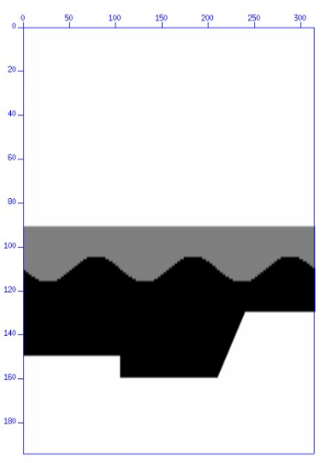
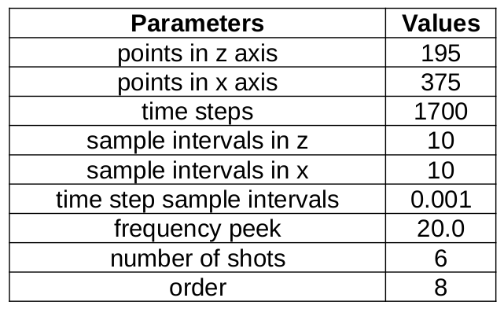
Results: Seismic modeling
oneAPI Developer Summit - IWOCL 2021
Compare results provided by both CUDA-based and migrated source code;
Input parameters and Koslov velocity model:

Slide 17
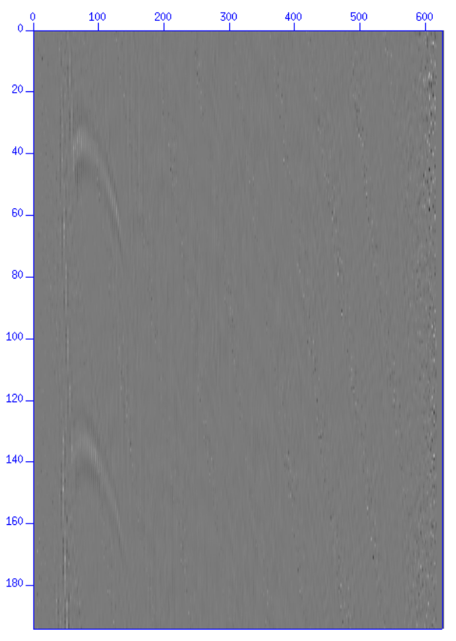
Results: Seismic modeling
oneAPI Developer Summit - IWOCL 2021
Seismic image generated by the complete CUDA- based RTM source code (left) and DPC++ migrated source code (right) considering a single snapshot:

Slide 18
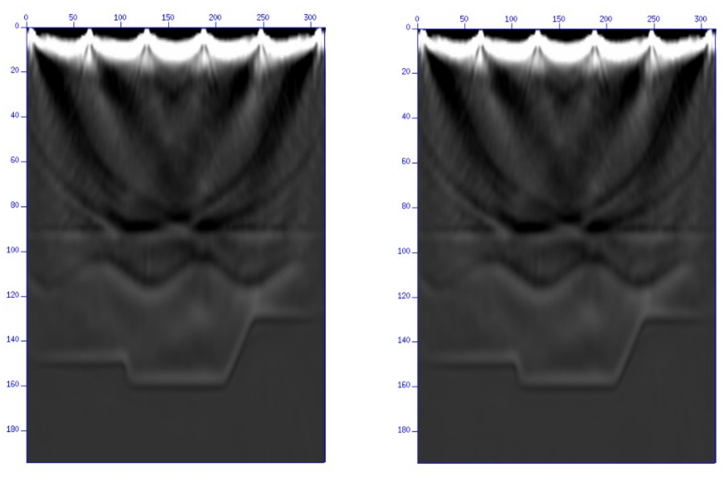
Results: Seismic modeling
oneAPI Developer Summit - IWOCL 2021
Seismic image generated by the complete CUDA- based RTM source code (left) and DPC++ migrated source code (right) considering the entire propagation:

Slide 19
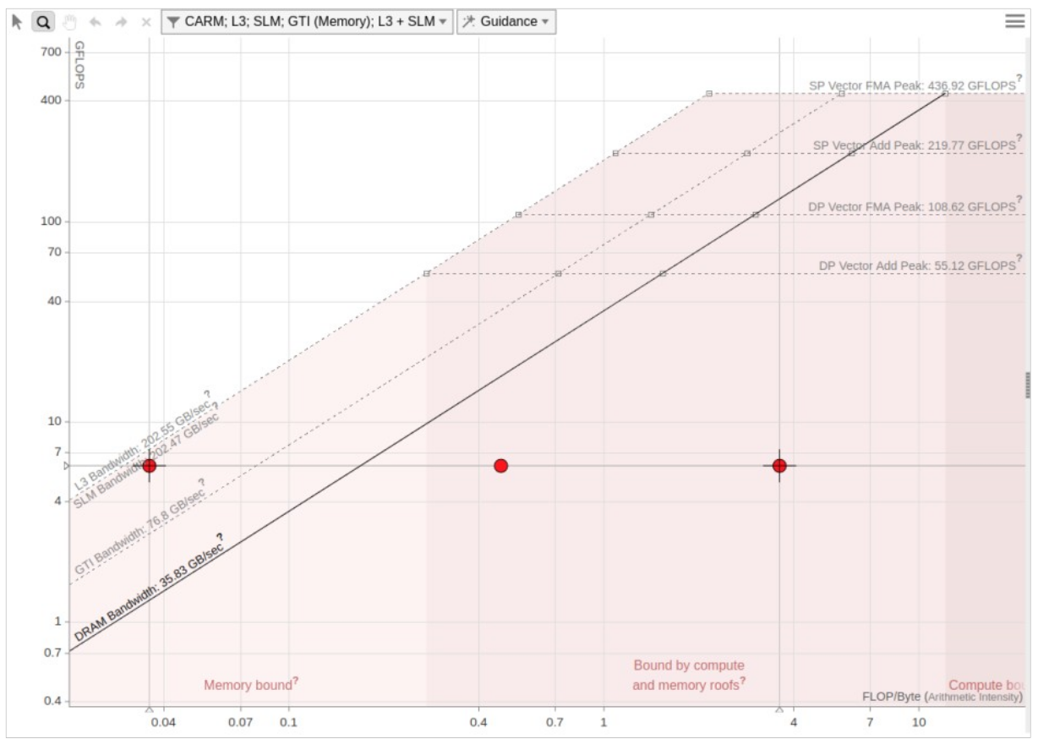
Results: Roofline analysis
oneAPI Developer Summit - IWOCL 2021
Roofline view of the DPC++ version running on an Intel(R) Gen9 HD Graphics NEO using explicit data transfer;
With a reduced number of floating-point operations, we can expect low performance metrics;
Performance of 6,052 GFLOPS;
Arithmetic intensity (AI) of 3,617 FLOP/Byte.

Slide 20
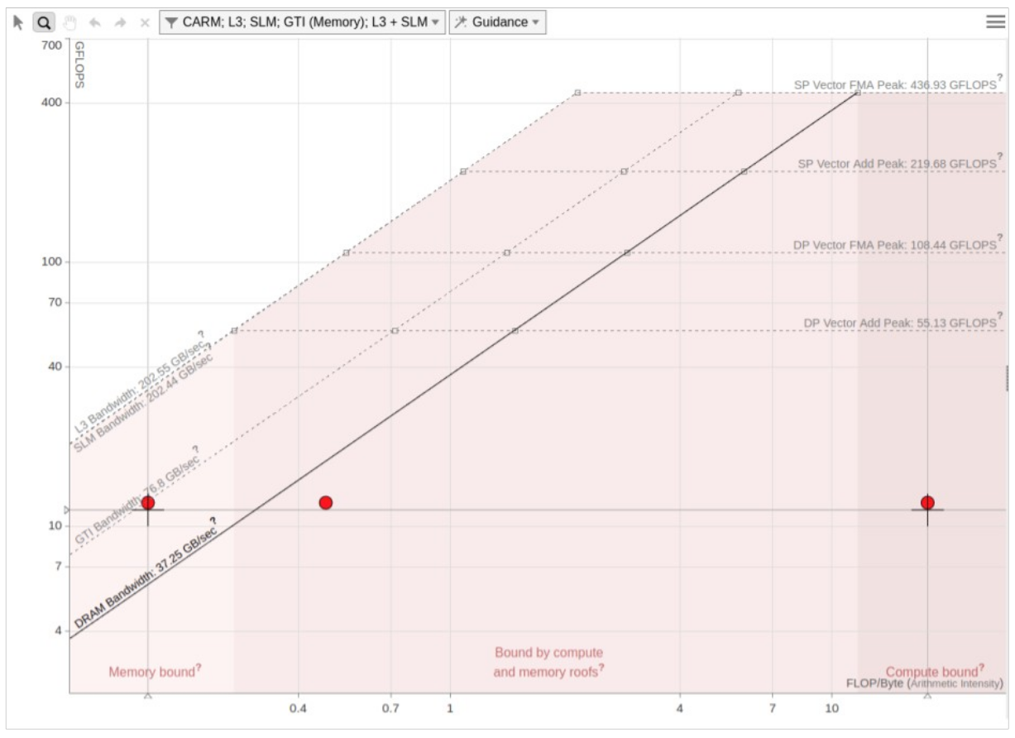
Results: Roofline analysis
oneAPI Developer Summit - IWOCL 2021
Roofline view of the DPC++ version running on an Intel(R) Gen9 HD Graphics NEO using buffers/accessors memory management;
With a reduced number of floating-point operations, we can expect low performance metrics;
Performance of 12.246 GFLOPS;
Arithmetic intensity (AI) of 17,896 FLOP/Byte.

Slide 21
Conclusion
oneAPI Developer Summit - IWOCL 2021
Time spent on each step:
Reference code adjustments: 7 days;
Migration of the base code: 5 days;
Implementation of the buffered approach: 2 days
Comparative analysis: 5 days

Slide 22
Conclusion
oneAPI Developer Summit - IWOCL 2021
Successful proof of concept in migrating and generating guidance to tuning RTM application using OneAPI functionalities;
Migrated source code is more readable and easier to maintain;
Unifies the algorithm execution flow for our application in a unique structure;
Review of migrated source code:
  Simple memory management;
  Performance 2x higher and an arithmetic intensity 4,9x higher.

Slide 23
Conclusion: Other research opportunities
oneAPI Developer Summit - IWOCL 2021
Roofline analysis for complete RTM execution;
Exploration of CPU and FPGA execution for accelerated kernels;
Exploration of USM to achieve better memory management;

Slide 24
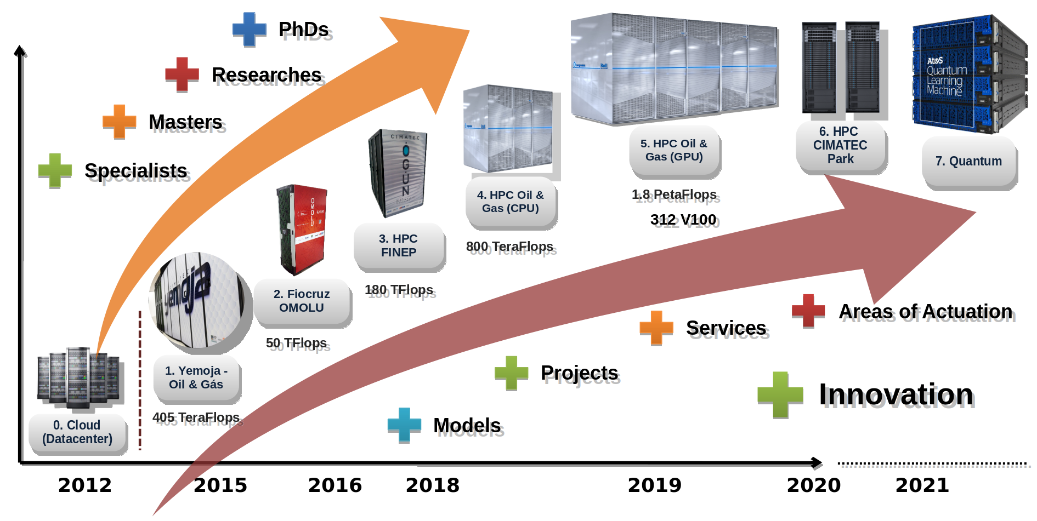
Manufacturing and Technology Integrated Campus – SENAI CIMATEC
oneAPI Developer Summit - IWOCL 2021

Slide 25
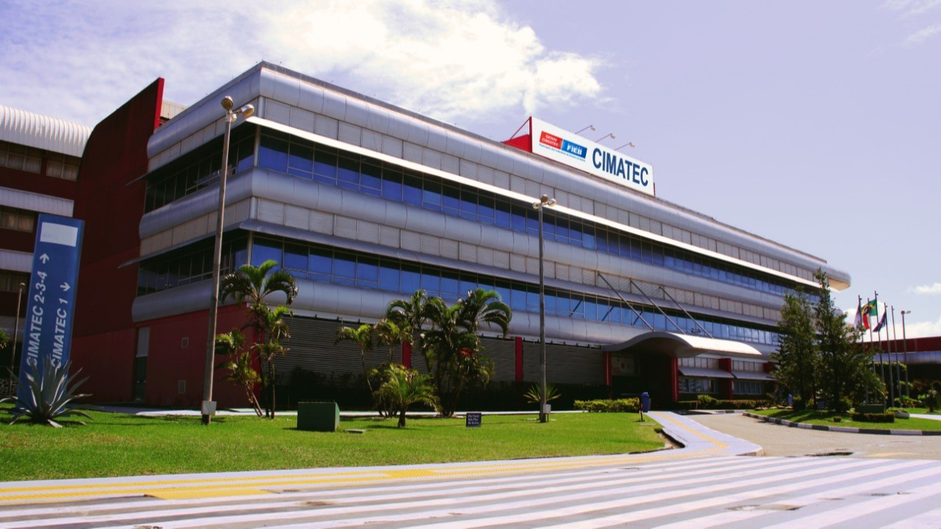

Manufacturing and Technology Integrated Campus – SENAI CIMATEC
oneAPI Developer Summit - IWOCL 2021
See more at: www.senaicimatec.com.br

Slide 26
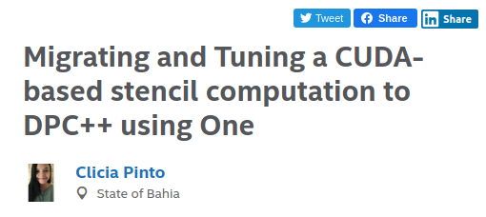
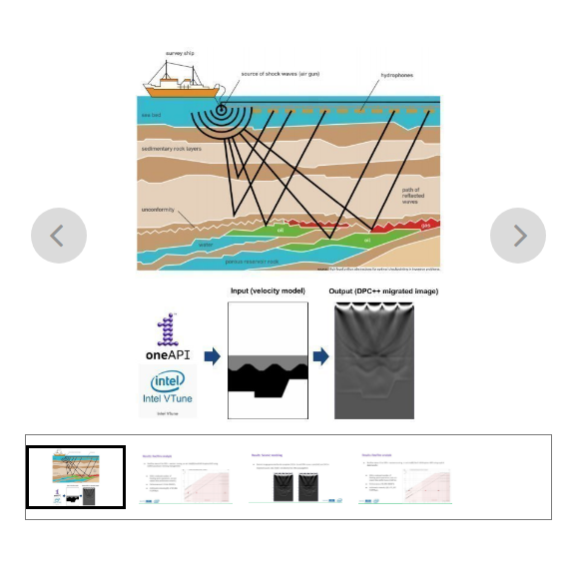
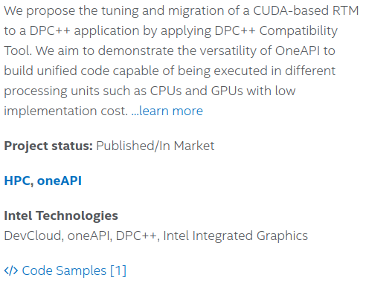
DevMesh Project
oneAPI Developer Summit - IWOCL 2021
Available at:
https://devmesh.intel.com/projects/migrating-and-tuning-a-cuda-based-stencil-computation-to-dpc-using-oneapi

Slide 27
oneAPI Developer Summit - IWOCL 2021
Thank you
clicia.pinto@fieb.org.br
Supercomputing Center SENAI/CIMATEC

