Slide 1
GWSynth
Audio from gravitational wave simulations

Slide 2
Gravitational Waves
Disturbance in the curvature of spacetime
Proposed in 1905
First detected at LIGO in 2015

Slide 3
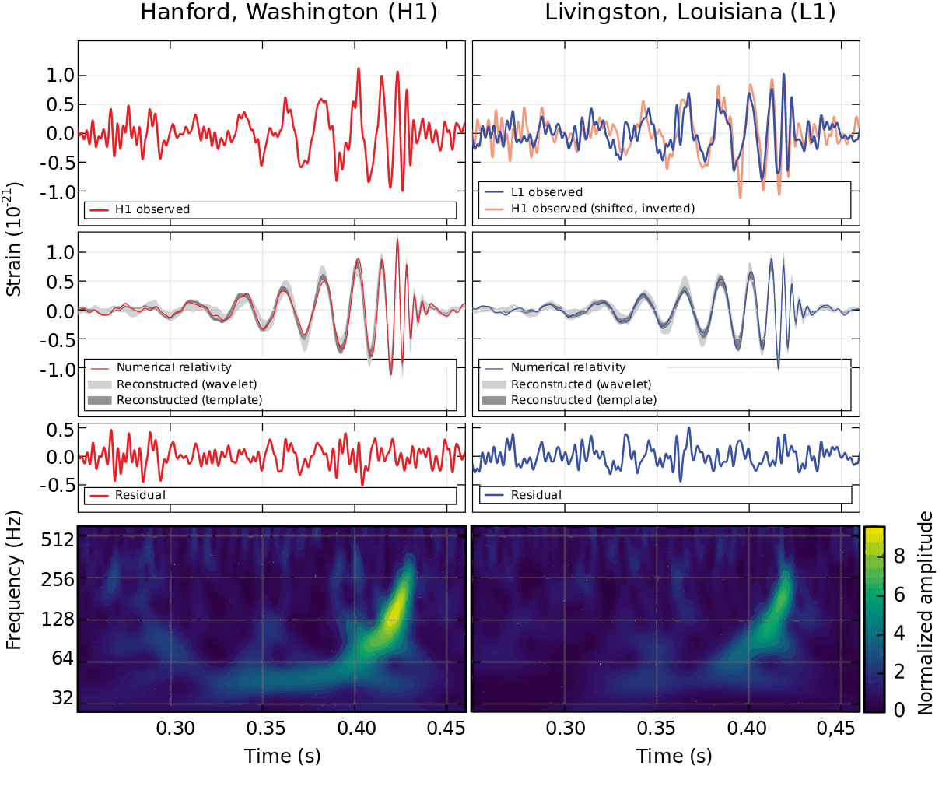
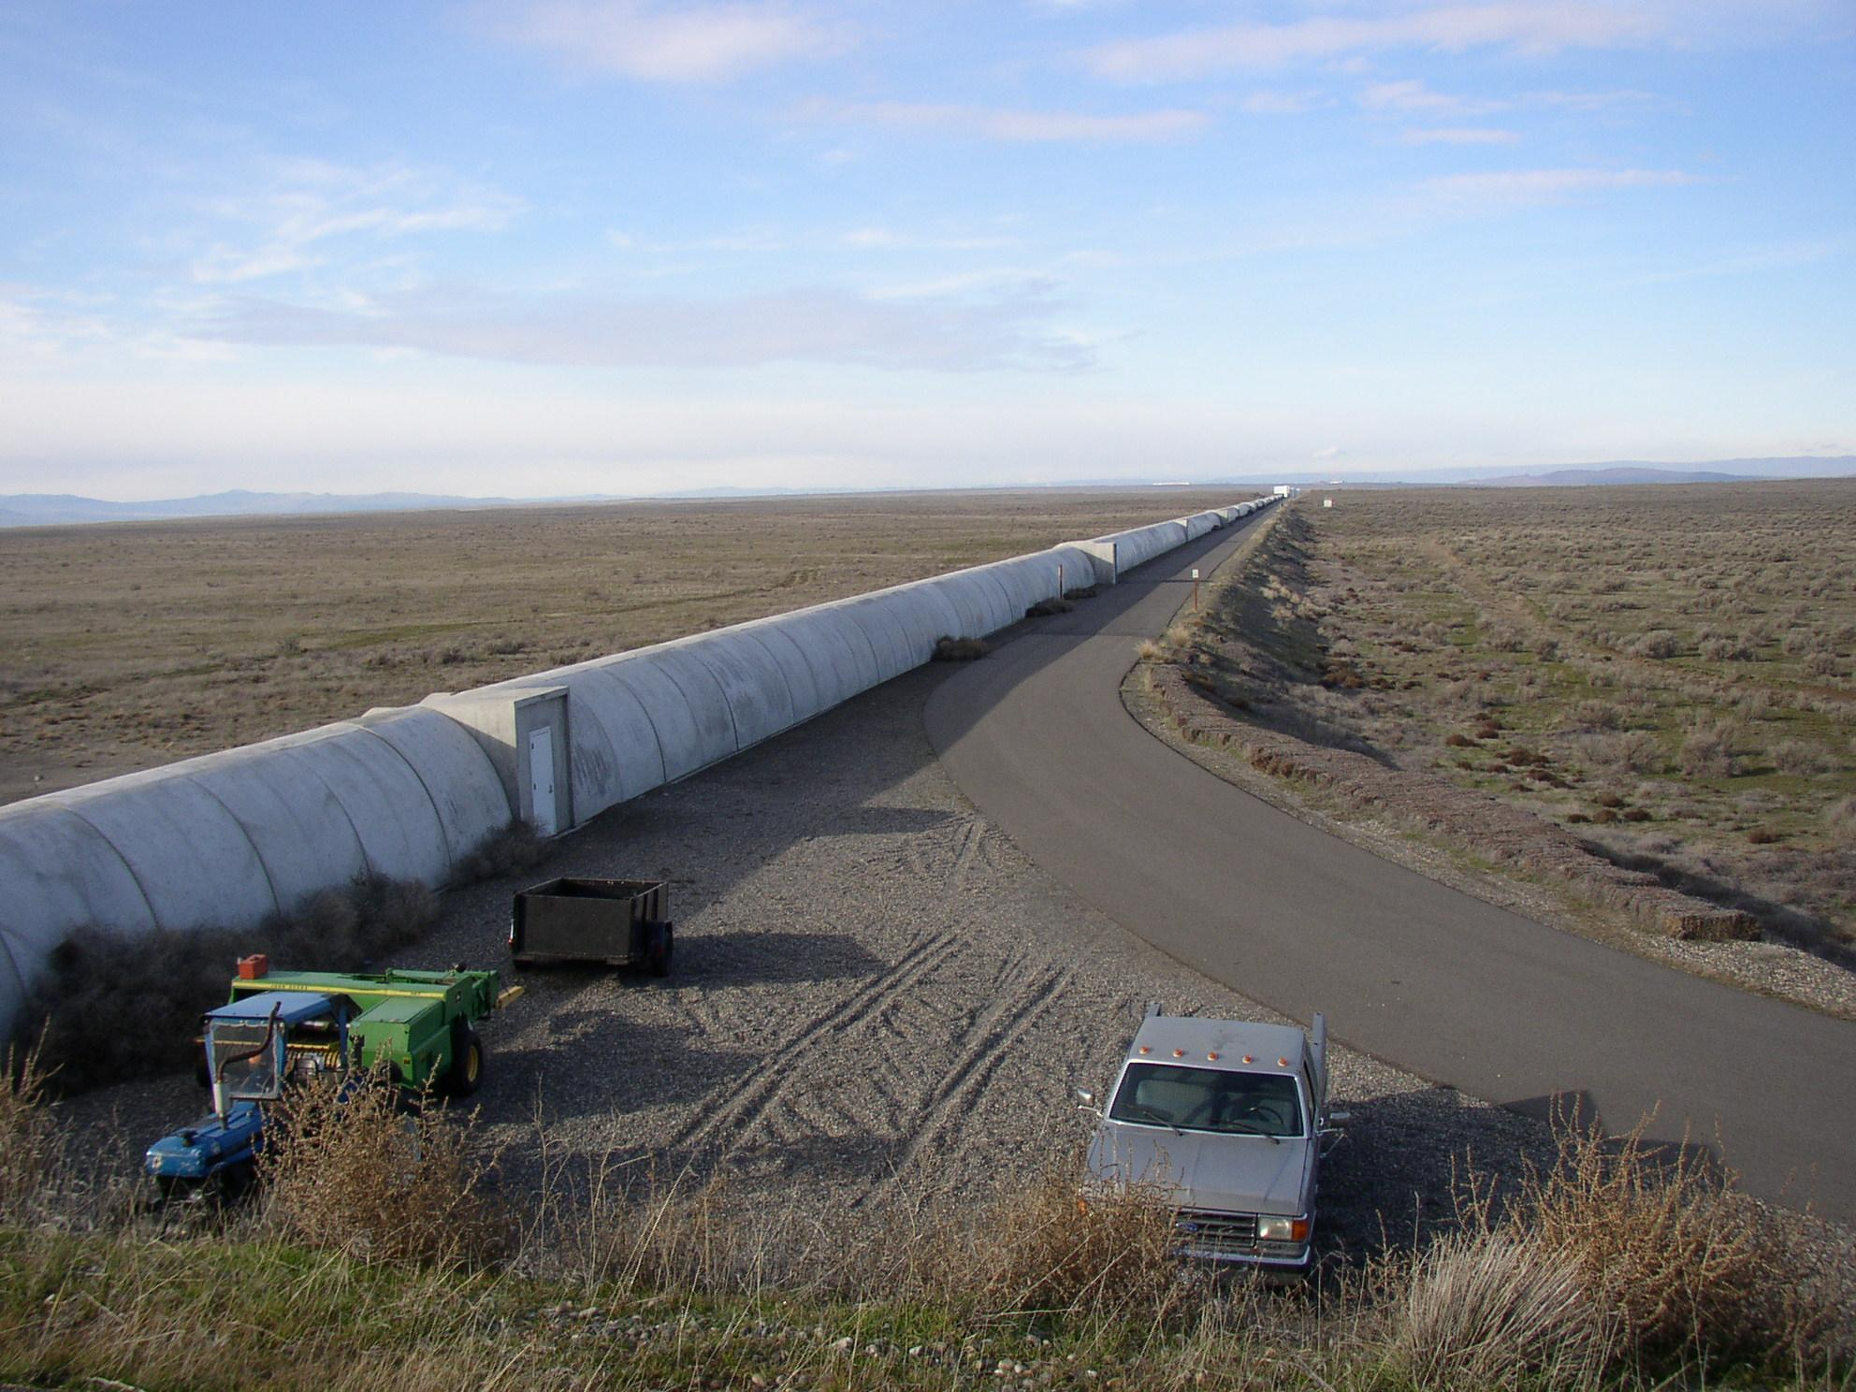
GW150914
First observation of GW
Merger of 35 and 30 solar mass black holes
Changed length of 4 km LIGO arms by fraction of proton width
Source: http://physics.aps.org/featured-article-pdf/10.1103/PhysRevLett.116.061102

Slide 4
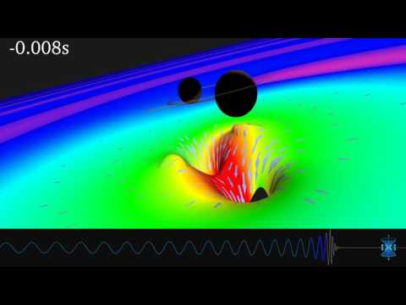
Source: https://www.black-holes.org/gw150914

Slide 5
Waveforms
Inspiral-merger-ringdown
Frequency coincidentally in audible range
Described as “chirps”
GW150914
Processed signal
NR Simulation
However when time reversed more resemble electronic “drums”
NR Simulation Reversed
808 “kick drum” sample

Slide 6
Simulation Methods
Numerical Relativity
LALSuite
oneAPI
Most accurate
Requires weeks to months of simulation
Completely infeasible for real-time applications
Semi-analytical models
Seconds to simulate
Almost fast enough for real-time
Easy programming of different accelerators
Potential for use beyond HPC and AI

Slide 7
Simulation Methods
Numerical Relativity
LALSuite
oneAPI
Most accurate
Requires weeks to months of simulation
Completely infeasible for real-time applications
Semi-analytical models
Seconds to simulate
Almost fast enough for real-time
Easy programming of different accelerators
Potential for use beyond HPC and AI

Slide 8
LALSuite
Collection of gravitational wave analysis codes
Developed at LIGO
Written in C
Contains numerous approximants with various capabilities/complexity e.g. spin, precession, tides, higher modes

Slide 9
EOBNRv2HM
Effective-one-body-numerical-relativity version 2 higher modes
Balance of complexity and capability
Changing inclination of orbital plane produces higher modes
Most time spent in integration of ODE and calculation of modes
Higher modes produce interesting waveforms

Slide 10
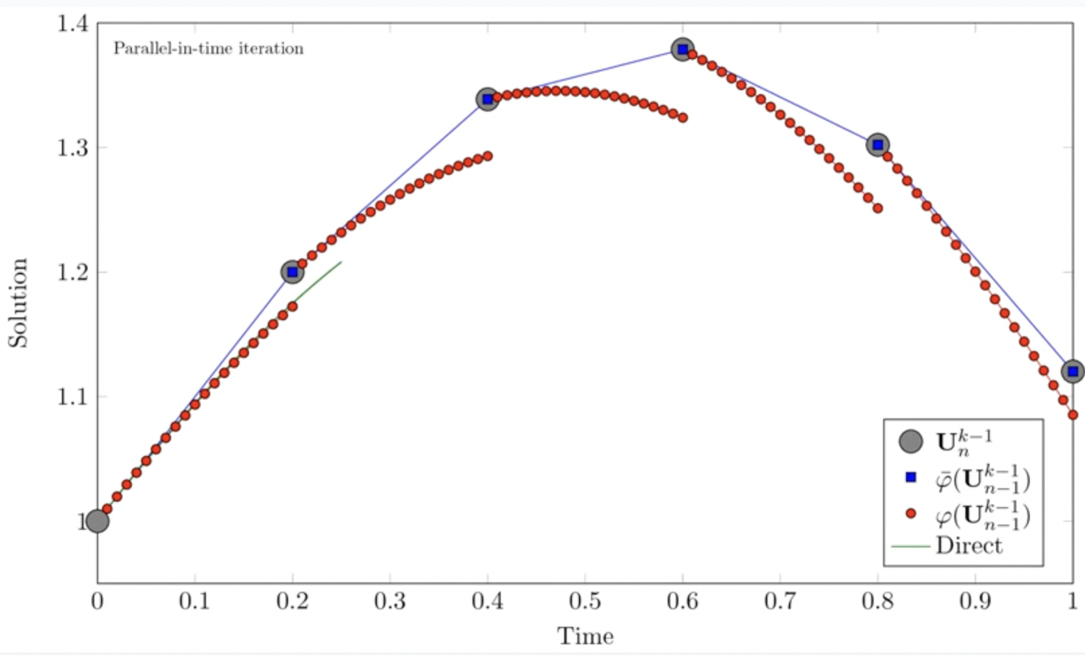
Parareal
Parallel-in-time integration method
Uses coarse and fine steps
Fine steps can be run in parallel
Speedup depends on number of parallel processors available for fine steps
Source: https://en.wikipedia.org/wiki/File:Parareal_Animation.ogv

Slide 11
Results
~2x speedup
Simulation time ~1 s
Room for improvement, ideally <100 ms

Slide 12
Future Work
Implement GUI
Optimize code for GPUs
Produce standalone code and plugin

